Slide 1
Class Room
Session 1

Slide 2


Database Technologies - MySQL
A day without new knowledge is a lost day.
The DIKW pyramid
the quality of having experience, knowledge, and good judgement; the quality of being wise.
Data is a mess and needs to be processed to make it meaningful. The DIKW hierarchy describes how data evolves into information, knowledge, and wisdom respectively.
skills acquired through experience or education, the theoretical or practical understanding of a subject.
learned about something or someone.
infoway

Slide 3
Introduction
Anyone who wants to develop a good application should have the knowledge three major components.
Any application has three major parts .
  UI
  Middle Layer
  Database
We would say that for a programmer to understand and be able to interact with a database is must, so than the data which is collected from the UI is processed and stored permanently. (eg. Any management systems, set top box, washing machine, mobile application etc.).
What is required to learn so than you can develop an Application.

Slide 4
Introduction
Why do we need databases?
We need databases because they organize data in a manner which allows us to query data, sort data, and manipulate data in various ways. We need some way to collect, store, retrieve, sort, and manipulate the data of the world. Databases allow us to do this.
Many companies collects data from different resource (like Weather data, Geographical data, Finance data, Scientific data, Transport data, Cultural data, etc.)

Slide 5
Introduction
4 Important Roles of Database in Industry.
It is needed for data access within the company.
It is needed to maintain strong relationships between data.
This system allows newer and better updates.
It helps to search data in a better manner.

Slide 6
Introduction
OBJECTIVE
Understand the role of a database management system in an organization.
Understand basic database concepts, including the structure and operation of the relational database.
Construct database queries using Structured Query Language (SQL).

Slide 7

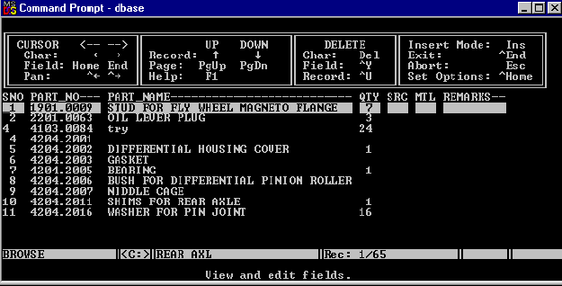

What is a database management system?

Slide 8
What is a database management system?
A database management system (DBMS) is software for creating and managing databases. The DBMS provides users and programmers with a systematic way to create, read, update, and delete data.
DBMS
It supports Single User only
Not Secured
No Relationship (PK/FK)

Slide 9

What is a relational database management system?

Slide 10



relational database management system?
A relational database management system (RDBMS) is a database management system (DBMS) that is based on the relational model.
RDBMS supports
client/server Technology
Highly Secured
Relationship (PK/FK)

Slide 11

MySQL
MySQL is the most popular Open Source
Relational Database Management System.
MySQL was created by a Swedish company - MySQL AB that was founded in 1995. It was acquired by Sun Microsystems in 2008; Sun was in turn acquired by Oracle Corporation in 2010.
When you use MySQL, you’re actually using at least two programmes. One program is the MySQL server, mysqld and other program is client program that connects to the database server.

Slide 12

A database application is a computer program whose primary purpose is entering and retrieving information.
What is database?
The most simple answer is we need databases b/c they organize data in a manner which allows us to query data, sort data, and manipulate data in various ways. We need some way to collect, store, retrieve, sort, and manipulate the data of the world. Databases allow us to do this.

Slide 13

What is Database?
A database is a system to organize, store and retrieve large amounts of data easily, which is stored in one or more data files by one or more users.
Each database is a collection of tables, which are called relations, hence the name "relational database".
Index Page

Slide 14

What is data?

Slide 15

What is Data?
Data is any facts, number, text, symbol, images, audio, video, or signal that can be recorded and that can be processed by a computer.
Data can be in the form of Text or Multimedia

Slide 16
Class Room
Session 2

Slide 17
A NULL value is not treated as a blank or 0.
The number of attributes(A) in relation is called as its Degree.
SQL Structured Query Language
Structured Query Language is a standard Database language which is used to create, maintain and retrieve the relational database.

Slide 18
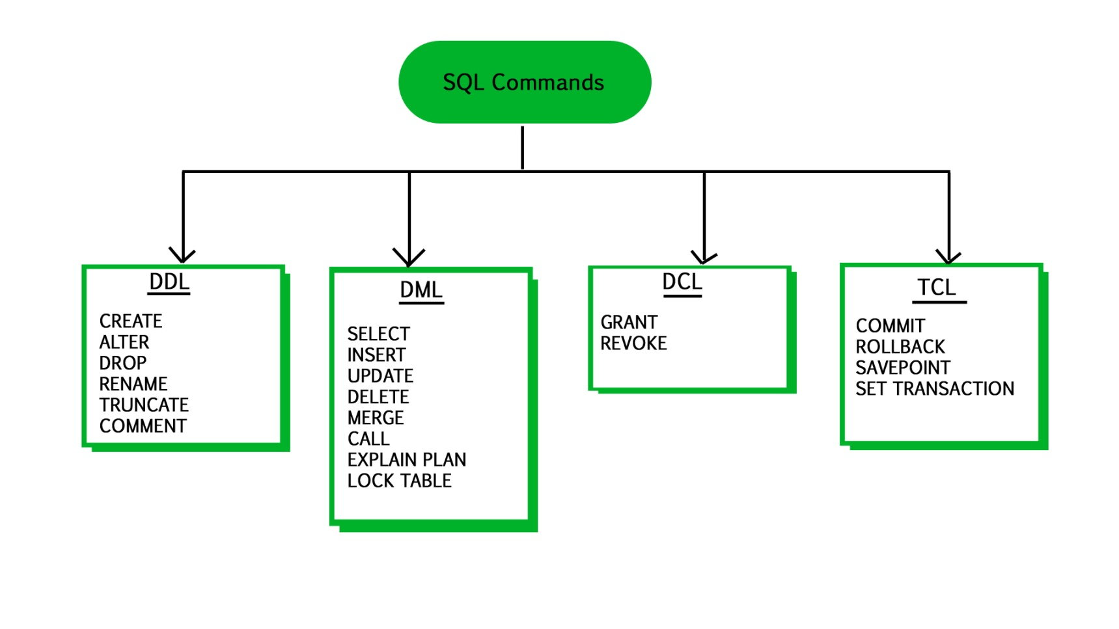
What is SQL?
SQL Structured Query Language is a database language designed and developed for managing data in relational database management systems (RDBMS). SQL is common language for all Relational Databases.

Slide 19
Topics to be covered
DDL commands – (Create table, Alter table, Drop table, Truncate table, Rename table.)
Basic Datatypes.
Constraints

Slide 20
Introduction
A Data Definition Language (DDL) is a computer language used to create and modify the structure of database objects in a database. These database objects include TABLES, VIEWS, INDEXES, etc.

Slide 21
Introduction
Create table :- In database, table is an object where we define the a structure. A structure is a collection of variables under a single name. These variables can be of different data types, and each has a name
Alter table.
Drop table.
Truncate table
Rename table.
Basic Datatypes.
Constraints :- Is used to define rules to allow or restrict what values can be stored in columns.

Slide 22
The char is a fixed-length character data type,
The varchar is a variable-length character data type.
datatypes
ENAME CHAR (10) | S | A | L | E | E | L |  |  |  |  | LENGTH -> 10
ENAME VARCHAR2(10) | S | A | L | E | E | L |  |  |  |  | LENGTH -> 6
When CHAR values are retrieved, the trailing spaces are removed (unless the PAD_CHAR_TO_FULL_LENGTH SQL mode is enabled)
In MySQL
ENAME CHAR (10) | S | A | L | E | E | L |  |  |  |  | LENGTH -> 6
ENAME VARCHAR(10) | S | A | L | E | E | L |  |  |  |  | LENGTH -> 6

Slide 23
dataType - STRING
MySQL supports a number of SQL data types in several categories: numeric types, date and time types, string.
Datatypes | Size | Description
CHAR [(length)] | 0-255
VARCHAR (length) | 0-65535 | The maximum row size (65,535 bytes, which is shared among all columns.
TINYTEXT [(length)] | (28 − 1) bytes
TEXT [(length)] | (216 -1) bytes | 65,535 bytes ~ 64kb
MEDIUMTEXT [(length)] | (224 -1) bytes | 16,777,215 bytes ~16MB
LONGTEXT [(length)] | (232 -1) bytes | 4,294,967,295 bytes ~4GB
ENUM('value1', 'value2',...) | 65,535 members
SET('value1', 'value2',...) | 64 members
By default, trailing spaces are trimmed from CHAR column values on retrieval. If PAD_CHAR_TO_FULL_LENGTH is enabled, trimming does not occur and retrieved CHAR values are padded to their full length.
SET sql_mode = '';
SET sql_mode = 'PAD_CHAR_TO_FULL_LENGTH';

Slide 24
dataType - NUMERIC
UNSIGNED prohibits negative values.
MySQL supports a number of SQL data types in several categories: numeric types, date and time types, string.
Datatypes | Size | Description
TINYINT [(length)] | 1 byte | -128 to +127
SMALLINT [(length)] | 2 bytes | -32,768 to +32,767
MEDIUMINT [(length)] | 3 bytes | -8,388,608 to 8,388,607
INT, INTEGER [(length)] | 4 bytes | -2,147,483,648 to +2,147,483,647
BIGINT [(length)] | 8 bytes | -9,223,372,036,854,775,808 to 9,223,372,036,854,775,807
FLOAT [(length[,decimals])] | 4 bytes
DECIMAL [(length[,decimals])], NUMERIC [(length[,decimals])] |  | NUMERIC will get converted in DECIMAL
DOUBLE [PRECISION] [(length[,decimals])], REAL [(length[,decimals])] | 8 bytes
For: float(M,D), double(M,D) or decimal(M,D), M must be >= D

Slide 25
dataType – DATE and TIME
MySQL supports a number of SQL data types in several categories: numeric types, date and time types, string.
Datatypes | Size | Description
YEAR | 1 byte
DATE | 3 bytes
TIME | 3 bytes
DATETIME | 8 bytes | '1000-01-01 00:00:00' to '9999-12-31 23:59:59'

Slide 26
dataType – Boolean
BOOL and BOOLEAN are synonym of TINYINT(1)
CREATE TABLE TEMP (COL1 int ,COL2 bool, COL3 boolean);
DESCRIBE TEMP;
INSERT INTO TEMP VALUES (1, TRUE ,FALSE);
SELECT * FROM TEMP;

Slide 27
Use a CREATE TABLE statement to specify the layout of your table
CREATE TABLE
By default, tables are created in the default database, using the InnoDB storage engine. An error occurs if the table exists, if there is no default database, or if the database does not exist.

Slide 28
Create Table
CREATE [TEMPORARY] TABLE [IF NOT EXISTS] tbl_name
(create_definition,...)
[table_options]
[partition_options]
create_definition:
col_name column_definition
column_definition:
data_type [NOT NULL | NULL] [DEFAULT default_value]
[AUTO_INCREMENT] [UNIQUE [KEY] | [PRIMARY] KEY]
[COMMENT 'string']
[reference_definition]
| data_type [GENERATED ALWAYS] AS (expression)
[VIRTUAL] [UNIQUE [KEY]] [COMMENT comment]
[NOT NULL | NULL] [[PRIMARY] KEY]
table_options:
ENGINE [=] engine_name
show engines;
set default_storage_engine = memory;

Slide 29
ERP Table structure

Slide 30
ERP
EMPLOYEE
DEPARTMENT
Field Name | Datatype (size)
ID | int
namefirst | varchar(45)
namelast | varchar(45)
dob | date
address | varchar(128)
mobile | varchar(10)
emailid | varchar(128)
Field Name | Datatype (size)
ID | int
name | varchar(45)
phone | Varchar(10)
PRODUCT
REGION
Field Name | Datatype (size)
ID | int
name | varchar(45)
manufacturer | varchar(45)
Field Name | Datatype (size)
ID | int
name | varchar(45)

Slide 31
Campus Table structure

Slide 32
Campus
COURSE
STUDENT
Field Name | Datatype (size)
ID | int
name | varchar(45)
duration | varchar(45)
summery | Varchar(1024)
Field Name | Datatype (size)
ID | int
namefirst | varchar(45)
namelast | varchar(45)
DOB | date
emailID | varchar(128)
phone | varchar(10)
address | varchar(128)
FACULTY
Field Name | Datatype (size)
ID | int
namefirst | varchar(45)
namelast | varchar(45)
DOB | date
emailID | varchar(128)
phone | varchar(10)
address | varchar(128)

Slide 33
If more than one of the Key values applies to a given column of a table, Key displays the one with the highest priority, in the order PRI, UNI, and MUL.
Note that a table with a foreign key that references another table's primary key is MUL
CONSTRAINTS
To limit or to restrict.
PRI => primary key
UNI => unique key
MUL=> is basically an index that is neither a primary key nor a unique key. The name comes from "multiple" because multiple occurrences of the same value are allowed.

Slide 34
Constraints
MySQL CONSTRAINT is used to define rules to allow or restrict what values can be stored in columns. The purpose of inducing constraints is to enforce the integrity of a database.
MySQL CONSTRAINTS can be classified into two types - column level and table level.
The column level constraints can apply only to one column where as table level constraints are applied to the entire table.

Slide 35
Employee (EmployeeID, FullName, SSN, DateOfBirth)
types of Keys?
1. Candidate Key: are individual columns in a table that qualifies for uniqueness of all the rows. Here in Employee table EmployeeID & SSN are Candidate keys.
2. Primary Key: is the columns you choose to maintain uniqueness in a table. Here in Employee table you can choose either EmployeeID or SSN columns, EmployeeID is preferable choice, as SSN is a secure value.
3. Alternate Key: Candidate column other the Primary column, like if EmployeeID is PK then SSN would be the Alternate key.
4. Super Key: If you add any other column/attribute to a Primary Key then it become a super key, like EmployeeID + FullName is a Super Key.
5. Composite Key: If a table do not have any single column that qualifies for a Candidate key, then you have to select 2 or more columns to make a row unique. Like if there is no EmployeeID or SSN columns, then you can make FullName + DateOfBirth as Composite primary Key. But still there can be a narrow chance of duplicate row.

Slide 36
Data integrity refers to the correctness and completeness of data.
A domain constraint and data integrity?
Data Domain refers to all the valid values which a column may contain and can be done by giving data type to the column.
Domain Constraint = data type + Constraints (NOT NULL / UNIQUE / PRIMARY KEY / FOREIGN KEY / CHECK / DEFAULT)
Data integrity refers to the validity of data, meaning data is consistent and correct. Data integrity is normally enforced in a database by a series of integrity constraints or rules.
Three types of integrity constraints: entity integrity, referential integrity and domain integrity:
Entity integrity concerns the concept of a primary key.
Referential integrity concerns the concept of a foreign key.
Domain integrity A domain is a set of values of the same type.

Slide 37
A primary key cannot be NULL
A primary key value must be unique
The primary key values cannot be changed
The primary key must be given a value when a new record is inserted.
What is the meaning of PRIMARY KEY constraint?
If, we give on a column a combination of NOT NULL & UNIQUE key then it behaves like a PRIMARY key.

Slide 38
Constraints – Primary Key
A primary key is a column or a set of columns that uniquely identifies each row in the table.
A primary key must contain unique values. If the primary key consists of multiple columns, the combination of values in these columns must be unique.
A primary key column cannot contain NULL values. It means that you have to declare the primary key column with the NOT NULL attribute. If you don’t, MySQL will force the primary key column as NOT NULL implicitly.
A table has only one primary key.
data dictionary
information_schema.table_constraints;
information_schema.key_column_usage;
information_schema.referential_constraints
Primary key in a relation is always associated with an INDEX object

Slide 39
Constraints – Add Primary Key
The following example creates users table whose primary key is user_id column.
CREATE TABLE USERS (user_id INT PRIMARY KEY, username VARCHAR(40), password VARCHAR(255), email VARCHAR(255)) ENGINE=InnoDB;
You can also specify the PRIMARY KEY at the end of the CREATE TABLE statement as follows.
CREATE TABLE USERS (user_id INT, username VARCHAR(40), password VARCHAR(255), email VARCHAR(255), constraint pk_user_id PRIMARY KEY(USER_ID)) ENGINE=InnoDB;
In case the primary key consists of multiple columns, you must specify them at the end of the CREATE TABLE statement. You put a coma-separated list of primary key columns inside parentheses followed the PRIMARY KEY keywords.
CREATE TABLE USERS (user_id INT, username VARCHAR(40), password VARCHAR(255), email VARCHAR(255), constraint pk_user_id PRIMARY KEY(USER_ID, USERNAME)) ENGINE=InnoDB;

Slide 40
Constraints – Add Primary Key using Alter
You can use the ALTER TABLE statement to add Primary Key on existing column.
ALTER TABLE USERS ADD CONSTRAINT pk_user_id PRIMARY KEY (user_id)
data dictionary
information_schema.table_constraints;
information_schema.key_column_usage;
information_schema.referential_constraints

Slide 41
Constraints – Drop Primary Key
You can use the ALTER TABLE statement to drop Primary Key.
ALTER TABLE USERS DROP PRIMARY KEY;
data dictionary
information_schema.table_constraints;
information_schema.key_column_usage;
information_schema.referential_constraints

Slide 42
A composite key is a primary key composed of multiple columns used to identify a record uniquely.
What is Composite Key?
CREATE TABLE TEMP (
COL1 INT,
COL2 INT,
COL3 INT,
CONSTRAINT PK_COL1_COL2 PRIMARY KEY (COL1, COL2))

Slide 43
What is the meaning of
UNIQUE KEY constraint?

Slide 44
Constraints – Unique Key
The UNIQUE constraint uniquely identifies each record in a database table. The UNIQUE and PRIMARY KEY constraints both provide a guarantee for uniqueness for a column or set of columns.
data dictionary
information_schema.table_constraints;
information_schema.key_column_usage;
information_schema.referential_constraints

Slide 45
Constraints – Add Unique Key
The following example creates users table whose unique key is user_id column.
CREATE TABLE USERS (user_id INT UNIQUE KEY, username VARCHAR(40), password VARCHAR(255), email VARCHAR(255)) ENGINE=InnoDB;
You can also specify the UNIQUE KEY at the end of the CREATE TABLE statement as follows.
CREATE TABLE USERS (user_id INT, username VARCHAR(40), password VARCHAR(255), email VARCHAR(255), constraint u_user_id UNIQUE KEY (user_id) ENGINE=InnoDB);
In case the unique key consists of multiple columns, you must specify them at the end of the CREATE TABLE statement. You put a coma-separated list of unique key columns inside parentheses followed the UNIQUE KEY keywords.
CREATE TABLE USERS (user_id INT, username VARCHAR(40), password VARCHAR(255), email VARCHAR(255), constraint pk_user_id UNIQUE KEY(user_id, username) ENGINE=InnoDB);

Slide 46
Constraints – Add Unique Key using Alter
You can use the ALTER TABLE statement to add Unique Key on existing column.
ALTER TABLE USERS ADD constraint u_user_id UNIQUE KEY (user_id)
data dictionary
information_schema.table_constraints;
information_schema.key_column_usage;
information_schema.referential_constraints

Slide 47
Constraints – Drop Unique Key
You can use the ALTER TABLE statement to drop Unique Key.
ALTER TABLE USERS DROP INDEX <COLUMN_NAME>;
ALTER TABLE USERS DROP INDEX U_USER_ID; // CONSTRAINT NAME
data dictionary
information_schema.table_constraints;
information_schema.key_column_usage;
information_schema.referential_constraints

Slide 48
A foreign key can have a different name from its primary key.
DataType of primary key and foreign key column must be same.
It ensures rows in one table have corresponding rows in another.
Unlike the Primary key, they do not have to be unique.
Foreign keys can be null even though primary keys can not.
What is the meaning of
FOREIGN KEY constraint?
A FOREIGN KEY is a field (or collection of fields) in one table that refers to the PRIMARY KEY in another/same table.
The table containing the FOREIGN KEY is referred to as the child table, and the table containing the PRIMARY KEY (referenced key) is the parent table.

Slide 49
Constraints – Foreign Key
A referential constraint could be violated in following cases.
An INSERT attempt to add a row to a child table that has a value in its foreign key columns that does not match a value in the corresponding parent table's column.
An UPDATE attempt to change the value in a child table's foreign key columns to a value that has no matching value in the corresponding parent table's parent key.
An UPDATE attempt to change the value in a parent table's parent key to a value that does not have a matching value in a child table's foreign key columns.
A DELETE attempt to remove a record from a parent table that has a matching value in a child table's foreign key columns.

Slide 50
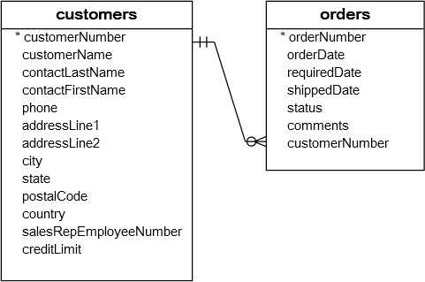
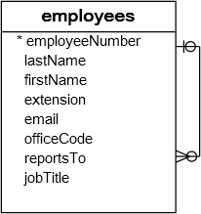
Constraints – Foreign Key
A foreign key is a field in a table that matches another field of another table. A foreign key places constraints on data in the related tables, which enables MySQL to maintain referential integrity.
The customers table is called parent table or referenced table, and the orders table is known as child table or referencing table.

Slide 51
Constraints – Foreign Key
A foreign key is a field in a table that matches another field of another table. A foreign key places constraints on data in the related tables, which enables MySQL to maintain referential integrity.
CREATE TABLE MODULE (id int ,subject varchar(1), description text, constraint pk_id_subject primary key(id, subject)) ENGINE=InnoDB;
CREATE TABLE STUDENT (id int , ModuleID int, subjectID varchar(1), address text, constraint fk_ModuleId_subjectID foreign key (ModuleID) references module(id)) ENGINE=InnoDB;
data dictionary
information_schema.table_constraints;
information_schema.key_column_usage;
information_schema.referential_constraints

Slide 52
Constraints – Foreign Key
A foreign key is a field in a table that matches another field of another table. A foreign key places constraints on data in the related tables, which enables MySQL to maintain referential integrity.
Cascaded FOREIGN KEY actions do not activate triggers.
[ON DELETE reference_option]
[ON UPDATE reference_option]
reference_option: RESTRICT | CASCADE | SET NULL | NO ACTION | SET DEFAULT
When an UPDATE or DELETE operation affects a key value in the parent table that has matching rows in the child table, the result depends on the referential action specified using ON UPDATE and ON DELETE sub clauses of the FOREIGN KEY clause.

Slide 53
Constraints – Foreign Key
CASCADE: Delete or update the row from the parent table, and automatically delete or update the matching rows in the child table. Both ON DELETE CASCADE and ON UPDATE CASCADE are supported.
SET NULL: Delete or update the row from the parent table, and set the foreign key column or columns in the child table to NULL. Both ON DELETE SET NULL and ON UPDATE SET NULL clauses are supported.
CREATE TABLE TEMP (id INT, fName varchar(10) , FOREIGN KEY (id) REFERENCES M(id) ON DELETE CASCADE) ENGINE=InnoDB;
CREATE TABLE TEMP (id INT, fName varchar(10), FOREIGN KEY (id) REFERENCES M(id) ON UPDATE CASCADE) ENGINE=InnoDB;
ALTER table E drop foreign key e_ibfk_1; // e_ibfk_1 is the default constraint name
ON DELETE or ON UPDATE that is not specified, the default action is always RESTRICT.

Slide 54
What is the meaning of
Check Constraint?
Prior to MySQL 8.0.16, CREATE TABLE permits only the following limited version of table CHECK constraint syntax, which is parsed and ignored.

Slide 55
Constraints – Check
The CHECK constraint limits the value that can be placed in a column.
CREATE TABLE USERS (user_id INT, username VARCHAR(40), password VARCHAR(255), email VARCHAR(255), age INT check (age >=18)) ENGINE=InnoDB;
CREATE TABLE USERS (user_id INT, username VARCHAR(40), password VARCHAR(255), email VARCHAR(255), age INT, constraint chk_age check (age >=18)) ENGINE=InnoDB;
The check constraint defined on a table must refer to only columns in that table. It can not refer to columns in other tables.
CREATE TABLE TEST (check(c3 > (c1 + c2)), c1 INT, c2 INT, c3 INT);
CREATE TABLE TEST (c1 INT, c2 INT, c3 INT, check(c3 > (c1 + c2)));
CREATE TABLE TEST (check(c3 > (c1 + c2)), primary key(c1), c1 INT, c2 INT, c3 INT);

Slide 56
Constraints – Check
CHECK condition expressions must adhere to the following rules. An error occurs if an expression contains disallowed constructs.
Non-generated and generated columns are permitted, except columns with the AUTO_INCREMENT attribute.
Literals, deterministic built-in functions, and operators are permitted.
Sub-queries are not permitted.
Environmental variables (such as CURRENT_USER, CURRENT_DATE, …) are not permitted.
Non-Deterministic built-in functions (such as AVG, COUNT, RAND, LAST_INSERT_ID, FIRST_VALUE, LAST_VALUE, ...) are not permitted.
Variables (system variables, user-defined variables, and stored program local variables) are not permitted.
Stored functions and user-defined functions are not permitted.

Slide 57
ERP Table structure with constraints

Slide 58
ERP
EMPLOYEE
DEPARTMENT
Field Name | Datatype (size)
ID | int primary key
namefirst | varchar(45)
namelast | varchar(45)
dob | date
emailid | varchar(128)
Field Name | Datatype (size)
ID | int primary key
name | varchar(45)
phone | Varchar(10)
PRODUCT
REGION
Field Name | Datatype (size)
ID | int primary key
name | varchar(45)
manufacturer | varchar(45)
Field Name | Datatype (size)
ID | int primary key
name | varchar(45)

Slide 59
ERP
PHONE
Field Name | Datatype (size)
ID | int primary key
employeeID | int FOREIGN KEY(`employeeID`) REFERENCES `employee`(`id`)
number | varchar(10)
ADDRESS
Field Name | Datatype (size)
ID | int primary key
employeeID | int FOREIGN KEY(`employeeID`) REFERENCES `employee`(`id`)
address | varchar(128)
QUALIFICATIONS
Field Name | Datatype (size)
ID | int primary key
employeeID | int FOREIGN KEY(`employeeID`) REFERENCES `employee`(`id`)
name | varchar(128)
college | varchar(128)
university | varchar(128)
marks | varchar(45)
year | int

Slide 60
ERP
SPOUSE
Field Name | Datatype (size)
ID | int primary key
employeeID | int FOREIGN KEY(`employeeID`) REFERENCES `employee`(`id`)
name | varchar(45)

Slide 61
Campus Table structure with constraints

Slide 62
Campus
COURSE
STUDENT
Field Name | Datatype (size)
ID | int primary key
name | varchar(45)
duration | varchar(45)
summery | Varchar(1024)
Field Name | Datatype (size)
ID | int primary key
namefirst | varchar(45)
namelast | varchar(45)
DOB | date
emailID | varchar(128)
STUDENT_PHONE
Field Name | Datatype (size)
ID | int primary key
studentID | int FOREIGN KEY(`studentID`) REFERENCES `student`(`id`)
number | varchar(45)
STUDENT_ADDRESS
Field Name | Datatype (size)
ID | int primary key
studentID | int unique not null FOREIGN KEY(`studentID`) REFERENCES `student`(`id`)
address | varchar(128)

Slide 63
Campus
STUDENT_QUALIFICATIONS
Field Name | Datatype (size)
ID | int primary key
studentID | int FOREIGN KEY(`studentID`) REFERENCES `student`(`id`)
name | varchar(128)
college | varchar(128)
university | varchar(128)
marks | varchar(45)
year | int
FACULTY
Field Name | Datatype (size)
ID | int primary key
namefirst | varchar(45)
namelast | varchar(45)
DOB | date
emailID | varchar(128)

Slide 64
Campus
FACULTY_QUALIFICATIONS
Field Name | Datatype (size)
ID | int primary key
facultyID | int FOREIGN KEY(`facultyID`) REFERENCES `faculty`(`id`)
name | varchar(128)
college | varchar(128)
university | varchar(128)
marks | varchar(45)
year | int
FACULTY_PHONE
Field Name | Datatype (size)
ID | int primary key
facultyID | int FOREIGN KEY(`facultyID`) REFERENCES `faculty`(`id`)
number | varchar(10)
FACULTY_ADDRESS
Field Name | Datatype (size)
ID | int primary key
facultyID | int unique not null FOREIGN KEY(`facultyID`) REFERENCES `faculty`(`id`)
address | varchar(128)

Slide 65
Campus
MODULES
Field Name | Datatype (size)
ID | int primary key
name | varchar(128)
duration | int
COURSE_MODULES
Field Name | Datatype (size)
ID | int primary key
courseID | int FOREIGN KEY (`courseID`) REFERENCES `infoway_campus`.`course`(`ID`)
moduleID | int FOREIGN KEY (`moduleID`) REFERENCES `infoway_campus`.`modules`(`ID`)
COURSE_BATCHES
Field Name | Datatype (size)
ID | int primary key
name | varchar(45)
courseID | int FOREIGN KEY (`courseID`) REFERENCES `infoway_campus`.`course` (`ID`)
starton | date
endson | date
capicity | int

Slide 66
Campus
BATCH_STUDENTS
Field Name | Datatype (size)
ID | int primary key
batchID | int FOREIGN KEY (`batchID`) REFERENCES `infoway_campus`.`course_batches` (`ID`)
studentID | int FOREIGN KEY (`studentID`) REFERENCES `infoway_campus`.`student` (`ID`)

Slide 67
Default value
TODO

Slide 68
Default value
TODO
CREATE TABLE TEMP (c1 INT, c2 INT, c3 INT,c4 int default (c2+c3) );

Slide 69
AUTO_INCREMENT Column
TODO

Slide 70
AUTO_INCREMENT
IDENTITY is a synonym to the LAST_INSERT_ID variable.
AUTO_INCREMENT applies only to integer and floating-point types.
There can be only one AUTO_INCREMENT column per table, it must be indexed, and it cannot have a DEFAULT value.
An AUTO_INCREMENT column works properly only if it contains positive values.
The AUTO_INCREMENT column must be indexed, which means it can be either PRIMARY KEY or UNIQUE index.
When you insert a value of NULL or 0 into AUTO_INCREMENT column, the column is set to the next sequence value.
Use LAST_INSERT_ID() function to find the row that contains the most recent AUTO_INCREMENT value
SELECT @@IDENTITY
SELECT LAST_INSERT_ID()
SET INSERT_ID = 7
There can be only one AUTO_INCREMENT column per table, it must be indexed, and it cannot have a DEFAULT value. An AUTO_INCREMENT column works properly only if it contains only positive values.

Slide 71
AUTO_INCREMENT
auto_increment_increment – is the incremental value, controls the interval between successive column values.
auto_increment_offset – determines the starting value for the AUTO_INCREMENT field; this value is used for the first record inserted into the table.
SET @@session.auto_increment_offset = 5
SET @@session.auto_increment_increment = 10
ALTER TABLE TEMP AUTO_INCREMENT = 0;

Slide 72
AUTO_INCREMENT
NO_AUTO_VALUE_ON_ZERO affects handling of AUTO_INCREMENT columns. Normally, you generate the next sequence number for the column by inserting either NULL or 0 into it. NO_AUTO_VALUE_ON_ZERO suppresses this behaviour for 0 so that only NULL generates the next sequence number.
SET sql_mode = '';
SET sql_mode = 'NO_AUTO_VALUE_ON_ZERO';

Slide 73
GENERATED column
TODO

Slide 74
Virtual column - GENERATED ALWAYS
CREATE TABLE supports the specification of generated columns. Values of a generated column are computed from an expression included in the column definition.
col_name data_type [GENERATED ALWAYS] AS (expression) [VIRTUAL | STORED] [NOT NULL | NULL] [UNIQUE [KEY]] [[PRIMARY] KEY] [COMMENT 'string']
VIRTUAL: Column values are not stored, but are evaluated when rows are read, immediately after any BEFORE triggers. A virtual column takes no storage.
STORED: Column values are evaluated and stored when rows are inserted or updated. A stored column does require storage space and can be indexed.
Note: The default is VIRTUAL if neither keyword is specified.
CREATE TABLE triangle (
sidea DOUBLE,
sideb DOUBLE,
sidec DOUBLE AS (SQRT(sidea * sidea + sideb * sideb)) );

Slide 75
Virtual column - GENERATED ALWAYS
CREATE TABLE supports the specification of generated columns. Values of a generated column are computed from an expression included in the column definition.
col_name data_type [GENERATED ALWAYS] AS (expression) [VIRTUAL | STORED] [NOT NULL | NULL] [UNIQUE [KEY]] [[PRIMARY] KEY] [COMMENT 'string']
Triggers cannot use NEW.col_name or use OLD.col_name to refer to generated columns.
CREATE TABLE ... LIKE, the destination table preserves generated column information from the original table.
CREATE TABLE ... SELECT, the destination table does not preserves generated column information from the original table.

Slide 76
zerofill column
Unsigned type can be used to permit only nonnegative numbers
When you select a column with type ZEROFILL it pads the displayed value of the field with zeros up to the display width specified in the column definition. Values longer than the display width are not truncated.
If you specify ZEROFILL for a numeric column, MySQL automatically adds the UNSIGNED attribute to the column.
CREATE TABLE TEMP (x INT(8) ZEROFILL NOT NULL, y INT(8) NOT NULL);
INSERT INTO TEMP (x, y) VALUES (1, 1), (12, 12), (123, 123), (123456789, 123456789);
SELECT x, y FROM TEMP ;

Slide 77
ALTER TABLE

Slide 78
Alter Table
ALTER TABLE changes the structure of a table. For example, you can add or delete columns, create or destroy indexes, change the type of existing columns, or rename columns or the table itself.
ALTER TABLE tbl_name [alter_specification [, alter_specification] ...]
| ADD [COLUMN] col_name column_definition [FIRST | AFTER col_name ]
| ADD [COLUMN] (col_name column_definition,...)
| ADD {INDEX|KEY} [index_name] (index_col_name,...)
| ADD [CONSTRAINT [symbol]] PRIMARY KEY
| ADD [CONSTRAINT [symbol]] UNIQUE KEY
| ADD [CONSTRAINT [symbol]] FOREIGN KEY reference_definition
| CHANGE [COLUMN] old_col_name new_col_name column_definition
[FIRST|AFTER col_name]
| MODIFY [COLUMN] col_name column_definition [FIRST | AFTER col_name]
| DROP [COLUMN] col_name
| DROP PRIMARY KEY
| DROP {INDEX|KEY} index_name
| DROP FOREIGN KEY fk_symbol
| RENAME [TO|AS] new_tbl_name

Slide 79
Alter Table
Change Columns :- You can rename a column using a CHANGE old_col_name new_col_name column_definition clause. To do so, specify the old and new column names and the definition that the column currently has.
Modify Columns :- You can also use MODIFY to change a column's type without renaming it.
Dropping Columns :- If a table contains only one column, the column cannot be dropped. If columns are dropped from a table, the columns are also removed from any index of which they are a part. If all columns that make up an index are dropped, the index is dropped as well.
To convert a table from one storage engine to another, use an ALTER TABLE statement that indicates the new engine:
ALTER TABLE tbl_name ENGINE = InnoDB
ALTER TABLE tbl_name ADD COL1 INT, ADD COL2 INT
ALTER TABLE tbl_name DROP COLUMN COL1, DROP COLUMN COL2
ALTER TABLE tbl_name DROP COLUMN C4, DROP COLUMN C5, ADD C3 INT

Slide 80
DROP TABLE
DROP and TRUNCATE are DDL commands, whereas DELETE is a DML command. Therefore DELETE operations can be rolled back (undone), while DROP and TRUNCATE operations cannot be rolled back.

Slide 81
Drop Table
DROP TABLE removes one or more tables. All table data and the table definition are removed.
DROP [TEMPORARY] TABLE [IF EXISTS] tbl_name [, tbl_name] ...

Slide 82
The TRUNCATE TABLE statement removes all the data of a table and resets the auto-increment value to zero.
TRUNCATE TABLE
DROP and TRUNCATE are DDL commands, whereas DELETE is a DML command. Therefore DELETE operations can be rolled back (undone), while DROP and TRUNCATE operations cannot be rolled back.

Slide 83
Truncate Table
Logically, TRUNCATE TABLE is similar to a DELETE statement that deletes all rows, or a sequence of DROP TABLE and CREATE TABLE statements.
TRUNCATE [TABLE] tbl_name
Truncate operations drop and re-create the table, which is much faster than deleting rows one by one.
Truncate operations cause an implicit commit, and so cannot be rolled back.
Truncate does not cause ON DELETE triggers to fire.
Truncate cannot be performed for InnoDB tables with parent-child foreign key relationships.
Truncate retain Identity and reset to the seed (start value) value.
Cannot truncate a table referenced in a foreign key constraint.

Slide 84
RENAME Table
RENAME TABLE old_tbl_name to new_tbl_name
RENAME TABLE EMP TO EMPLOYEE;

Slide 85
CREATE TABLE ... LIKE STATEMENT

Slide 86
CREATE TABLE ... LIKE
Use CREATE TABLE ... LIKE to create an empty table based on the definition of another table, including any column attributes and indexes defined in the original table.
CREATE TABLE [IF NOT EXISTS] new_tbl LIKE orig_tbl;
LIKE works only for base tables, not for VIEWS.
You cannot execute CREATE TABLE or CREATE TABLE ... LIKE while a LOCK TABLES statement is in effect.
CREATE TABLE E like EMP;
LIKE works only for base tables, not for views.

Slide 87
Class Room
Session 12

Slide 88
Topics to be covered
Create View
Update View
Drop View
Types of Views
Create complex views
Create Index
Drop Index
Index Constraints
Creating Temporary Tables
Family tree and connect by

Slide 89
Views

Slide 90
View
A VIEW is a logical representation of one or more tables. A VIEW contains no data itself. The tables upon which a VIEW is based are called base tables.
If a view is defined as SELECT * on a table, new columns added to the table later do not become part of the VIEW, and columns dropped from the table will result in an error when selecting from the VIEW.
A view must have unique column names with no duplicates, just like a base table. By default, the names of the columns retrieved by the SELECT statement are used for the VIEW column names.
The definition cannot refer to a TEMPORARY table, and you cannot create a TEMPORARY VIEW.
You cannot associate a TRIGGER with a VIEW.
If we drop the base table, the VIEW will not be dropped.

Slide 91
View
Views are not updatable in the following cases:
A table in the FROM clause is reference by a subquery in the WHERE statement.
There is a subquery in the SELECT clause.
The SQL statement defining the view joins tables.
One of the tables in the FROM clause is a non-updatable view.
The SELECT statement of the view contains an aggregate function such as SUM(), COUNT(), MAX(), MIN(), and so on.
The keywords DISTINCT, GROUP BY, HAVING, UNION, or UNION ALL appear in the defining SQL statement.

Slide 92
Create View
The select_statement is a SELECT statement that provides the definition of the view. The select_statement can select from base tables or other views.
CREATE [OR REPLACE]
VIEW view_name [(column_list)]
AS select_statement
[WITH CHECK OPTION]
UPDATE AND DELETE on VIEW (with check option given on view) will work only when the DATA MATCHES IN WHERE CLAUSE.
CREATE VIEW V1 as SELECT * from DEPT;
CREATE or REPLACE VIEW V1 as SELECT * from DEPT with CHECK OPTION;
desc INFORMATION_SCHEMA.VIEWS;

Slide 93
SHOW CREATE VIEW Syntax
SHOW CREATE VIEW view_name
show create view v1;
SHOW [FULL] TABLES [{FROM | IN} db_name]
[LIKE 'pattern' | WHERE expr]
show full tables where table_type like 'VIEW';

Slide 94
Alter / Drop View
This statement changes the definition of a view, which must exist.
ALTER VIEW view_name [(column_list)]
AS select_statement
[WITH CHECK OPTION]
DROP VIEW removes one or more views.
DROP VIEW [IF EXISTS]
view_name [, view_name] ...

Slide 95
MySQL indexes (PRIMARY KEY, UNIQUE, INDEX, and FULLTEXT) are stored in B-trees.
Index

Slide 96
Index
Indexes are used to find rows with specific column values quickly. Without an index, MySQL must begin with the first row and then read through the entire table to find the relevant rows. If the table has an index for the columns in question, MySQL can quickly determine the position to seek to in the middle of the data file without having to look at all the data. This is much faster than reading every row sequentially.
To find the rows matching a WHERE clause quickly.
If the table has a multiple-column index, any leftmost prefix of the index can be used by the optimizer to look up rows. For example, if you have a three-column index on (col1, col2, col3), you have indexed search capabilities on (col1), (col1, col2), and (col1, col2, col3).
If we drop the base table, the INDEX will be dropped automatically.

Slide 97
Create Index
Indexes are used to find rows with specific column values quickly.
CREATE [UNIQUE] INDEX index_name
ON tbl_name (index_col_name,...)
CREATE INDEX IND1 ON EMP (ename)
CREATE UNIQUE INDEX IND1 ON EMP (ename)

Slide 98
SHOW INDEX Syntax
SHOW {INDEX | INDEXES | KEYS}
{FROM | IN} tbl_name
[{FROM | IN} db_name]
[WHERE expr]
SHOW INDEX FROM EMP;
SELECT table_name, index_name from INFORMATION_SCHEMA.STATISTICS;
SHOW INDEX returns table index information.

Slide 99
Drop Index
DROP INDEX drops the index named index_name from the table tbl_name.
DROP INDEX index_name ON tbl_name
DROP INDEX IND1 ON EMPLOYEE;

Slide 100
CREATE TEMPORARY TABLE

Slide 101
Temporary Table
You can use the TEMPORARY keyword when creating a table.
A TEMPORARY table is visible only to the current session, and is dropped automatically when the session is closed.
Use TEMPORARY table with the same name as the original can be useful when you want to try some statements that modify the contents of the table, without changing the original table.
The permanent (original) table becomes hidden (inaccessible) to the client who creates the TEMPORARY table with same name as the original.
If you issue a DROP TABLE statement, the TEMPORARY table is removed and the original table reappears, it is possible, only when then original tbl_name and temporary tbl_name are same.
The original table also reappears if you rename the TEMPORARY table.

Slide 102
CREATE TEMPORARY TABLE ... LIKE
Use CREATE TABLE ... LIKE to create an empty table based on the definition of another table.
CREATE TEMPORARY TABLE [IF NOT EXISTS] new_tbl LIKE orig_tbl;
LIKE works only for base tables, not for VIEWS.
You cannot execute CREATE TABLE or CREATE TABLE ... LIKE while a LOCK TABLES statement is in effect.
You can use the TEMPORARY keyword when creating a table. A TEMPORARY table is visible only to the current session, and is dropped automatically when the session is closed.
CREATE TEMPORARY TABLE E like EMP;
Use TEMPORARY table with the same name as the original can be useful when you want to try some statements that modify the contents of the table, without changing the original table.

Slide 103
mysqldump -uroot -p db1 >> d:\bk.sql
mysqldump -u[username] -p[password] --all-databases > D:\db_backup.sql
mysqldump -P 3306 -h [ip_address] -u [uname] -p[pass] db_name > db_backup.sql
mysql -P 3306 –h192.168.100.74 -uroot -proot < D:\ backup_fileName.sql saleel
Snapshots
To create a raw data snapshot of MyISAM tables, you can use standard copy tools such as cp or copy, a remote copy tool such as scp or rsync, an archiving tool such as zip or tar, or a file system snapshot tool such as dump, providing that your MySQL data files exist on a single file system. If you are replicating only certain databases, copy only those files that relate to those tables.

Slide 104
cluster
A cluster comprises multiple interconnected computers or servers that appear as if they are one server to end users and applications.

Slide 105
Class Room
Session 3

Slide 106
Introduction
A Data Manipulation Language (DML) is a computer language used to retrieve, insert, update and delete data in/from database.

Slide 107
Introduction
Insert :- To insert data into a MySQL table, you would need to use the INSERT INTO command. You can INSERT data into the MySQL table by using the mysql> prompt or by using any programming language.
Update :- We use the UPDATE statement to update existing data in a table. We can use the UPDATE statement to change column values of a single row, a group of rows, or all rows in a table. You can UPDATE data in MySQL table by using the mysql> prompt or by using any programming language.

Slide 108
Introduction
Delete :- We use the DELETE statement to delete existing data in a table. We can use the DELETE statement to delete a single row, a group of rows, or all rows in a table. You can DELETE data from the MySQL table by using the mysql> prompt or by using any programming language.
Selection process :- The SELECT command is used to fetch data from the MySQL database. You can fetch data from the MySQL table by using the mysql> prompt or by using any programming language.

Slide 109
Topics to be covered
DML commands
Insert
Update
Delete
Selection process

Slide 110
INSERT ROWS using VALUES

Slide 111
INSERT … VALUES
INSERT inserts new rows into an existing table. The INSERT ... VALUES
INSERT [INTO] tbl_name [(col_name,...)] {VALUES | VALUE} ({expr | DEFAULT}, ...) , (...), ... [ON DUPLICATE KEY UPDATE assignment_list]
The affected-rows value for an INSERT can be obtained using the ROW_COUNT() function.
Column Values
Column List
Inserting multiple rows

Slide 112
INSERT ROWS using SET

Slide 113
DML- INSERT …SET
INSERT inserts new rows into an existing table. The INSERT ... SET forms of the statement insert rows based on explicitly specified values.
INSERT [INTO] tbl_name SET col_name={expr | DEFAULT}, ... [ON DUPLICATE KEY UPDATE assignment_list]
The affected-rows value for an INSERT can be obtained using the ROW_COUNT() function.
A SET clause indicates columns explicitly by name, together with the value to assign each one.

Slide 114
INSERT ROWS using SELECT

Slide 115
INSERT ... SELECT
With INSERT ... SELECT, you can quickly insert many rows into a table from one or many tables.
INSERT [INTO] tbl_name [(col_name,...)] SELECT ... [ON DUPLICATE KEY UPDATE assignment_list]
INSERT INTO DEPT (DEPTNO) SELECT 1 + 1;
INSERT INTO DEPT (DEPTNO) SELECT DEPTNO FROM DEPT;
INSERT INTO DEPT SELECT * FROM DEPT;
INSERT INTO DEPT (SELECT MAX(DEPTNO) + 1, 'HRD', 'BARODA', 'r57px33px' FROM DEPT);
set @x := 40;
INSERT INTO DEPT VALUES (@x := @x + 1 , 'HRD', 'BARODA', 'r57px33px');

Slide 116
INSERT ... SELECT
With INSERT ... SELECT, you can quickly insert many rows into a table from one or many tables.
INSERT [INTO] tbl_name [(col_name,...)] SELECT ... [ON DUPLICATE KEY UPDATE assignment_list]
INSERT INTO DEPT (DEPTNO) SELECT 1 + 1;
INSERT INTO DEPT (DEPTNO) SELECT DEPTNO FROM DEPT;
INSERT INTO DEPT SELECT * FROM DEPT;
INSERT INTO DEPT (SELECT MAX(DEPTNO) + 1, 'HRD', 'BARODA', 'r57px33px' FROM DEPT);
set @x := 40;
INSERT INTO DEPT VALUES (@x := @x + 1 , 'HRD', 'BARODA', 'r57px33px');

Slide 117
Single-table UPDATE
ORDER BY in UPDATE: if the table contains 1 and 2 in the id column and 1 is updated to 2 before 2 is updated to 3, an error occurs. To avoid this problem, add an ORDER BY clause to cause the rows with larger id values to be updated before those with smaller values
UPDATE TEMP SET C1 = C1 + 1 ORDER BY C1 DESC;

Slide 118
Single-table UPDATE
The UPDATE statement updates columns of existing rows in the named table with new values. The SET clause indicates which columns to modify and the values they should be given. The WHERE clause, if given, specifies the conditions that identify which rows to update. With no WHERE clause, all rows are updated. If the ORDER BY clause is specified, the rows are updated in the order that is specified. The LIMIT clause places a limit on the number of rows that can be updated.
UPDATE <table_reference> SET col_name1 = {expr1 | DEFAULT} [, col_name2 = {expr2 | DEFAULT}] ...
[WHERE where_condition]
[ORDER BY ...]
[LIMIT row_count]
UPDATE TEMP SET dname='xyz' LIMIT 2;
UPDATE TEMP SET c1='x' ORDER BY loc LIMIT 2;
UPDATE TEMP SET c1 = 'x' WHERE deptno <50;
UPDATE TEMP SET c1 = 'x' WHERE deptno <50 LIMIT 2;

Slide 119
Single-Table DELETE

Slide 120
Single-table DELETE
The DELETE statement deletes rows from tbl_name and returns the number of deleted rows. To check the number of deleted rows, call the ROW_COUNT() function. The optional WHERE clause identify which rows to delete. With no WHERE clause, all rows are deleted. If the ORDER BY clause is specified, the rows are deleted in the order that is specified. The LIMIT clause places a limit on the number of rows that can be deleted.
DELETE FROM table_reference
[WHERE where_condition]
[ORDER BY ...]
[LIMIT row_count]
LIMIT clauses apply to single-table deletes, but not multi-table deletes.
DELETE FROM TEMP;
DELETE FROM TEMP ORDER BY LOC LIMIT 2;
DELETE FROM TEMP WHERE DEPTNO <50;
DELETE FROM TEMP WHERE DEPTNO <50 LIMIT 2;

Slide 121
SELECT CLAUSE
The SELECT statement retrieves or extracts data from tables in the database.
You can use one or more tables separated by comma to include various conditions using a WHERE clause, but WHERE clause is an optional part of SELECT command.
You can fetch one or more fields in a single SELECT command.
You can specify star (*) in place of fields. In this case, SELECT will return all the fields.
You can specify any condition using WHERE clause.
You can specify an offset using OFFSET from where SELECT will start returning records. By default offset is zero.
You can limit the number of returns using LIMIT attribute.

Slide 122
Capabilities of
SELECT Statement
SELECTION
PROJECTION
JOINING

Slide 123
Capabilities of
SELECT Statement
SELECTION
Selection capability in SQL is to choose the rows in a table that you want to return by a query.
EMPNO | ENAME | JOB | HIREDATE
1 | Saleel | Manager | 01-Jan-95
2 | Janhavi | Sales | 20-Dec-94
3 | Snehal | Manager | 21-May-97
4 | Rahul | Account | 30-Jul-97
5 | Ketan | Sales | 01-Jan-94

Slide 124
Capabilities of
SELECT Statement
PROJECTION
Projection capability in SQL to choose the columns in a table that you want to return by your query.
EMPNO | ENAME | JOB | HIREDATE
1 | Saleel | Manager | 01-Jan-95
2 | Janhavi | Sales | 20-Dec-94
3 | Snehal | Manager | 21-May-97
4 | Rahul | Account | 30-Jul-97
5 | Ketan | Sales | 01-Jan-94

Slide 125
Capabilities of
SELECT Statement
JOINING
Join capability in SQL to bring together data that is stored in different tables by creating a link between them.
EMPNO | ENAME | JOB | HIREDATE | DEPTNO
1 | Saleel | Manager | 01-Jan-95 | 20
2 | Janhavi | Sales | 20-Dec-94 | 10
3 | Snehal | Manager | 21-May-97 | 10
4 | Rahul | Account | 30-Jul-97 | 20
5 | Ketan | Sales | 01-Jan-94 | 30
DEPTNO | DNAME | LOC
10 | HRD | PUNE
20 | SALES | BARODA

Slide 126
SELECT statement
SELECTION Process
SELECT * FROM <table_references>
Selection-List
PROJECTION Process
SELECT column-list FROM <table_references>
Selection-List

Slide 127
Class Room
Session 5

Slide 128
Topics to be covered
Select with (WHERE, ORDER BY clause, and LIMIT)

Slide 129
SELECT statement…

Slide 130
In the select list of a query, a quoted column alias can be specified using identifier ( ` ) or string quoting ( ' or " ) characters.
Column - ALIAS
SELECT 'HELLO' ' WORLD';
SELECT 'HELLO' AS ' WORLD';
SELECT ENAME `EmployeeName` FROM EMP;
SELECT ENAME AS `EmployeeName` FROM EMP;

Slide 131
SELECT statement - ALIAS
A programmer can use an alias to temporarily assign another name to a table or column for the duration of a SELECT query. Assigning an alias does not actually rename the column or table.
A select_expr can be given an alias using AS alias_name. The alias is used as the expression's column name and can be used in GROUP BY, ORDER BY, or HAVING clauses.
The AS keyword is optional when aliasing a select_expr with an identifier.
Standard SQL disallows references to column aliases in a WHERE clause.
A table reference can be aliased using tbl_name AS alias_name or tbl_name alias_name
If the column alias contains spaces, put it in quotes.

Slide 132
SELECT statement - ALIAS
SQL aliases are used to give a table, or a column in a table, a temporary name.
Column ALIAS
SELECT ColName1 [ [as] alias_name], ColName2 [ [as] alias_name],... ColN from <table_references> [ [as] alias_name]
SELECT EMPNO as EmployeeNumber, ENAME EmployeeName FROM EMP;
SELECT ENAME "Employee Name" FROM EMP;
SELECT ENAME 'Employee Name' FROM EMP;
SELECT * FROM EMP E;
You can use the alias in GROUP BY, ORDER BY, or HAVING clauses to refer to the column.
Standard SQL disallows references to column aliases in a WHERE clause.

Slide 133
SELECT statement - ALIAS
SQL aliases are used to give a table, or a column in a table, a temporary name.
Column ALIAS
You can use the alias in GROUP BY, ORDER BY, or HAVING clauses to refer to the column.
SELECT orderNumber `Order no.`, SUM(price * quantity) total
FROM orderdetails
GROUP BY `Order no.`
HAVING total > 60000;

Slide 134
Column - EXPRESSIONS

Slide 135
SELECT statement - EXPRESSIONS
Column EXPRESSIONS
SELECT ColName1, expressions,... from <table_references>
SELECT 1001 + 1;
SELECT 1001 + 1 FROM DUAL;
SELECT '1' + '1' ;
SELECT '1' + 'a1';
SELECT '1' + '1a';
SELECT 'a1' + 1;
SELECT '1a' + 1;
SELECT SAL, SAL + 1000 AS 'New Salary' FROM EMP;
SELECT SAL, COMM, SAL + COMM FROM EMP;
SELECT SAL, COMM, SAL + IFNULL (COMM, 0) FROM EMP;

Slide 136

SELECT statement… syntax
SELECT is used to retrieve rows selected from one or more tables, and can include UNION statements and subqueries.

Slide 137
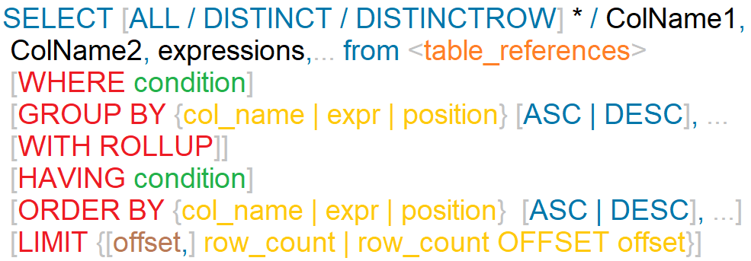
SELECT statement
SELECT syntax
DISTINCTROW is a synonym for DISTINCT.
The ALL and DISTINCT modifiers specify whether duplicate rows should be returned. ALL (the default) specifies that all matching rows should be returned, including duplicates. DISTINCT specifies removal of duplicate rows from the result set. It is an error to specify both modifiers. DISTINCTROW is a synonym for DISTINCT.

Slide 138
Nulls by default occur at the top, but you can use IsNull to assign default values, that will put it in the position you require.
The ISNULL() function tests whether an expression is NULL. If expression is a NULL value, the ISNULL() function returns 1. Otherwise, it returns 0.
ORDER BY Clause
To sort a result, use an ORDER BY clause.
You can sort on multiple columns, and you can sort different columns in different directions.
The default sort order is ascending, with smallest values first. To sort in reverse (descending) order, add the DESC keyword to the name of the column you are sorting by.
SELECT id AS 'a' FROM tbl_name ORDER BY `a`;
SELECT id AS 'a' FROM tbl_name ORDER BY 'a';

Slide 139
SELECT - ORDER BY
When doing an ORDER BY, NULL values are presented first if you do ORDER BY ... ASC and last if you do ORDER BY ... DESC.
SELECT column-list from <table_references>
[ORDER BY {col_name | expr | position} [ASC | DESC], ...]
"Ordered by attributes A1, A2, …"
Tuples are sorted by specified attributes
Results are sorted by A1 first
Within each value of A1, results are sorted by A2
If the ASC or DESC modifier is not provided in the ORDER BY clause, the results will be sorted by expression in ascending order. This is equivalent to ORDER BY expression ASC.
The ORDER BY clause can be used in a SELECT statement, SELECT LIMIT statement, Update LIMIT, and DELETE LIMIT statement in MySQL.

Slide 140
SELECT - ORDER BY
The ORDER BY clause is used to sort the records in your result set.
SELECT column-list from <table_references>
[ORDER BY {col_name | expr | position} [ASC | DESC], ...]
SELECT * FROM EMP ORDER BY COMM
SELECT * FROM EMP ORDER BY COMM IS NULL
SELECT ENAME, length(ENAME) FROM EMP ORDER BY length(ENAME), ENAME desc
SELECT * FROM EMP ORDER BY IF(JOB = ‘manager', 3, IF(JOB = 'salesman', 2, null))
SELECT * FROM EMP ORDER BY FIELD(JOB, 'manager', 'salesman')
SELECT * FROM EMP ORDER BY ISNULL(COMM), COMM
SELECT ENAME `e` FROM EMP ORDER BY `e`
SELECT ENAME `e` FROM EMP ORDER BY e
SELECT ENAME 'e' FROM EMP ORDER BY 'e'

Slide 141
Comparison Functions and Operator

Slide 142
Comparison Functions and Operator
BETWEEN ... AND ... | Check whether a value is within a range of values
COALESCE() | Return the first non-NULL argument
= | Equal operator
<=> | NULL-safe equal to operator
> | Greater than operator
>= | Greater than or equal operator
IN() | Check whether a value is within a set of values
IS | Test a value against a boolean
IS NOT | Test a value against a boolean
IS NOT NULL | NOT NULL value test
IS NULL | NULL value test
ISNULL() | Test whether the argument is NULL
< | Less than operator
<= | Less than or equal operator
LIKE | Simple pattern matching
NOT BETWEEN ... AND ... | Check whether a value is not within a range of values
!=, <> | Not equal operator
NOT IN() | Check whether a value is not within a set of values
NOT LIKE | Negation of simple pattern matching

Slide 143
BETWEEN ... AND ...
Check whether a value is within a range of values
All three expressions: expr, begin_expr, and end_expr must have the same data type.
Comparison BETWEEN ... AND ...
If any expression is NULL, the BETWEEN operator returns a NULL value.

Slide 144
Identifier Qualifiers
The maximum length for each type of identifier like (Database, Table, Column, Index, Constraint, View, Stored Program, User-Defined Variable, Tablespace) is 64 characters, whereas for Alias is 256 characters.

Slide 145
Identifier Qualifiers
You can refer to a table within the default database as tbl_name, or as db_name.tbl_name to specify a database explicitly.
You can refer to a column as col_name, tbl_name.col_name, or db_name.tbl_name.col_name.
You need not specify a tbl_name or db_name.tbl_name prefix for a column reference unless the reference would be ambiguous.
The identifier quote character is the backtick (`)

Slide 146
Identifier Qualifiers
In MySQL, you can refer to a table column using any of the following forms.
Column Reference | Description
col_name | The column col_name from whichever table used in the statement contains a column of that name.
tbl_name.col_name | The column col_name from table tbl_name of the default database.
db_name.tbl_name.col_name | The column col_name from table tbl_name of the database db_name.
The identifier quote character is the backtick (`)

Slide 147
Identifier Qualifiers
In MySQL, you can refer to a table using any of the following forms.
Table Reference | Description
tbl_name | The table tbl_name from whichever table used in the statement to fetch the data.
db_name.tbl_name | The table tbl_name from whichever database db_name.
The identifier quote character is the backtick (`)

Slide 148
The NULL value

Slide 149
The NULL value - NULL
The NULL value is special. It means "NO VALUE" or "UNKNOWN VALUE" and cannot be compared to known values the way you compere two known values to each other. If you attempt to use NULL with the usual arithmetic comparison operators, the result is undefined (NULL).
Instead of using =, < >, or != to test for equality or inequality with NULL values, use IS NULL or IS NOT NULL
MySQL specific <=> comparison operator is true even for NULL-to-NULL comparisons.

Slide 150
Control Flow Functions

Slide 151
Control Flow Functions - IFNULL
IFNULL function
MySQL IFNULL() takes two expressions, if the first expression is not NULL, it returns the first expression. Otherwise, it returns the second expression, it returns either numeric or string value.
IFNULL(expression1, expression2)
SELECT IFNULL (1, 2) as R1;
SELECT IFNULL (null, 2) as R1;
SELECT IFNULL (1/0, 2) as R1;
SELECT IFNULL (1/0, 'Yes') as R1;
SELECT comm, IFNULL(COMM + COMM*.25, 1000) FROM EMP;

Slide 152
Control Flow Functions - IF
IF function
If expr1 is TRUE or expr1 <> 0 or expr1 <> NULL, then IF() returns expr2, otherwise it returns expr3, it returns either numeric or string value.
IF(expr1, expr2 , expr3)
SELECT IF(1 > 2, 2, 3) as R1;
SELECT sal, IF(sal = 3000, 'Ok', 'Not Bad') R1 FROM EMP;
SELECT ename, sal, IF(sal = 3000 and ename = 'FORD', 'Y', 'N') R1 FROM EMP;
SELECT ename, sal, comm, IF(comm is NULL && ename = 'FORD', 'Y', 'N') R1 FROM EMP;
SELECT deptno, IF(deptno = 10, 'Sales', IF(deptno = 20 , 'Purchase' ,'N/A')) R1 FROM EMP;

Slide 153
Control Flow Functions - NULLIF
NULLIF function
Returns NULL if expr1 = expr2 is true, otherwise returns expr1.
NULLIF(expr1, expr2)
SELECT NULLIF(1, 1) as R1;
SELECT NULLIF(1, 2) as R1;

Slide 154
Control Flow Functions - CASE
CASE function
Returns the result for the first condition that is true. If there was no matching result value, the result after ELSE is returned, or NULL if there is no ELSE part.
CASE value WHEN [compare_value] THEN result [WHEN [compare_value] THEN result ...] [ELSE result] END
SELECT deptno, CASE deptno when 10 then 'Accounts' when 20 then 'Sales' ELSE 'N/A' END R1 FROM EMP;
SELECT deptno, CASE deptno when 10 then 'Accounts' ELSE 'N/A' END CASE FROM EMP; // error

Slide 155
Control Flow Functions - CASE
CASE function
Returns the result for the first condition that is true. If there was no matching result value, the result after ELSE is returned, or NULL if there is no ELSE part.
CASE WHEN [condition] THEN result [WHEN [condition] THEN result ...] [ELSE result] END
SELECT deptno, CASE when deptno = 10 then 'Sales' when deptno = 20 then 'Purchase' ELSE 'N/A' END R1 FROM EMP;

Slide 156
In WHERE clause operations can be performed using…
CONSTANTS
TABLE columns
FUNCTION calls (PRE-DEFINED / UDF)
WHERE Clause
The WHERE Clause is used when you want to retrieve specific information from a table excluding other irrelevant data.
Expressions in WHERE clause can use
Arithmetic operators
Comparison operators
Logical operators

Slide 157
SELECT - WHERE
We can use a conditional clause called WHERE clause to filter out results. Using WHERE clause, we can specify a selection criteria to select required records from a table.
SELECT column-list from <table_references>
[WHERE where_condition]
Comparison Functions and Operators
= | Equal operator
> | Greater than operator
>= | Greater than or equal operator
< | Less than operator
<= | Less than or equal operator
!=, <> | Not equal operator
<=> | NULL-safe equal to operator

Slide 158
SELECT - WHERE
We can use a conditional clause called WHERE clause to filter out results. Using WHERE clause, we can specify a selection criteria to select required records from a table.
SELECT column-list from <table_references>
[WHERE where_condition]
Logical Operators
AND, && | Logical AND eg. SELECT 1 AND 1;
OR, || | Logical OR eg. SELECT 1 OR 1;
NOT, ! | Negates value eg. SELECT NOT 1;
Logical AND. Evaluates to 1 if all operands are nonzero and not NULL, to 0 if one or more operands are 0, otherwise NULL is returned.
Logical OR. When both operands are non-NULL, the result is 1 if any operand is nonzero, and 0 otherwise. With a NULL operand, the result is 1 if the other operand is nonzero, and NULL otherwise. If both operands are NULL, the result is NULL.
Logical NOT. Evaluates to 1 if the operand is 0, to 0 if the operand is nonzero, and NOT NULL returns NULL.

Slide 159
SELECT - WHERE
We can use a conditional clause called WHERE clause to filter out results. Using WHERE clause, we can specify a selection criteria to select required records from a table.
SELECT column-list from <table_references>
[WHERE where_condition]
Comparison Functions and Operators
IS NULL | NULL value test
IS NOT NULL | NOT NULL value test
ISNULL(expr) | If expr is NULL, ISNULL() returns 1, otherwise it returns 0.
STRCMP(expr1,expr2) | STRCMP() returns 0 if the strings are the same, -1 if the first argument is smaller than the second according to the current sort order, and 1 otherwise.
LEAST(value1,value2,...) | With two or more arguments, returns the smallest argument.
GREATEST(value1,value2,...) | With two or more arguments, returns the largest argument.

Slide 160
SELECT - WHERE
We can use a conditional clause called WHERE clause to filter out results. Using WHERE clause, we can specify a selection criteria to select required records from a table.
SELECT column-list from <table_references>
[WHERE where_condition]
Comparison Functions and Operators
BETWEEN ... AND ... | Check whether a value is within a range of values
NOT BETWEEN ... AND ... | Check whether a value is not within a range of values
expr IN (value,...) | Check whether a value is within a set of values
expr NOT IN (value,...) | Check whether a value is not within a set of values
expr LIKE pat [ESCAPE 'escape_char'] | Pattern matching using an SQL pattern. Returns 1 (TRUE) or 0 (FALSE). If either expr or pat is NULL, the result is NULL.
expr NOT LIKE pat [ESCAPE 'escape_char'] | Negation of simple pattern matching.

Slide 161
IS NULL / IS NOT NULL
"IS NULL" is the keyword that performs the Boolean comparison. It returns true if the supplied value is NULL and false if the supplied value is not NULL.
“IS NOT NULL" is the keyword that performs the Boolean comparison. It returns true if the supplied value is not NULL and false if the supplied value is null.

Slide 162




NULL- IS NULL / IS NOT NULL

Slide 163
Like

Slide 164


Like - String Comparison Functions
syntax
expr LIKE pat [ESCAPE 'escape_char']
% matches any number of characters, even zero characters.
_ matches exactly one character.
If we use default escape character '\', then don’t use ESCAPE keyword.
To test for literal instances of a wildcard character, precede it by the escape character. If you do not specify the ESCAPE character, \ is assumed.
\% matches one % character.
\_ matches one _ character.
The ESCAPE keyword is used to escape pattern matching characters such as the (%) percentage and underscore (_) if they form part of the data.

Slide 165
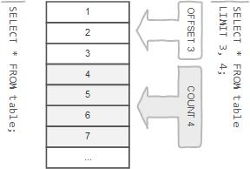
Row Limiting Clause
LIMIT is applied after HAVING
LIMIT also enables you to pull a section of rows from the middle of a result set. Specify two values: The number of rows to skip at the beginning of the result set, and the number of rows to return.

Slide 166
SELECT - LIMIT
Limit value are not to be given within ()
The LIMIT clause can be used to constrain the number of rows returned by the SELECT statement. LIMIT takes one or two numeric arguments, which must both be nonnegative integer value.
SELECT column-list from <table_references>
[LIMIT {[offset,] row_count | row_count OFFSET offset}]
You can specify an offset using OFFSET from where SELECT will start returning records. By default offset is zero.
The first argument specifies the offset of the first row to return, and the second specifies the maximum number of rows to return.
SELECT * FROM EMP LIMIT 5;
SELECT * FROM EMP LIMIT 1, 5;
SELECT * FROM EMP LIMIT 5 offset 1;
SELECT rand(), EMP.* FROM EMP ORDER BY 1 LIMIT 1;

Slide 167
SELECT - LIMIT
This variable is used to return the maximum number of rows from SELECT statements. Its default value is unlimited. But if you changed the limit then SELECT statement returns the rows equals to the value.
SQL_SELECT_LIMIT = {value | DEFAULT}
This variable does not apply to SELECT statement that executed in the stored procedures or functions.
SET SQL_SELECT_LIMIT=2;
SET SQL_SELECT_LIMIT=DEFAULT;
SELECT * FROM EMP;

Slide 168
Class Room
Session 6 & 9

Slide 169
Topics to be covered
Session 6
Select with (GROUP BY, HAVING clause)
Session 9
SQL Operators
SQL Built in Functions:
SQL Aggregate functions
SQL Scalar functions

Slide 170

Standard SQL does not allow you to use an alias in the GROUP BY clause, however, MySQL supports this.
MySQL also allows you to sort the groups in ascending or descending orders while the standard SQL does not.
DISTINCT (if used outside an aggregation function) that is superfluous.
GROUP BY Clause
SELECT id AS 'a', COUNT(*) AS cnt FROM tbl_name GROUP BY `a`;
SELECT id AS 'a', COUNT(*) AS cnt FROM tbl_name GROUP BY 'a';

Slide 171
Standard SQL does not allow you to use an alias in the GROUP BY clause, however, MySQL supports this.
MySQL also allows you to sort the groups in ascending or descending orders while the standard SQL does not.
G1,G2,….,Gn GF1(A1), F2(A2),…..Fm(Am) (r)
GROUP BY Clause with DISTINCT
DISTINCT (if used outside an aggregation function) that is superfluous.

Slide 172
SELECT - GROUP BY
Columns selected for output can be referred to in ORDER BY and GROUP BY clauses using column names, column aliases, or column positions. Column positions are integers and begin with 1
If you use GROUP BY, output rows are sorted according to the GROUP BY columns as if you had an ORDER BY for the same columns. To avoid the overhead of sorting that GROUP BY produces, add ORDER BY NULL.
MySQL extends the GROUP BY clause so that you can also specify ASC and DESC after columns named in the clause
If a query includes GROUP BY but you want to avoid the overhead of sorting the result, you can suppress sorting by specifying ORDER BY NULL.
For example:
SELECT JOB, COUNT(*) FROM EMP GROUP BY JOB ORDER BY NULL;
SELECT * FROM EMP ORDER BY field (JOB, 'MANAGER', 'SALESMAN');

Slide 173
SELECT - GROUP BY
This function's will produce a single value for an entire group or a table.
You can use GROUP BY to group values from a column, and, if you wish, perform calculations on that column.
SELECT G1,G2,...,Gn,F1(A1),F2(A2),...Fm(Am) from <table_references>
[GROUP BY {col_name | expr | position} [ASC | DESC], ... [WITH ROLLUP]]
SELECT JOB , SUM(SAL) FROM EMP GROUP BY JOB WITH ROLLUP;
SELECT COALESCE (JOB, 'Total') , SUM(SAL) FROM EMP GROUP BY JOB WITH ROLLUP;
Aggregate (GROUP BY) Function
AVG([DISTINCT] expr) | Returns the average value of expr. The DISTINCT option can be used to return the average of the distinct values of expr.
COUNT(expr) | Returns a count of the number of non-NULL values of expr in the rows retrieved by a SELECT statement. If there are no matching rows, COUNT() returns 0.
COUNT(DISTINCT expr,[expr...]) | Returns a count of the number of rows with different non-NULL expr values. If there are no matching rows, COUNT(DISTINCT) returns 0.

Slide 174







The aggregate functions allow you to perform the calculation of a set of rows and return a single value. The GROUP BY clause is often used with an aggregate function (such as SUM, AVG, MAX, MIN, and COUNT.) to perform calculation and return a single value for each subgroup.
The HAVING clause can refer to aggregate functions, which the WHERE clause cannot.
aggregate functions
// ERROR

Slide 175


The aggregate functions allow you to perform the calculation of a set of rows and return a single value. The GROUP BY clause is often used with an aggregate function (such as SUM, AVG, MAX, MIN, and COUNT.) to perform calculation and return a single value for each subgroup.
The HAVING clause can refer to aggregate functions, which the WHERE clause cannot.
aggregate functions

Slide 176

There are 3 places where aggregate functions can appear in a query
in the SELECT-LIST (the items before the FROM clause).
in the ORDER BY clause.
and in the HAVING clause.
"An aggregate may not appear in the WHERE clause unless it is in a subquery contained in a WHERE or HAVING clause or a select list, and the column being aggregated is an outer reference"

Slide 177
AVG and COUNT Aggregate (GROUP BY) Function
Blank space between aggregate functions like (SUM, MIN, MAX, COUNT) are not allowed. Eg. SELECT SUM (sal) from EMP;
AVG()
If there are no matching rows, AVG() returns NULL.
SUM()
If the return set has no rows, SUM() returns NULL.
The DISTINCT keyword can be used to sum only the distinct values of expr.
COUNT()
Returns a count of the number of non-NULL values.
If there are no matching rows, COUNT() returns 0.
COUNT(*) is somewhat different in that it returns a count of the number of rows retrieved, whether or not they contain NULL values.

Slide 178
AVG and COUNT Aggregate (GROUP BY) Function
Blank space between aggregate functions like (SUM, MIN, MAX, COUNT) are not allowed. Eg. SELECT SUM (sal) from EMP;
SELECT COUNT(JOB) FROM EMP;
SELECT COUNT(*) FROM EMP;
SELECT COUNT(EMP.*) FROM EMP;
SELECT COUNT(IF(COMM IS NULL, 1, NULL)), COUNT(IF(COMM IS NOT NULL, 0, NULL)) FROM EMP;
SET sql_mode = ' ';
SET sql_mode = IGNORE_SPACE;

Slide 179
SELECT - GROUP BY
This function's will produce a single value for an entire group or a table.
You can use GROUP BY to group values from a column, and, if you wish, perform calculations on that column.
SELECT G1,G2,...,Gn,F1(A1),F2(A2),...Fm(Am) from <table_references>
[GROUP BY {col_name | expr | position} [ASC | DESC], ... [WITH ROLLUP]]
Aggregate (GROUP BY) Function
MAX([DISTINCT] expr) | Returns the maximum value of expr. MAX() may take a string argument; in such cases, it returns the maximum string value. The DISTINCT keyword can be used to find the maximum of the distinct values of expr.
MIN([DISTINCT] expr) | Returns the minimum value of expr. MIN() may take a string argument; in such cases, it returns the minimum string value. The DISTINCT keyword can be used to find the minimum of the distinct values of expr.
SUM([DISTINCT] expr) | Returns the sum of expr. If the return set has no rows, SUM() returns NULL. The DISTINCT keyword can be used to sum only the distinct values of expr.

Slide 180
MIN and MAX Aggregate (GROUP BY) Function
Blank space between aggregate functions like (SUM, MIN, MAX, COUNT) are not allowed. Eg. SELECT SUM (sal) from EMP;
MAX()
If there are no matching rows, MAX() returns NULL.
MAX() may take a string argument; in such cases, it returns the maximum string value
MAX() compares ENUM and SET columns by their string value rather than by the string's relative position in the set.
MIN()
If there are no matching rows, MIN() returns NULL.
MIN() may take a string argument; in such cases, it returns the minimum string value.
MIN() compares ENUM and SET columns by their string value rather than by the string's relative position in the set.

Slide 181
There are 3 places where aggregate functions can appear in a query
in the SELECT-LIST (the items before the FROM clause).
in the ORDER BY clause.
and in the HAVING clause.
"An aggregate may not appear in the WHERE clause unless it is in a subquery contained in a HAVING clause or a select list, and the column being aggregated is an outer reference"

Slide 182
SELECT - GROUP BY
Examples:
SELECT JOB, SAL + 1001 FROM EMP GROUP BY JOB;
SELECT JOB, COUNT(JOB) FROM EMP GROUP BY COUNT(JOB); //error
SELECT JOB, SAL + 1001 FROM EMP GROUP BY SAL + 1001;
SELECT ENAME, LENGTH(ENAME) R1 FROM EMP GROUP BY R1;
SET sql_mode = '';
SET sql_mode = 'ONLY_FULL_GROUP_BY';

Slide 183
The HAVING clause is often used with the GROUP BY clause to filter groups based on a specified condition. If the GROUP BY clause is omitted, the HAVING clause behaves like the WHERE clause.
The HAVING clause can refer to aggregate functions, which the WHERE clause cannot.
HAVING Clause

Slide 184
SELECT - HAVING
The MySQL HAVING clause is used in the SELECT statement to specify filter conditions for a group of rows. HAVING clause is often used with the GROUP BY clause. When using with the GROUP BY clause, we can apply a filter condition to the columns that appear in the GROUP BY clause.
If the GROUP BY clause is omitted, the HAVING clause behaves like the WHERE clause.
SELECT column-list from <table_references>
[GROUP BY {col_name | expr | position} [ASC | DESC], ... [WITH ROLLUP]]
[HAVING where_condition]

Slide 185
Difference between WHERE and HAVING clause

Slide 186
WHERE and HAVING clause
WHERE clause can be used with - SELECT, UPDATE, and DELETE statements, where as HAVING clause can only be used with the SELECT statement.
WHERE clause filters rows before aggregation (GROUPING), where as, HAVING clause filters groups, after the aggregations are performed.
Aggregate functions (SUM , MIN, MAX, AVG and COUNT) cannot be used in the WHERE clause, unless it is in a sub query contained in a HAVING clause, whereas, aggregate functions can be used in HAVING clause.

Slide 187
User-Defined Variables

Slide 188
User-Defined Variables
A user variable name can contain other characters if you quote it as a string or identifier (for example, @'my-var', @"my-var", or @`my-var`).
User-defined variables are session specific. A user variable defined by one client cannot be seen or used by other clients.
All variables for a given client session are automatically freed when that client exits.
User variable names are not case sensitive. Names have a maximum length of 64 characters.
If the value of a user variable is selected in a result set, it is returned to the client as a string.
If you refer to a variable that has not been initialized, it has a value of NULL and a type of string.

Slide 189
User-Defined Variables
You can store a value in a user-defined variable in one statement and refer to it later in another statement. This enables you to pass values from one statement to another.
SET @var_name = expr [, @var_name = expr] ...
For SET, either = or := can be used as the assignment operator.
You can also assign a value to a user variable in statements (SELECT, …) other than SET. In this case, the assignment operator must be := and not = because latter is treated as the comparison operator =.
mysql> SET @v1 = 1001, @v2 = 2, @v3 = 'Saleel';
mysql> SET @v1 = 1001, @v2 = 2, @v3 := @v1 + @v2;
mysql> SELECT @v1 := MIN(SAL), @v2 := MAX(SAL) FROM EMP;
mysql> SELECT @v1, @v2, @v3;

Slide 190

User-Defined Variables
User variables are intended to provide data values. They cannot be used directly in an SQL statement as an identifier or as part of an identifier.
SET @var_name = expr [, @var_name = expr] ...
mysql> SET @v1 = 'ENAME'; // WHERE ENAME IS COLUMN NAME.
mysql> SELECT @v1 FROM EMP;

Slide 191
Rownum

Slide 192
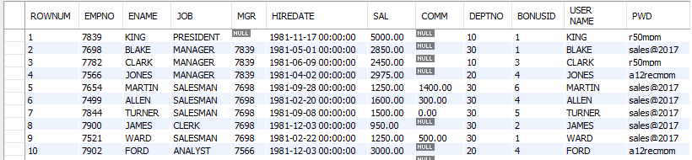
Select - Rownum
mysql> SET @ROW = 0;
mysql> SELECT @ROW := @ROW + 1 AS ROWNUM , EMP.* FROM EMP;
mysql> SELECT @ROW := @ROW + 1 AS ROWNUM , EMP.* FROM EMP,
(SELECT @ROW := 0) AS E;
mysql> SELECT @rank := @rank + 1 ,E.* FROM (SELECT JOB, SAL FROM EMP
GROUP BY JOB ORDER BY SAL desc) E , (SELECT @rank := 0) EE;

Slide 193
Date and Time Functions

Slide 194
NOW(), CURDATE(), CURTIME()
DateTime Functions
In MySQL, the NOW() function returns a default value for a DATETIME.
MySQL inserts the current date and time into the column whose default value is NOW().
In MySQL, the CURDATE() returns the current date in 'YYYY-MM-DD'. CURRENT_DATE() and CURRENT_DATE are the synonym of CURDATE().
In MySQL, the CURTIME() returns the value of current time in 'HH:MM:SS'. CURRENT_TIME() and CURRENT_TIME are the synonym of CURTIME().

Slide 195
NOW(), CURDATE(), CURTIME()
DateTime Functions
SELECT NOW()
SELECT CURDATE()
SELECT CURTIME()
Result in something like this:
NOW() CURDATE() CURTIME()
2017-02-11 10:22:31 2017-02-11 10:22:31

Slide 196
Date()
DateTime Functions
The DATE() function extracts the date value from a date or datetime expression.
DATE(expr)
SELECT DATE("2017-06-15 09:34:21")
SELECT NOW(), DATE (NOW())
Returns NULL if expression is not a date or a datetime value.

Slide 197
+ or - operator
DateTime Functions
Date arithmetic also can be performed using INTERVAL together with the + or - operator
date + INTERVAL expr unit / date - INTERVAL expr unit
SELECT NOW(), NOW() + INTERVAL 1 DAY;
unit Value | ExpectedexprFormat
SECOND | SECONDS
MINUTE | MINUTES
HOUR | HOURS
DAY | DAYS
WEEK | WEEKS
MONTH | MONTHS
QUARTER | QUARTERS
YEAR | YEARS

Slide 198
ADDDATE()
DateTime Functions
ADDDATE() is a synonym for DATE_ADD().
ADDDATE(date, INTERVAL expr unit) / ADDDATE(expr, days)
SELECT NOW(), ADDDATE(NOW(), interval 1 DAY)
unit Value | ExpectedexprFormat
SECOND | SECONDS
MINUTE | MINUTES
HOUR | HOURS
DAY | DAYS
WEEK | WEEKS
MONTH | MONTHS
QUARTER | QUARTERS
YEAR | YEARS

Slide 199
DATE_ADD()
DateTime Functions
DATE_ADD(date, INTERVAL expr unit)
SELECT NOW(), DATE_ADD(NOW(), interval 1 DAY)
unit Value | ExpectedexprFormat
SECOND | SECONDS
MINUTE | MINUTES
HOUR | HOURS
DAY | DAYS
WEEK | WEEKS
MONTH | MONTHS
QUARTER | QUARTERS
YEAR | YEARS

Slide 200
DATE_SUB()
DateTime Functions
DATE_SUB() is a synonym for SUBDATE().
DATE_SUB(date, INTERVAL expr unit)
SELECT NOW(), DATE_SUB(NOW(), interval 1 DAY);
unit Value | ExpectedexprFormat
SECOND | SECONDS
MINUTE | MINUTES
HOUR | HOURS
DAY | DAYS
WEEK | WEEKS
MONTH | MONTHS
QUARTER | QUARTERS
YEAR | YEARS

Slide 201
ADDTIME()
DateTime Functions
ADDTIME() adds expr2 to expr1 and returns the result. expr1 is a time or datetime expression, and expr2 is a time expression.
ADDTIME(expr1, expr2)
SELECT NOW(), ADDTIME(NOW(), '1:1:1') // 'HH:MM:SS'
SELECT NOW(), ADDTIME(NOW(), '2 2:10:5') // 'DAY HH:MM:SS'

Slide 202
SUBTIME()
DateTime Functions
SUBTIME() returns expr1 − expr2 expressed as a value in the same format as expr1. expr1 is a time or datetime expression, and expr2 is a time expression.
SUBTIME(expr1, expr2)
SELECT NOW(), SUBTIME(NOW(), '1:1:1') // 'HH:MM:SS'
SELECT NOW(), SUBTIME(NOW(), '2 1:1:1') // 'DAY HH:MM:SS'

Slide 203
EXTRACT
DateTime Functions
The EXTRACT() function is used to return a single part of a date/time, such as year, month, day, hour, minute, etc.
EXTRACT(unit FROM date)
Unit Value
MICROSECOND | SECOND | MINUTE | HOUR | DAY
WEEK | MONTH | QUARTER | YEAR
MINUTE_SECOND | HOUR_SECOND | DAY_SECOND | DAY_HOUR
HOUR_MINUTE | DAY_MINUTE | YEAR_MONTH
SELECT EXTRACT (DAY_MINUTE FROM NOW())
SELECT EXTRACT (YEAR_MONTH FROM NOW())

Slide 204
Date Functions
DateTime Functions
Syntax | Result
DAY(date) | DAY() is a synonym for DAYOFMONTH().
DAYNAME(date) | Returns the name of the weekday for date.
DAYOFMONTH(date) | Returns the day of the month for date, in the range 1 to 31
DAYOFWEEK(date) | Returns the weekday index for date (1 = Sunday, 2 = Monday, …, 7 = Saturday).
DAYOFYEAR(date) | Returns the day of the year for date, in the range 1 to 366
LAST_DAY(date) | Takes a date or datetime value and returns the corresponding value for the last day of the month. Returns NULL if the argument is invalid.
MONTH(date) | Returns the month for date, in the range 1 to 12 for January to December
MONTHNAME(date) | Returns the full name of the month for date.
SELECT dayofweek (now()), WEEKDAY(now());
SELECT dayofweek (date_add(now(), interval 1 day)), weekday (date_add (now(), interval 1 day));

Slide 205
Date Functions
DateTime Functions
Syntax | Result
WEEKDAY(date) | Returns the weekday index for date (0 = Monday, 1 = Tuesday, … 6 = Sunday).
WEEKOFYEAR(date) | Returns the calendar week of the date as a number in the range from 1 to 53.
QUARTER(date) | Returns the quarter of the year for date, in the range 1 to 4.
HOUR(time) | Returns the hour for time. The range of the return value is 0 to 23 for time-of-day values.
MINUTE(time) | Returns the minute for time, in the range 0 to 59.
SECOND(time) | Returns the second for time, in the range 0 to 59.
DATEDIFF(expr1,expr2) | Returns the number of days between two dates or datetimes.
SELECT NOW(), NOW() + interval 1 DAY, WEEKDAY(NOW() + interval 1 DAY);
SELECT * FROM EMP WHERE DAY(HIREDATE) = 17;

Slide 206
Date and Time Formats

Slide 207
DateTime Formats
Formats | Description
%a | Abbreviated weekday name (Sun-Sat)
%b | Abbreviated month name (Jan-Dec)
%c | Month, numeric (0-12)
%D | Day of month with English suffix (0th, 1st, 2nd, 3rd, �)
%d | Day of month, numeric (00-31)
%e | Day of month, numeric (0-31)
%f | Microseconds (000000-999999)
%H | Hour (00-23)
%h | Hour (01-12)
SELECT DATE_FORMAT (now(), '%a');

Slide 208
DateTime Formats
Formats | Description
%I | Hour (01-12)
%i | Minutes, numeric (00-59)
%j | Day of year (001-366)
%k | Hour (0-23)
%l | Hour (1-12)
%M | Month name (January-December)
%m | Month, numeric (00-12)
%p | AM or PM
%r | Time, 12-hour (hh:mm:ss followed by AM or PM)
%S | Seconds (00-59)
%s | Seconds (00-59)

Slide 209
DateTime Formats
Formats | Description
%T | Time, 24-hour (hh:mm:ss)
%U | Week (00-53) where Sunday is the first day of week
%u | Week (00-53) where Monday is the first day of week
%V | Week (01-53) where Sunday is the first day of week, used with %X
%v | Week (01-53) where Monday is the first day of week, used with %x
%W | Weekday name (Sunday-Saturday)
%w | Day of the week (0=Sunday, 6=Saturday)
%X | Year for the week where Sunday is the first day of week, four digits, used with %V
%x | Year for the week where Monday is the first day of week, four digits, used with %v
%Y | Year, numeric, four digits
%y | Year, numeric, two digits

Slide 210
String Functions

Slide 211
String Functions
Syntax | Result
ASCII(str) | Returns the numeric value of the leftmost character of the string str. Returns 0 if str is the empty string. Returns NULL if str is NULL. e.g. SELECT ascii(ename) from EMP;
CHAR(N,...) | CHAR() interprets each argument N as an integer and returns a string consisting of the characters given by the code values of those integers. NULL values are skipped. e.g. SELECT char(65, 66, 67);
CONCAT(str1,str2,...) | Returns the string that results from concatenating the arguments. CONCAT() returns NULL if any argument is NULL. e.g. SELECT concat('Mr. ' , ename) from EMP;

Slide 212
String Functions
Syntax | Result
CONCAT(str1,str2,...) | For quoted strings, concatenation can be performed by placing the strings next to each other. e.g. SELECT 'My' 'S' 'QL';
ELT(N,str1,str2,str3,...) | ELT() returns the Nth element of the list of strings: str1 if N = 1, str2 if N = 2, and so on. Returns NULL if N is less than 1 or greater than the number of arguments. e.g. SELECT ELT(1, 'Infoway', 'Technologies', 'Kothrud', 'Pune'); SELECT ELT(1, ename, job, sal) from EMP;
STRCMP(expr1,expr2) | STRCMP() returns 0 if the strings are the same, -1 if the first argument is smaller than the second according to the current sort order, and 1 otherwise.

Slide 213
String Functions
Syntax | Result
FIELD(str,str1,str2,str3,...) | Returns the index (position) of str in the str1, str2, str3, ... list. Returns 0 if str is not found. If str is NULL, the return value is 0. e.g. SELECT field('pune', 'Infoway', 'Technologies', 'Kothrud', 'Pune'); SELECT field(NULL, 'Infoway', 'Technologies', 'Kothrud', 'Pune'); SELECT field('', 'Infoway', 'Technologies', 'Kothrud', 'Pune');
LCASE(str) | Returns lower case string. LCASE() is a synonym for LOWER().
UCASE(str) | Returns upper case string. UCASE() is a synonym for UPPER()..
LENGTH(str) | Returns the length of the string.
LPAD(str, len, padstr) | Returns the string str, left-padded with the string padstr to a length of len characters.

Slide 214
String Functions
Syntax | Result
RPAD(str, len, padstr) | Returns the string str, right-padded with the string padstr to a length of len characters.
LEFT(str, len) | Returns the leftmost len characters from the string str, or NULL if any argument is NULL.
RIGHT(str, len) | Returns the rightmost len characters from the string str, or NULL if any argument is NULL.
LTRIM(str) | Returns the string str with leading space characters removed.
RTRIM(str) | Returns the string str with trailing space characters removed.
TRIM([{BOTH | LEADING | TRAILING} [remstr] FROM] str) | SELECT TRIM(LEADING 'x' FROM 'xxxABCxxx'); -> 'ABCxxx' SELECT TRIM(BOTH 'x' FROM 'xxxABCxxx'); -> 'ABC' SELECT TRIM(TRAILING 'xyz' FROM 'ABCxxyz'); -> 'ABCx'
If none of the specifiers BOTH, LEADING, or TRAILING is given, BOTH is assumed. remstr is optional and, if not specified, spaces are removed.

Slide 215
String Functions
Syntax | Result
FORMAT(X,D) | Formats the number X to a format like '#,###,###.##', rounded to D decimal places, and returns the result as a string. If D is 0, the result has no decimal point or fractional part. e.g. SELECT format(1234.456,2);
INSTR(str, substr) | Returns the position of the first occurrence of substring substr in string str.
REPLACE(str, from_str, to_str) | Returns the string str with all occurrences of the string from_str replaced by the string to_str. REPLACE() performs a case-sensitive match when searching for from_str. e.g. SELECT replace('Hello', 'l', 'x');
REVERSE(str) | Returns the string str with the order of the characters reversed.
SUBSTR(str, pos, len) | SUBSTR() is a synonym for SUBSTRING(). e.g. SELECT substr ('This is the test by IWAY', 6); SELECT substr ('This is the test by IWAY', -4, 4);
MID(str, pos, len) | MID(str, pos, len) is a synonym for SUBSTRING(str, pos, len).

Slide 216
Mathematical Functions

Slide 217
Mathematical Functions
Syntax | Result
ABS(X) | Returns the absolute value of X.
CEIL(X) | CEIL() is a synonym for CEILING().
CEILING(X) | Returns CEIL value.
FLOOR(X) | Returns FLOOR value.
MOD(N,M), N % M, N MOD M | Returns the remainder of N divided by M. MOD(N,0) returns NULL.
POWER(X,Y) | This is a synonym for POW().

Slide 218
Mathematical Functions
Syntax | Result
RAND([N]) | Returns a random floating-point value v
ROUND(X) ROUND(X,D) | Rounds the argument X to D decimal places. The rounding algorithm depends on the data type of X. D defaults to 0 if not specified. D can be negative to cause D digits left of the decimal point of the value X to become zero.
TRUNCATE(X,D) | Returns the number X, truncated to D decimal places. If D is 0, the result has no decimal point or fractional part. D can be negative to cause D digits left of the decimal point of the value X to become zero.
SELECT ROUND(RAND() * 100)

Slide 219
Class Room
Session 7 & 8

Slide 220
Class Room
Topics to be covered
SQL Joins
  CROSS Join
  INNER Join
  LEFT Join
  RIGHT Join
  FULL Join

Slide 221
JOINS

Slide 222
JOINS
JOINS are used to retrieve data from multiple tables.
JOIN is performed whenever two or more tables are joined in a SQL statement.

Slide 223
JOINS
Cartesian or Product Join – Cross Join
Equijoin – Inner Join
Natural Join
Simple Join
Outer Join – Right Outer Join, Left Outer Join
Self Join

Slide 224
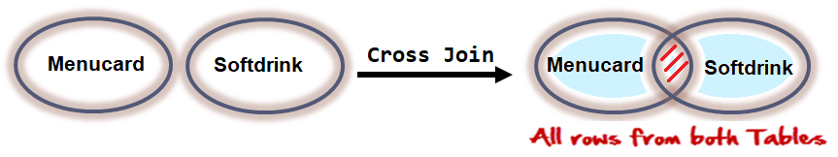
JOINS - Cartesian or Product
Cartesian or Product joins are joins without a join condition. Each row of one table is combined with each row of another table. The result is referred to as a Cartesian product.
SELECT column-list from <table_references>, <table_references>

Slide 225
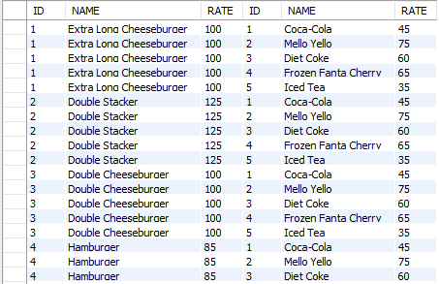
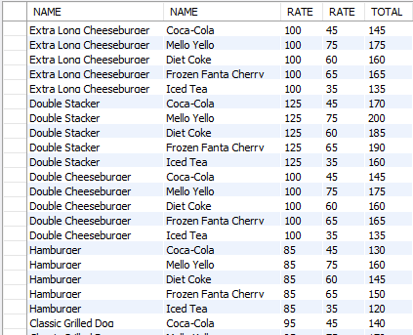
JOINS - Cartesian or Product
Cartesian or Product joins are joins without a join condition. Each row of one table is combined with each row of another table. The result is referred to as a Cartesian product.
SELECT column-list from <table_references>, <table_references>
SELECT * FROM MENUCARD, SOFTDRINK;
SELECT M.NAME, S.NAME, M.RATE, S.RATE, M.RATE + S.RATE AS "TOTAL" FROM MENUCARD M, SOFTDRINK S;

Slide 226

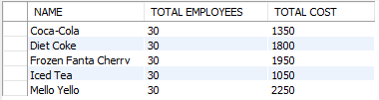
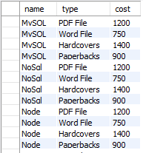
JOINS - Cartesian or Product
SELECT NAME, COUNT(*) "TOTAL EMPLOYEES", RATE * COUNT(*) "TOTAL COST" FROM N2EMPLOYEE, SOFTDRINK GROUP BY NAME;
SELECT NAME, TYPE, COST FROM BOOK, AVAILABLEIN;

Slide 227
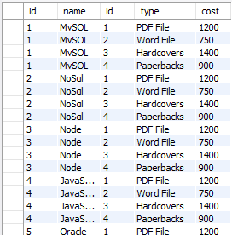
JOINS – Cross Join
The CROSS JOIN produced a result set which is the product of rows of two associated tables when no WHERE clause is used with CROSS JOIN. In this join, the result set appeared by multiplying each row of the first table with all rows in the second table if no condition introduced with CROSS JOIN.
SELECT column-list from <table_references> CROSS JOIN <table_references>
SELECT * FROM BOOK CROSS JOIN AVAILABLEIN;

Slide 228
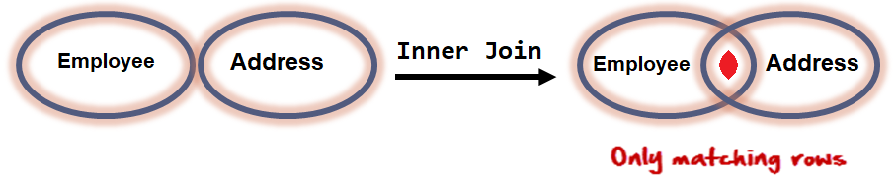
JOINS – equi join
EQUI JOIN performs a JOIN against equality or matching column(s) values of the associated tables. An equal sign (=) is used as comparison operator in the where clause to refer equality.
SELECT column-list from <table_references>, <table_references> WHERE table1.column-name = table2.column-name

Slide 229
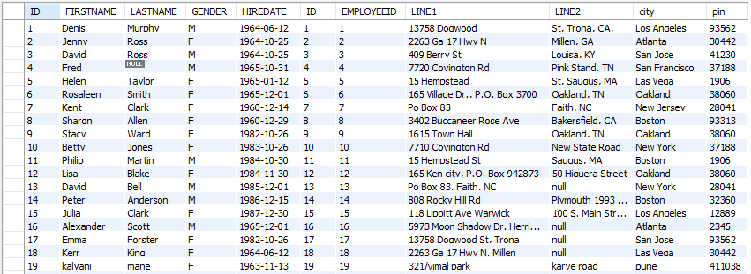
JOINS – equi join
EQUI JOIN performs a JOIN against equality or matching column(s) values of the associated tables. An equal sign (=) is used as comparison operator in the where clause to refer equality.
SELECT column-list from <table_references>, <table_references> WHERE table1.column-name = table2.column-name
SELECT * FROM EMPLOYEE E, ADDRESS A WHERE E.ID = A.EMPLOYEEID;

Slide 230
Display how many employees are working from every department?
Display the department name where less the 3 employees are working?

Slide 231
ON Contrition
When this join condition gets applied none of the columns of the relation will get eliminated in the result set.
In order to apply this join condition, on any two tables they need not to have any common column.
ON condition and USING Attribute
USING Attribute Contrition
When all the common columns are used in the join predicate then the result would be same as Natural join.
In the result set of the join the duplicates of the columns used in the predicate gets eliminated.

Slide 232

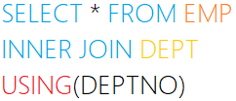
JOINS – USING & ON clause
The ON clause
The ON clause is used to join tables where the column names don’t match in both tables.
JOINING CONDITION
The USING clause
The USING clause is used if several columns share the same name but you don’t want to join using all of these common columns. The columns listed in the USING clause can’t have any qualifiers in the statement.
JOINING CONDITION

Slide 233
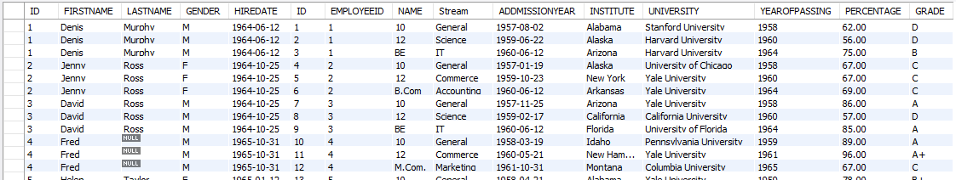

JOINS – Inner Join
Inner join returns rows when there is at least one match in both tables.
The INNER JOIN selects all rows from both participating tables as long as there is a match between the columns. An SQL INNER JOIN is same as JOIN clause, combining rows from two or more tables.
SELECT column-list from <table_references> [INNER] JOIN <table_references> ON table1.column-name = table2.column-name
SELECT * FROM EMPLOYEE E INNER JOIN QUALIFICATION Q ON E.ID = Q.EMPLOYEEID;

Slide 234
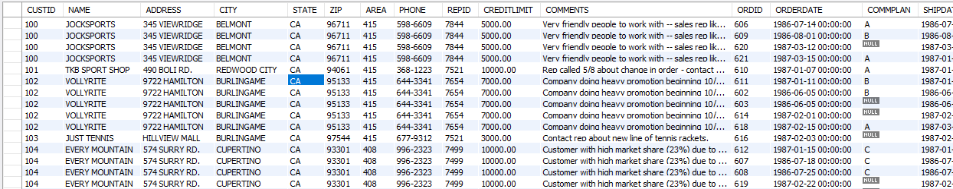
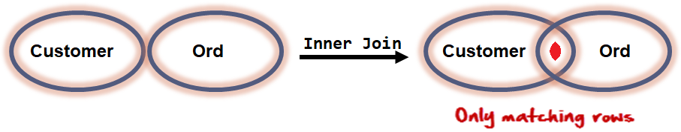
JOINS – Inner Join
Inner join returns rows when there is at least one match in both tables.
The INNER JOIN selects all rows from both participating tables as long as there is a match between the columns. An SQL INNER JOIN is same as JOIN clause, combining rows from two or more tables.
SELECT column-list from <table_references> [INNER] JOIN <table_references> USING (column-name)
SELECT * FROM CUSTOMER INNER JOIN ORD USING (CUSTID);

Slide 235

JOINS – Natural Join
Joins two tables based on common column names. Hence one must confirm the common columns before using a NATURAL JOIN
The NATURAL JOIN is such a join that performs the same task as an INNER JOIN.
SELECT column-list from <table_references> NATURAL JOIN <table_references> NATURAL JOIN <table_references>
SELECT * FROM EMP NATURAL JOIN DEPT
The associated tables have one or more pairs of identically column-names.
The columns must be of the same name and data type.
Don't use ON / USING clause in a NATURAL JOIN.
When this join condition gets applied always the duplicates of the common columns get eliminated from the result.
A NATURAL JOIN can be used with a LEFT OUTER join, or a RIGHT OUTER join.
If the column-names are not same, then NATURAL JOIN will work as CROSS JOIN.

Slide 236
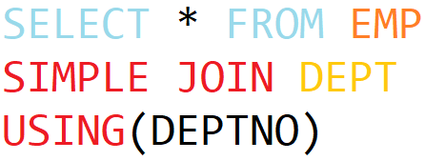
JOINS – Simple Join
The SIMPLE JOIN is such a join that performs the same task as an INNER JOIN.
SELECT column-list from <table_references> SIMPLE JOIN <table_references> USING (column-list)
SELECT * FROM EMP SIMPLE JOIN DEPT USING(DEPTNO)
JOINING CONDITION

Slide 237
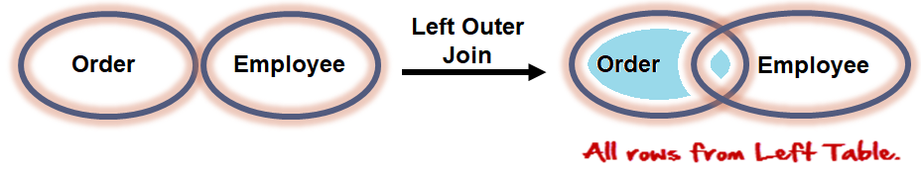
JOINS – Left Outer Join
The LEFT JOIN keyword returns all rows from the left table (table1), with the matching rows in the right table (table2). The result is NULL in the right side when there is no match.
SELECT column-list from <table_references> LEFT [OUTER ] JOIN <table_references> ON table1.column-name = table2.column-name

Slide 238
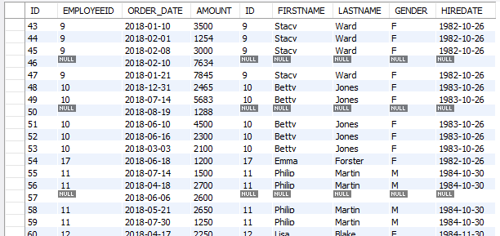
JOINS – Left Outer Join
SELECT * FROM ORDER O LEFT OUTER JOIN EMPLOYEE E ON E.ID = O.EMPLOYEEID;

Slide 239
JOINS – Left Outer Join
The LEFT JOIN keyword returns all rows from the left table (table1), with the matching rows in the right table (table2). The result is NULL in the right side when there is no match.
SELECT column-list from <table_references> LEFT [OUTER ] JOIN <table_references> USING (column-name)
SELECT * FROM EMP LEFT OUTER JOIN DEPT USING(DEPTNO);
SELECT column-list from <table_references> NATURAL LEFT [OUTER ] JOIN <table_references>
SELECT * FROM EMP NATURAL LEFT OUTER JOIN DEPT;

Slide 240

JOINS – Right Outer Join
The RIGHT JOIN keyword returns all rows from the right table (table2), with the matching rows in the left table (table1). The result is NULL in the left side when there is no match.
SELECT column-list from <table_references> RIGHT [OUTER ] JOIN <table_references> ON table1.column-name = table2.column-name

Slide 241
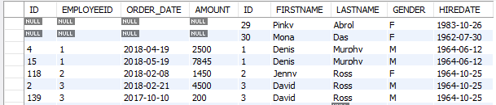
JOINS – Right Outer Join
SELECT * FROM ORDER RIGHT OUTER JOIN EMPLOYEE ON ON E.ID = O.EMPLOYEEID;

Slide 242
JOINS – Right Outer Join
The RIGHT JOIN keyword returns all rows from the right table (table2), with the matching rows in the left table (table1). The result is NULL in the left side when there is no match.
SELECT column-list from <table_references> RIGHT [OUTER ] JOIN <table_references> USING (column-name)
SELECT * FROM EMP RIGHT OUTER JOIN DEPT USING(DEPTNO);
SELECT column-list from <table_references> NATURAL RIGHT [OUTER ] JOIN <table_references>
SELECT * FROM EMP NATURAL RIGHT OUTER JOIN DEPT;

Slide 243
JOINS – Self Join
A SELF JOIN is a join in which a table is joined with itself (which is also called Unary relationships), especially when the table has a FOREIGN KEY which references its own PRIMARY KEY.
SELECT a.column_name, b.column_name... FROM table1 a, table1 b WHERE a.common_name = b.common_name;

Slide 244
Class Room
Session 10

Slide 245
Topics to be covered
Set Operators
  UNION
  UNION ALL
  INTERSECT
  MINUS

Slide 246


UNION: To apply ORDER BY or LIMIT to an individual SELECT, place the clause inside the parentheses that enclose the SELECT.
E.g. (SELECT …) UNION (SELECT …)
Set Operation in SQL

Slide 247
UNION
The UNION operator is used to combine the result sets of 2 or more SELECT statements. It removes duplicate rows between the various SELECT statements. Each SELECT statement within the UNION operator must have the same number of fields in the result sets.
The default behaviour for UNION is that duplicate rows are removed from the result.
SELECT ... UNION [ALL | DISTINCT] SELECT ... [UNION [ALL | DISTINCT] SELECT ...]
(SELECT DEPTNO FROM EMP LIMIT 1) UNION (SELECT DEPTNO FROM DEPT LIMIT 1);
SELECT 'EMP' as 'Table Name', count(*) FROM EMP UNION SELECT 'DEPT', count(*) FROM DEPT UNION SELECT 'BONUS', count(*) FROM BONUS;

Slide 248

UNION
SELECT * FROM OLDBOOK UNION SELECT * FROM NEWBOOK;
OldBook
ID | NAME
1 | MySQL
2 | hBase
3 | Oracle
4 | C++
4 | C++
NewBook
ID | NAME
1 | JavaScript
2 | hBase
3 | Redis
Result
ID | NAME
1 | MySQL
2 | hBase
3 | Oracle
4 | C++
1 | JavaScript
3 | Redis
UNION
=

Slide 249

UNION ALL
SELECT * FROM OLDBOOK UNION ALL SELECT * FROM NEWBOOK;
OldBook
ID | NAME
1 | MySQL
2 | hBase
3 | Oracle
4 | C++
4 | C++
NewBook
ID | NAME
1 | JavaScript
2 | hBase
3 | Redis
Result
ID | NAME
1 | MySQL
2 | hBase
3 | Oracle
4 | C++
4 | C++
1 | JavaScript
2 | hBase
3 | Redis
=
UNION ALL

Slide 250
INTERSECT
An INTERSECT query returns the intersection of 2 or more datasets. If a record exists in both data sets, it will be included in the INTERSECT results.
There is no INTERSECT operator in MySQL, you can easily simulate this type of query using either the IN clause or the EXISTS clause.
SELECT * FROM OLDBOOK O WHERE EXISTS (SELECT * FROM NEWBOOK N WHERE O.ID = N.ID AND O.NAME = N.NAME);
OldBook
ID | NAME
1 | MySQL
2 | hBase
3 | Oracle
4 | C++
4 | C++
NewBook
ID | NAME
1 | JavaScript
2 | hBase
3 | Redis
Result
ID | NAME
2 | hBase
=
INTERSECT

Slide 251
MINUS
The MINUS operator takes the distinct rows of one query and returns the rows that do not appear in a second result set.
There is no MINUS operator in MySQL, you can easily simulate this type of query using either the NOT IN clause or the NOT EXISTS clause.
SELECT * FROM OLDBOOK O WHERE NOT EXISTS (SELECT * FROM NEWBOOK N WHERE O.ID = N.ID AND O.NAME = N.NAME);
SELECT * FROM NEWBOOK N WHERE NOT EXISTS (SELECT * FROM OLDBOOK O WHERE O.ID = N.ID AND O.NAME = N.NAME);
OldBook
ID | NAME
1 | MySQL
2 | hBase
3 | Oracle
4 | C++
4 | C++
NewBook
ID | NAME
1 | JavaScript
2 | hBase
3 | Redis
Result
ID | NAME
1 | MySQL
3 | Oracle
4 | C++
4 | C++
MINUS
=
Result
ID | NAME
1 | JavaScript
3 | Redis
=

Slide 252
Class Room
Session 11

Slide 253
Class Room
Topics to be covered
Sub Queries - With select, update, insert and delete statements

Slide 254
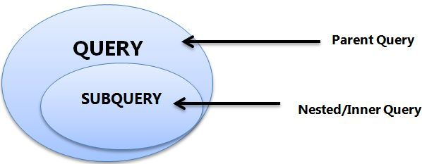
- A subquery must be enclosed in parentheses.
- Use single-row operators with single-row subqueries, and use multiple-row operators with multiple-row subqueries.
- If a subquery (inner query) returns a null value to the outer query, the outer query will not return any rows when using certain comparison operators in a WHERE clause.
Sub-Queries
You may use comparison operators such as <>, <, >, <=, and >= with a single row subquery.
Multiple row subquery returns one or more rows to the outer SQL statement. You may use the IN, ANY, or ALL operator in outer query to handle a subquery that returns multiple rows.

Slide 255
If ORDER BY occurs within a subquery and also is applied in the outer query, the outermost ORDER BY takes precedence.
(SELECT ... ORDER BY a) ORDER BY a DESC;
If LIMIT occurs within a subquery and also is applied in the outer query, the outermost LIMIT takes precedence.
(SELECT ... LIMIT 1) LIMIT 2;
Sub-Queries

Slide 256

Single Row Subqueries
A single row subquery returns zero or one row to the outer SQL statement. You can place a subquery in a WHERE clause, a HAVING clause, or a FROM clause of a SELECT statement.
Outer Query
Subquery or Inner query

Slide 257

Multiple Row and Column Subqueries
A multiple row subquery returns one or more rows to the outer SQL statement. You may use the IN, ANY, or ALL operator in outer query to handle a subquery that returns multiple rows.
Outer Query
Subquery or Inner query

Slide 258
Subqueries
A subquery is a SELECT statement within another statement.
A subquery may occur in:
A SELECT clause
A FROM clause
A WHERE clause
A HAVING clause
A subquery's outer statement can be any one of: SELECT, INSERT, UPDATE, DELETE, SET, or DO.

Slide 259

Subqueries with INSERT
syntax
INSERT INTO table_name [ (column1 [, column2 ]) ]
SELECT [ *|column1 [, column2 ] FROM table1 [, table2 ]
[ WHERE VALUE OPERATOR ];

Slide 260
Subqueries with UPDATE
syntax
UPDATE table_name SET column_name = new_value [ WHERE OPERATOR [ VALUE ] (SELECT column_name FROM table_name) [ WHERE) ]

Slide 261
Subqueries with DELETE
syntax
DELETE FROM table_name [ WHERE OPERATOR [ VALUE ]
(SELECT column_name FROM table_name) [ WHERE) ]

Slide 262
Types of Subqueries
The Subquery as Scalar Operand – SELECT clause
Comparisons using Subqueries – Single row subquery (to give in where or in having clause)
Subqueries in the FROM Clause – Inline Views /
Subqueries with ALL, ANY, IN, or SOME – Multiple row subquery (to give in where clause or having clause)
Row Subqueries
Subqueries with EXISTS or NOT EXISTS
Correlated Subqueries

Slide 263
The Subquery as Scalar Operand

Slide 264
The Subquery as Scalar Operand
A scalar subquery is a subquery that returns exactly one column value from one row. A scalar subquery is a simple operand, and you can use it almost anywhere a single column value is legal.
If the subquery returns 0 rows then the value of scalar subquery expression is NULL.
if the subquery returns more than one row then MySQL returns an ERROR.
SELECT (SELECT 1, 2) ; // error
SELECT (SELECT ename, sal FROM EMP); // error
SELECT (SELECT * FROM EMP); // error
SELECT (SELECT NULL + 1);
SELECT ENAME, (SELECT DNAME FROM DEPT WHERE EMP.DEPTNO = DEPT.DEPTNO) R1 FROM EMP ;

Slide 265


The Subquery as Scalar Operand
SELECT (SELECT STDPRICE FROM PRICE WHERE PRODID = 100890 AND ENDDATE IS NOT NULL) "STANDARD PRICE", (SELECT MINPRICE FROM PRICE WHERE PRODID = 100890 AND ENDDATE IS NOT NULL) AS "MINIMUM PRICE";
SELECT (SELECT STDPRICE FROM PRICE WHERE PRODID = 100890 AND ENDDATE IS NOT NULL) - (SELECT MINPRICE FROM PRICE WHERE PRODID = 100890 AND ENDDATE IS NOT NULL) AS "PRICE DIFFERENCE";

Slide 266
Comparisons using Subquery

Slide 267
Comparisons using Subqueries
A subquery can be used before or after any of the comparison operators. The subquery can return at most one value. The value can be the result of an arithmetic expression or a column function. SQL then compares the value with the value on the other side of the comparison operator.
SELECT * FROM EMP where deptno = (SELECT deptno FROM DEPT where deptno in (10, 20));
SELECT * FROM EMP WHERE DEPTNO = (SELECT 5 + 5);
SELECT * FROM EMP WHERE SAL = (SELECT MAX(SAL) FROM EMP);
Comparison Functions and Operators
= | Equal operator
> | Greater than operator
>= | Greater than or equal operator
< | Less than operator
<= | Less than or equal operator
!=, <> | Not equal operator
<=> | NULL-safe equal to operator

Slide 268

Comparisons using Subqueries
movie : (movieid, name, release_date)
actor : (actorid, name)
actor_movie : (actorid, movieid)
Actor
Movie
Movie _Actor
SELECT A.ACTORID, A.NAME FROM ACTOR A, ACTOR_MOVIE AM WHERE A.ACTORID = AM.ACTORID GROUP BY AM.ACTORID HAVING COUNT(*) = (SELECT MAX(R1) FROM (SELECT COUNT(*) R1 FROM ACTOR_MOVIE GROUP BY ACTORID) M);

Slide 269
Subquery in the FROM Clause

Slide 270

Subqueries in the FROM Clause
Subqueries work in a SELECT statement's FROM clause.
SELECT ... FROM (subquery) [AS] name ...
Every table in a FROM clause must have a name, therefore the [AS] name clause is mandatory.
SET @x :=0;
SELECT * FROM (SELECT @x := @x + 1 as R1, EMP.* FROM EMP) E
WHERE R1 = 5;
SELECT * FROM (SELECT @cnt := @cnt + 1 R1, mod(@cnt,2) R2, EMP.* FROM EMP, (SELECT @cnt:=0) E ) E1 WHERE R2 = 0;
SELECT MIN(R1) FROM (SELECT COUNT(JOB) R1 FROM EMP GROUP BY JOB) E;
SELECT MAX(R1) FROM (SELECT COUNT(*) R1 FROM ACTOR_MOVIE GROUP BY ACTORID) M

Slide 271
When used with a subquery, the word IN is an alias for = ANY.
NOT IN is not an alias for <> ANY, but for <> ALL.
Subquery with IN, ALL, ANY, or SOME

Slide 272
Subqueries with IN, ALL, ANY, or SOME
operand comparison_operator ANY (subquery)
operand IN (subquery)
operand comparison_operator SOME (subquery)
operand comparison_operator ALL (subquery)
The word SOME is an alias for ANY.
The ANY keyword, which must follow a comparison operator, means return TRUE if the comparison is TRUE for ANY of the values in the column that the subquery returns.
The word ALL, which must follow a comparison operator, means return TRUE if the comparison is TRUE for ALL of the values in the column that the subquery returns.
IN and =ANY are not synonyms when used with an expression list. IN can take an expression list, but = ANY cannot.
SELECT * FROM EMP WHERE DEPTNO IN (5+5, 10+10)
SELECT * FROM EMP WHERE DEPTNO =ANY (10, 20) //error

Slide 273
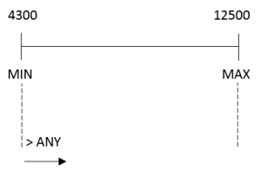
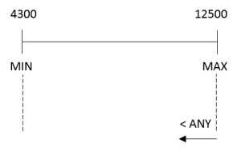
any / some
"x = ANY (...)": The value must match one or more values in the list to evaluate to TRUE.
"x != ANY (...)": The value must not match one or more values in the list to evaluate to TRUE.
"x > ANY (...)": The value must be greater than the smallest value in the list to evaluate to TRUE.
"x < ANY (...)": The value must be smaller than the biggest value in the list to evaluate to TRUE.
"x >= ANY (...)": The value must be greater than or equal to the smallest value in the list to evaluate to TRUE.
"x <= ANY (...)": The value must be smaller than or equal to the biggest value in the list to evaluate to TRUE.

Slide 274
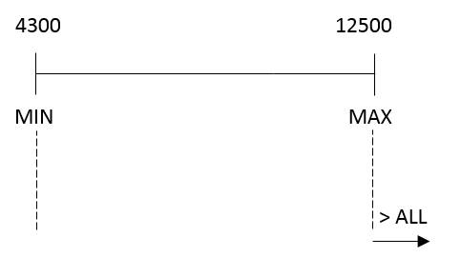
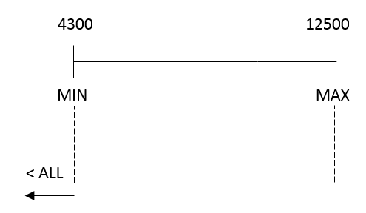
all
"x = ALL (...)": The value must match all the values in the list to evaluate to TRUE.
"x != ALL (...)": The value must not match any values in the list to evaluate to TRUE.
"x > ALL (...)": The value must be greater than the biggest value in the list to evaluate to TRUE.
"x < ALL (...)": The value must be smaller than the smallest value in the list to evaluate to TRUE.
"x >= ALL (...)": The value must be greater than or equal to the biggest value in the list to evaluate to TRUE.
"x <= ALL (...)": The value must be smaller than or equal to the smallest value in the list to evaluate to TRUE.

Slide 275
all
empty table
The expression is TRUE, if table T2 is empty.
SELECT * FROM EMP WHERE DEPTNO >ALL (SELECT C1 FROM T2) // This statement will return all rows from EMP table.

Slide 276
Subqueries with IN, ALL, ANY, or SOME
You can use a subquery after a comparison operator, followed by the keyword IN, ALL, ANY, or SOME.
SELECT * FROM EMP WHERE DEPTNO IN (SELECT DEPTNO FROM EMP WHERE DEPTNO = 10 or DEPTNO = 20);
SELECT * FROM EMP WHERE SAL >ALL (SELECT SAL FROM EMP WHERE ENAME = 'ADAMS' or ENAME = 'TURNER');
SELECT * FROM EMP WHERE SAL >ANY (SELECT SAL FROM EMP WHERE ENAME = 'ADAMS' or ENAME = 'TURNER');
SELECT * FROM EMP WHERE SAL >SOME (SELECT SAL FROM EMP WHERE ENAME = 'ADAMS' or ENAME = 'TURNER');

Slide 277
Row Subquery

Slide 278
Row Subqueries
Scalar or column Subqueries return a single value or a column of values. A row subquery is a subquery variant that returns a single row and can thus return more than one column value. You can use = , >, <, >=, <=, <>, !=, <=>
SELECT * from EMP where deptno, 1 = (SELECT deptno, 1 from DEPT where deptno=10);
SELECT * FROM EMP WHERE ROW (DEPTNO, 1) = (SELECT DEPTNO, 1 FROM DEPT WHERE DEPTNO = 10);

Slide 279
Subquery with EXISTS or NOT EXISTS

Slide 280
Subqueries with EXISTS or NOT EXISTS
The EXISTS operator tests for the existence of rows in the results set of the subquery. If a subquery row value is found, EXISTS subquery is TRUE and in this case NOT EXISTS subquery is FALSE.
SELECT * FROM EMP WHERE EXISTS (SELECT * FROM DEPT WHERE EMP.DEPTNO = DEPT.DEPTNO);
SELECT * FROM EMP WHERE NOT EXISTS (SELECT DEPTNO FROM EMP WHERE EMP.DEPTNO = DEPT.DEPTNO);
SELECT * FROM EMP M WHERE EXISTS (SELECT * FROM EMP E WHERE E.MGR = M.EMPNO);
SELECT * FROM EMP M WHERE NOT EXISTS (SELECT * FROM EMP E WHERE E.MGR = M.EMPNO);

Slide 281
Correlated Subquery

Slide 282
Correlated Subqueries
A correlated subquery (also known as a synchronized subquery) is a subquery that uses values from the outer query. The subquery is evaluated once for each row processed by the outer query.
Following query find all employees who earn more than the average salary in their department.
SELECT * FROM EMP E WHERE SAL > (SELECT AVG(SAL) FROM EMP WHERE E.DEPTNO = EMP.DEPTNO) ORDER BY DEPTNO;
SELECT ENAME, SAL, JOB FROM EMP WHERE SAL > (SELECT AVG(SAL) FROM EMP E WHERE E.JOB = EMP.JOB);
SELECT JOB, MAX(SAL) FROM EMP WHERE SAL < (SELECT MAX(SAL) FROM EMP E WHERE EMP.JOB = E.JOB GROUP BY E.JOB) GROUP BY JOB;
SELECT DISTINCTROW DEPTNO FROM EMP WHERE EXISTS (SELECT DEPTNO FROM DEPT WHERE EMP.DEPTNO = DEPT.DEPTNO); (Intersect)
SELECT DISTINCTROW DEPTNO FROM DEPT WHERE NOT EXISTS (SELECT DEPTNO FROM EMP WHERE EMP.DEPTNO = DEPT.DEPTNO);

Slide 283
Commit and Rollback

Slide 284
Commit and Rollback
To undo MySQL statements you use the ROLLBACK statement. To write the changes into the database within a transaction, you use the COMMIT statement.
START TRANSACTION
[transaction_characteristic]
transaction_characteristic:
| READ WRITE
| READ ONLY
It is important to note that MySQL automatically commits the changes to the database by default.
START TRANSACTION READ ONLY;
INSERT DEPT values (60, 'HRD', 'Pune' );
COMMIT

Slide 285
Commit and Rollback
To undo MySQL statements you use the ROLLBACK statement. To write the changes into the database within a transaction, you use the COMMIT statement.
BEGIN [WORK]
COMMIT [WORK]
ROLLBACK [WORK]
SET autocommit = {0 | 1}
It is important to note that MySQL automatically commits the changes to the database by default.
BEGIN WORK
INSERT DEPT VALUES (60, 'HRD', 'Pune' );
COMMIT WORK
SET autocommit = {0 | 1} 0 - disable; 1 - enable
SELECT @@AUTOCOMMIT;

Slide 286
Theory session

Slide 287
What is Relation and Relationship?

Slide 288
What is Relation and Relationship?
Relation ("R"): In Database, a relation represents a table or an entity than contain attributes.
Relationship: In database, relationship is that how the two entities are connected to each other, i.e. what kind of relationship type they hold between them.
Primary/Foreign key is used to specify this relationship.

Slide 289
properties of relational table
ID | firstName
1 | Saleel Bagde
2 | Sharmin
3 | Vrushali
4 | Ruhan
Relational tables have six properties:
Values are atomic.
Column values are of the same kind.
Each row is unique.
The sequence of columns is insignificant – (unimportant).
The sequence of rows is insignificant – (unimportant).
Each column must have a unique name.

Slide 290
What is Entity Relationship Diagram?

Slide 291
Entity Relationship Diagram (ER Diagram)
Use E-R model to get a high-level graphical view to describe the "ENTITIES" and their "RELATIONSHIP"

Slide 292
Entity Relationship Diagram (ER Diagram)
The basic constructs of ER Model are
Entity, Attributes and Relationships.

Slide 293
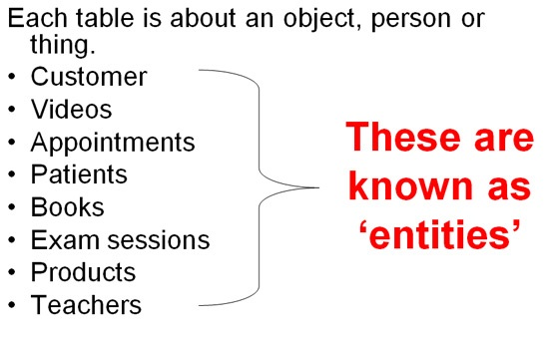
An entity can be a real-world object.
What is Entity?

Slide 294
Entity
In relation to a database , an entity is a person, place, or thing about which data can be stored.
e.g., in a school database, students, teachers, classes, and courses can be considered as entities.
All these entities have some attributes or properties that give them their identity.
Every entity has its own characteristics.

Slide 295

When you are designing attributes for your entities, you will sometimes find that an attribute does not have a value for every instance of the entity. For example, you might want an attribute for a person's middle name, but you can't require a value because some people have no middle name. For these occasions, you can define the attribute so that it can contain null values.
What is an Attribute?
Entity
In some cases, you might not want a specific attribute to contain a null value, but you don't want to require that the user or program always provide a value. In this case, a default value might be appropriate. A default value is a value that applies to an attribute if no other valid value is available.
Attribute

Slide 296
Attributes
A table has rows and columns
In RDBMS, a table organizes data in rows and columns. The COLUMNS are known as ATTRIBUTES / FIELDS whereas the ROWS are known as RECORDS / TUPLE.
In Relation: EMP
Attributes
SSN | EmployeeName | Job | Hiredate | Salary
1 | KING | PRESIDENT | 2017-02-15 | 5000
… | … | … | … | …
… | … | … | … | …
… | … | … | … | …
Rows

Slide 297
Attributes
In Entity Relationship(ER) Model attributes can be classified into the following types.
Simple/Atomic and Composite Attribute
Single Valued and Multi Valued attribute
Stored and Derived Attributes
Complex Attribute

Slide 298
Attributes
Simple / Atomic Attribute --VS-- Composite Attribute
(Can’t be divided further) (Can be divided further)
Single Value Attribute --VS-- Multi Valued Attribute
(Only One value) (Multiple values)
Stored Attribute --VS-- Derived Attribute
(Only One value) (Virtual)
Complex Attribute
(Composite & Multivalued)

Slide 299
Composite VS Multi Valued Attribute

Slide 300

Composite / Multi Valued Attributes
Composite Attribute
Person Entity
Name attribute: FirstName, MiddleName, and LastName
PhoneNumber attribute: CountryCode, CityCode, and PhoneNumber
Multi Valued Attribute
Person Entity
Hobbies attribute: reading, hiking, hockey, skiing, photography.
SpokenLanguages attribute: Hindi, Marathi, Gujarati, English.

Slide 301
What is an Prime, Non-Prime Attribute?

Slide 302
Attributes
Prime attribute
An attribute, which is a part of the prime-key, is known as a prime attribute.
Non-prime attribute
An attribute, which is not a part of the prime-key, is said to be a non-prime attribute.

Slide 303
Entity Relationship Diagram Symbols

Slide 304
Entity Relationship Diagram Symbols
Attribute
Composite Attribute
Key Attribute
Strong Entity
Weak Entity
Derived Attribute
Weak Relationship
Relationship
Multivalued Attribute

Slide 305
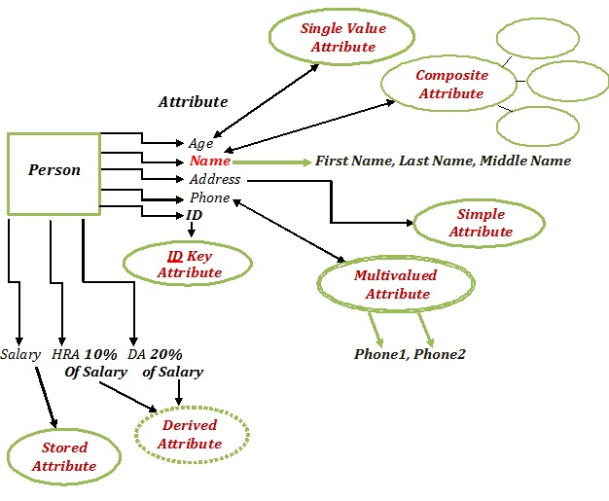
Entity Relationship Diagram

Slide 306
What is a degree, cardinality, domain, and union in database?
Degree d(R): Total no of attributes/columns present in a relation/table is called degree of the relation and is denoted by d(R).
Cardinality |R|: Total no if tuples present in a relation or Rows present in a table, is called cardinality of a relation and is denoted by |R|.
Domain: Total range of accepted values for an attribute of the relation is called the domain of the attribute. (Data Type)
Union Compatibility: Two relations R and S are set to be Union Compatible to each other if and only if:
  They have the same degree d(R).
  Domains of the respective attributes should also be same.

Slide 307
What is a domain constraint in database?
Domain Constraint = data type + Constraints (NOT NULL / UNIQUE / PRIMARY KEY / FOREIGN KEY / CHECK / DEFAULT)

Slide 308
Common relationships

Slide 309

Relationships - Binary
The three most common relationships in ER models are Binary, Unary, and Ternary
A binary relationship is when two entities participate and is the most common relationship.

Slide 310
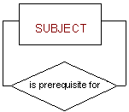
Relationships - Unary
The three most common relationships in ER models are Binary, Unary, and Ternary
A unary relationship is when both participants in the relationship are the same entity.

Slide 311
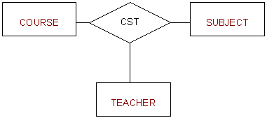
Relationships - Ternary
The three most common relationships in ER models are Binary, Unary, and Ternary
A ternary relationship is when three entities participate in the relationship.

Slide 312

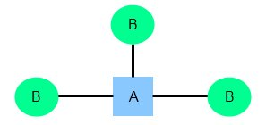
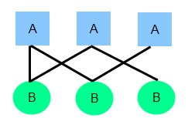
Relationships
There are three degrees of relationship
one-to-one (1:1)
one-to-many (1:M)
many-to-many (M:N)

Slide 313
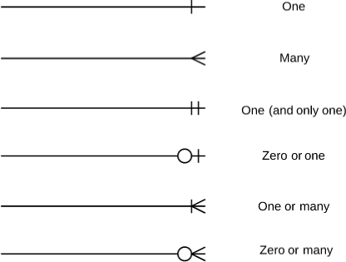
Relationships

Slide 314
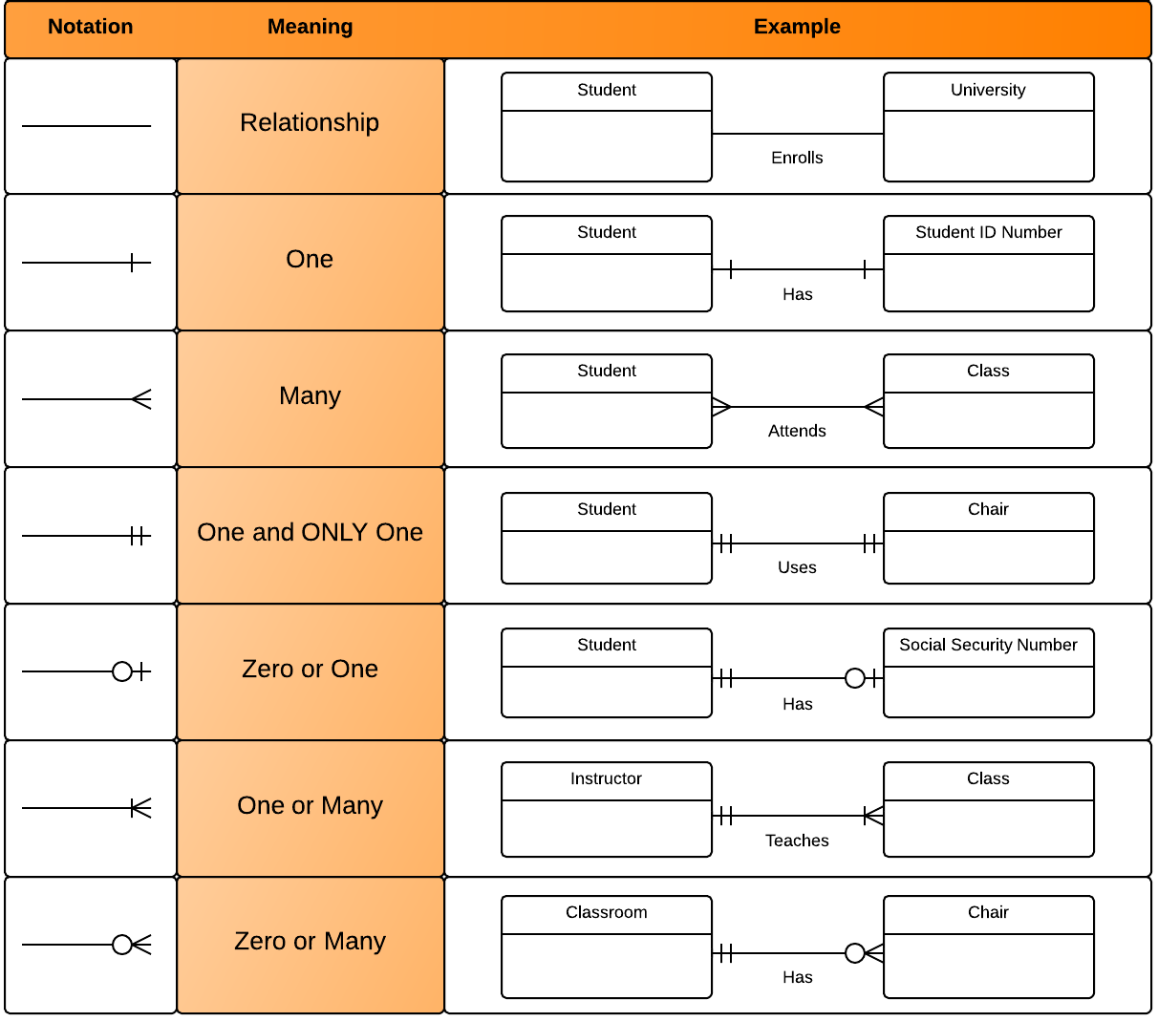
Relationships

Slide 315



one to one Relationships
The employee can manage only one department, and each department can be managed by one employee only.
personID
Name
DOB Gender
Nationality
passportID
personID (not null, unique, and foreign key)
passportNumber issueDate
expireDate

Slide 316

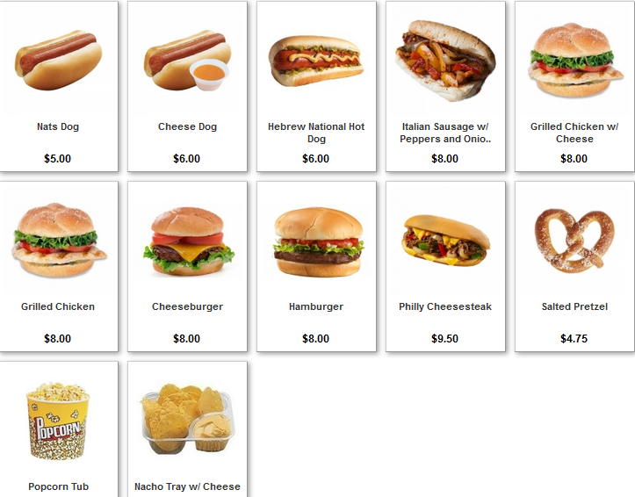
one to many Relationships
The customer may place many orders, but each order can be placed by one customer only.
personID
Name
DOB Gender
Nationality
orderID
personID (foreign key)
Name
Qty
OrderDate

Slide 317

many to one Relationships
The department may have many employees, but each employee can work only in one department.

Slide 318



many to many Relationships
One student may belong to more than one student organizations, and one organization can admit more than one student.

Slide 319
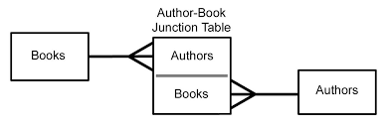
many to many Relationships

Slide 320

SQL commands

Slide 321
Comments in MySQL
From a # character to the end of the line.
From a -- sequence to the end of the line.
From a /* sequence to the following */ sequence.

Slide 322
Login to MySQL

Slide 323
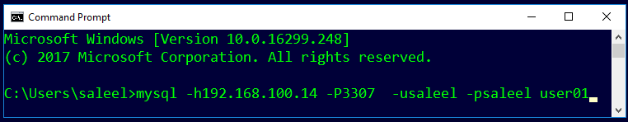
Login
Default port for MySQL Server: 3306
C:\> mysql –hstp5 –P3307 –usaleel –p user01
C:\> mysql –h192.168.100.14 –P3307 –usaleel –p user01
C:\> mysql –h192.168.100.14 –P3307 –usaleel –psaleel user01

Slide 324
Before MySQL version 5.5, MyISAM is the default storage engine when you create a table without specifying the storage engine explicitly. From version 5.5, MySQL uses InnoDB as the default storage engine.
A storage engine is a software module that a database management system uses to create, read, update data from a database. There are two types of storage engines in MySQL: transactional and non-transactional.
STORAGE ENGINES
When you create a table, MySQL creates a disk file that contains the table’s format (that is, its definition) . The format file has a basename that is the same name as the table name and an .frm extension.
Storage Engine | File on disk
MEMORY | Data is not stores on the disk
InnoDB | .idb (data and index)
MyISAM | MYD (data), .MYI (index)
CSV | .CSV (data), CSM (metadata)

Slide 325
SHOW ENGINES Syntax
For MySQL 5.5 and later, the default storage engine is InnoDB. The default storage engine for MySQL prior to version 5.5 was MyISAM.
SHOW [STORAGE] ENGINES
SHOW ENGINES displays status information about the server's storage engines. This is particularly useful for checking whether a storage engine is supported, or to see what the default engine is.
INFORMATION_SCHEMA.ENGINES
show engines;
show STORAGE engines;
INFORMATION_SCHEMA provides access to database metadata, information about the MySQL server such as the name of a database or table, the data type of a column, or access privileges.

Slide 326
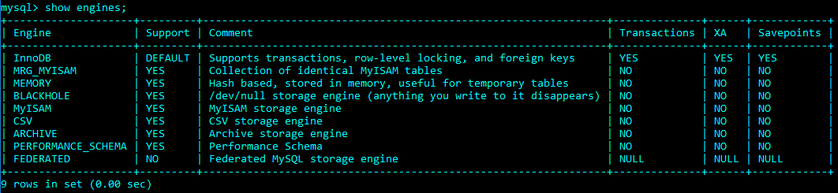
ENGINES
SET DEFAULT_STORAGE_ENGINE = InnoDB;

Slide 327
SHOW DATABASES

Slide 328
SHOW DATABASES Syntax
SHOW {DATABASES | SCHEMAS} [LIKE 'pattern' | WHERE expr]
SHOW SCHEMAS is a synonym for SHOW DATABASES.
SHOW DATABASES;
SHOW SCHEMAS;
SHOW DATABASES LIKE 'U%';
SHOW SCHEMAS LIKE 'U%';
NULL means “no database is selected”. Issue the USE dbName command to select the database.

Slide 329
USE DATABASES
The USE db_name statement tells MySQL to use the db_name database as the default (current) database for subsequent statements. The database remains the default until the end of the session or another USE statement is issued.

Slide 330
USE DATABASES Syntax
USE db_name
USE, does not require a semicolon.
USE must be followed by a database name.
USE db1
\U db1

Slide 331
Class Room
Session 4 & 21

Slide 332
Introduction
In relational database, is the process of organizing data to minimize redundancy. Normalization usually involves dividing a database into two or more tables and defining relationships between the tables.

Slide 333
Topics to be covered
Three Level Architecture of DBMS
  Physical Level
  Conceptual Level
  External Level
Need of Normalization
Introduction to Normalization
Types of Normalization
  First Normal Form
  Second Normal Form
  Third Normal Form

Slide 334
The three levels of database architecture

Slide 335
Physical Level
Physical Level
This is the lowest level in the three level architecture. It is also known as the internal level. The physical level describes how data is actually stored in the database. In the lowest level, data is stored in the external hard drives in the form of bits, it can be said that the data is stored in files and folders.

Slide 336
Conceptual Level
Conceptual Level
The conceptual level is at a higher level than the physical level. It is also known as the logical level. It describes how the database appears to the users conceptually and the relationships between various data tables. The conceptual level does not care for how the data in the database is actually stored.

Slide 337
External Level
External Level
This is the highest level in the three level architecture and closest to the user. It is also known as the view level. The external level only shows the relevant database content to the users in the form of views and hides the rest of the data. So different users can see the database as a different view as per their individual requirements.

Slide 338
What is Data Modeling?

Slide 339
Data Modeling
Data modeling is a process used to define and analyze data requirements needed to support the business processes within the scope of corresponding systems in organizations.
Data modeling involves a progression from conceptual model to logical model to physical object.

Slide 340
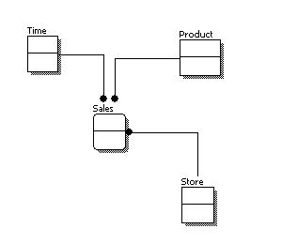
Conceptual Model Design
Features of conceptual data model include:
Includes the important entities and the relationships among them.
No attribute is specified.
No primary key is specified.

Slide 341
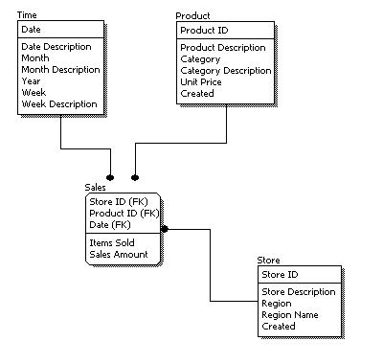
Logical Model Design
Features of logical data model include:
Includes all entities and relationships among them.
All attributes for each entity are specified.
The primary key for each entity is specified.
Foreign keys are specified.

Slide 342
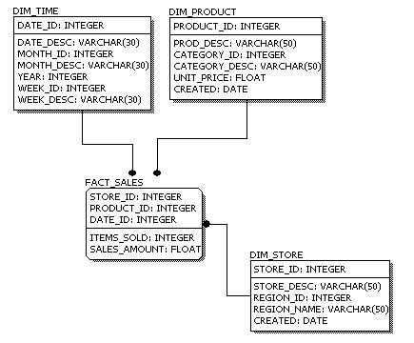
Physical Model Design
Features of physical data model include:
Convert entities into tables.
Convert relationships into foreign keys.
Convert attributes into columns.

Slide 343
Data Modeling
Feature | Conceptual | Logical | Physical
Entity Names | ✓ | ✓
Entity Relationships | ✓ | ✓
Attributes |  | ✓
Primary Keys |  | ✓ | ✓
Foreign Keys |  | ✓ | ✓
Table Names |  |  | ✓
Column Names |  |  | ✓
Column Data Types |  |  | ✓

Slide 344
Normalization in DBMS
Database Normalization is a technique that helps in designing the schema of the database in an optimal manner so as to ensure the above points. The core idea of database normalization is to divide the tables into smaller subtables and store pointers to data rather than replicating it.

Slide 345
Problem
To understand normalization in database with example tables, let’s assume that we are supposed to store the details of courses and instructors in a university.
Course code | Course venue | Instructor Name | Instructor’s phone number
CS101 | Lecture Hall 20 | Prof. George | +1 6514821924
CS152 | Lecture Hall 21 | Prof. Atkins | +1 6519272918
CS154 | CS Auditorium | Prof. George | +1 6514821924
At first, this design seems to be good. However, issues start to develop once we need to modify information. For instance, suppose, if Prof. George changed his mobile number. In such a situation, we will have to make edits in 2 places. What if someone just edited the mobile number against CS101, but forgot to edit it for CS154? This will lead to stale/wrong information in the database.

Slide 346
Solution
This problem, however, can be easily tackled by dividing our table into 2 simpler tables.
Table 1 (Instructor)
Instructor's ID | Instructor's name | Instructor's number
1 | Prof. George | +1 6514821924
2 | Prof. Atkins | +1 6519272918
Table 2 (Course)
Course code | Course venue | Instructor ID
CS101 | Lecture Hall 20 | 1
CS152 | Lecture Hall 21 | 2
CS154 | CS Auditorium | 1

Slide 347
First Normal Form (1NF)
The First normal form simply says that each cell of a table should contain exactly one value.
Instructor's name | Course code
Prof. George | (CS101, CS154)
Prof. Atkins | (CS152)
Here, the issue is that in the first row, we are storing 2 courses against Prof. George. A better method would be to store the courses separately. This way, if we want to edit some information related to CS101, we do not have to touch the data corresponding to CS154.
Instructor's name | Course code
Prof. George | CS101
Prof. George | CS154
Prof. Atkins | CS152

Slide 348
Second Normal Form (2NF)
For a table to be in second normal form, the following 2 conditions are to be met:
The table should be in the first normal form.
The primary key of the table should compose of exactly 1 column.
Let us take another example of storing student enrollment in various courses. Each student may enroll in multiple courses. Similarly, each course may have multiple enrollments.
A sample table may look like this (student name and course code)
Student name | Course code
Rahul | CS152
Rajat | CS101
Rahul | CS154
Raman | CS101

Slide 349
Second Normal Form (2NF)
The First normal form simply says that each cell of a table should contain exactly one value.
Table 1 (Student)
Student name | Enrolment number
Rahul | 1
Rajat | 2
Raman | 3
Table 2 (Courses)
Course code | Enrolment number
CS101 | 2
CS101 | 3
CS152 | 1
CS154 | 1

Slide 350
Third Normal Form (3NF)
Column A is said to be functionally dependent on column B if changing the value of A may require a change in the value of B.
Here, the department column is dependent on the professor name column. This is because if in a particular row, we change the name of the professor, we will also have to change the department value.
Course code | Course venue | Instructor's name | Department
MA214 | Lecture Hall 18 | Prof. Ronald | Mathematics Department
ME112 | Auditorium building | Prof. John | Electronics Department
MA215 | Lecture Hall 19 | Prof. Ronald | Mathematics Department

Slide 351
Third Normal Form (3NF)
Here, when we changed the name of the professor, we also had to change the department column. This is not desirable since someone who is updating the database may remember to change the name of the professor, but may forget updating the department value. This can cause inconsistency in the database.
Third normal form avoids this by breaking this into separate tables
Course code | Course venue | Instructor's ID
MA214 | Lecture Hall 18 | 1
ME112 | Auditorium building, | 2
MA215 | Lecture Hall 19 | 1
Here, the third column is the ID of the professor who’s taking the course.
Instructor's ID | Instructor's Name | Department
1 | Prof. Ronald | Mathematics Department
2 | Prof. John | Electronics Department

Slide 352
Third Normal Form (3NF)
Therefore, in the third normal form, the following conditions are required:
The table should be in the second normal form.
There should not be any functional dependency.

Slide 353
If this is the data the convert in in 3NF
Business Rules.
A salesman can sale one or many products.
A salesman can sale a product in one or many regions.
A product can be sold in one or may regions.
Salesman Name | Region1 | Region2 | Region3 | Region4
Saleel | Car, Bus | Car, Bus, Cycle | Cycle, Motorcycle | Car
Rahul | Shirt, Pant, Gloves | Gloves, Book, Pencil | Pencil, Notebook | Keyboard, Mouse
Omkar | Keyboard, Mouse | Pen Drives, CD | Monitors, Scanners | Scanner, CD
Ninad | Photos, Photo Frames | Shirt, Pants, Gloves | Cycle, Motorcycle | Bus, Cycle, Car

Slide 354
Class Room
Session 13, 14, 16

Slide 355
Topics to be covered
Introduction to MYSQL Programming
Cursor
Stored Procedures
Functions
Exceptions

Slide 356
PL/SQL
PL/SQL is a procedural language extension to Structured Query Language (SQL). The purpose of PL/SQL is to combine database language and procedural programming language.

Slide 357
CREATE PROCEDURE and CREATE FUNCTION

Slide 358
Stored Procedure and Function
These statements create stored routines. By default, a routine is associated with the default database. To associate the routine explicitly with a given database, specify the name as db_name.sp_name when you create it.
desc mysql.proc
CREATE PROCEDURE sp_name ([proc_parameter[,...]])
proc_parameter:
[ IN | OUT | INOUT ] param_name type
CREATE FUNCTION sp_name ([func_parameter[,...]])
RETURNS type
SELECT * FROM information_schema.parameters
WHERE SPECIFIC_NAME = 'pro1';
DROP PROCEDURE IF EXISTS MyProcedure;
delimiter $$
CREATE PROCEDURE MyProcedure()
begin
SELECT 'Infoway Technologies, Pune';
end $$
delimiter ;

Slide 359
A parameter is a variable in a method definition. When a method is called, the arguments are the data you pass into the method's parameters. Parameter is variable in the declaration of function. Argument is the actual value of this variable that gets passed to function.
Difference between arguments and parameters?
Parameter is variable in the declaration of procedure or a function.
Argument is the actual value of this variable that gets passed to a procedure or a function.

Slide 360
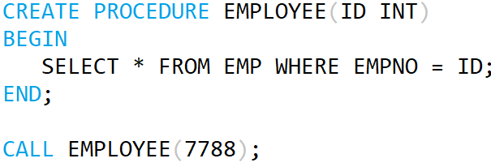
Stored Procedure and Function
Parameter List
Argument List

Slide 361
Difference between Stored Procedure and Function?

Slide 362
Stored Procedure and Function
A FUNCTION always returns a value using the return statement. PROCEDURE may return one or more values through OUT parameter(s) or may not return any at all.
Functions are normally used for computations where as procedures are normally used for executing business logic.
A Function returns 1 value only. Procedure can return multiple values (max 1024).
A function can be called directly by SQL statement like select func_name from dual while procedures cannot.
The major difference is that UDFs can be used like any other expression within SQL statements, whereas stored procedures must be invoked using the CALL statement.

Slide 363
Calling Procedure from Function and contrariwise
drop FUNCTION if exists F1;
delimiter $$
create FUNCTION F1() returns varchar(100)
begin
declare x varchar(100) default 'Hello World';
# select "Hello World";
call p1(x);
return x;
end$$
delimiter ;
drop PROCEDURE if exists P1;
delimiter $$
create PROCEDURE P1(out para1 varchar(100))
begin
# select "Hello World123";
select "Hello World123" into para1;
end$$
delimiter ;
// ERROR 1415 (0A000): Not allowed to
return a result set from a function
// ERROR 1415 (0A000): Not allowed to
return a result set from a function
This will work

Slide 364
SOURCE and CALL Stored Procedure

Slide 365
SOURCE and CALL Stored Procedure
If you are already running mysql, you can execute an SQL script file using the source command or \. command
source file_name.sql
\. file_name.sql
MySQL> source pl1.sql;
MySQL> \. file_name.sql;
The CALL statement invokes a stored procedure that was defined previously with CREATE PROCEDURE. Stored procedures that take no arguments can be invoked without parentheses. That is, CALL sp_name and CALL sp_name() are equivalent.
CALL sp_name([parameter[,...]])
CALL sp_name[()]
MySQL> call sp_name;
MySQL> call sp_name();

Slide 366
By default, mysql itself recognizes the semicolon as a statement delimiter, so you must redefine the delimiter temporarily to cause mysql to pass the entire stored program definition to the server. To redefine the mysql delimiter, use the delimiter command.
DELIMITER - Statement

Slide 367
A compound statement is a block that can contain other blocks; declarations for variables, condition handlers, and cursors; and flow control constructs such as loops and conditional tests.
BEGIN ... END Compound-Statement

Slide 368
BEGIN ... END
BEGIN ... END syntax is used for writing compound statements, which can appear within stored programs (stored procedures and functions, triggers, and events). A compound statement can contain multiple statements, enclosed by the BEGIN and END keywords. statement_list represents a list of one or more statements, each terminated by a semicolon (;) statement delimiter. The statement_list itself is optional, so the empty compound statement (BEGIN END) is legal.
[begin_label:] BEGIN
[statement_list]
END [end_label]

Slide 369
Declaring variables
DECLARE variable_name datatype(size) DEFAULT default_value;
Assigning variables
DECLARE is permitted only inside a BEGIN ... END compound statement and must be at its start, before any other statements.
1 2 | DECLARE z INT DEFAULT 0; SET z = 10;
DECLARE VARIABLES
First, you specify the variable name after the DECLARE keyword. The variable name must follow the naming rules of MySQL table column names.
Second, you specify the data type of the variable and its size. A variable can have any MySQL data types such as INT, VARCHAR , and DATETIME.
Third, when you declare a variable, its initial value is NULL. You can assign the variable a default value using the DEFAULT keyword.

Slide 370
Local Variable DECLARE and User-Defined Variables
Local variables are declared within stored procedures and are only valid within the BEGIN…END block where they are declared. Local variables can have any SQL data type.
DECLARE var_name [, var_name] ... type [DEFAULT value]
User variables in MySQL stored procedures, user variables are referenced with an ampersand (@) prefixed to the user variable name.
SET @var_name = expr [, @var_name = expr] ...
DROP PROCEDURE IF EXISTS MyProcedure;
delimiter $$
CREATE PROCEDURE MyProcedure()
beginLabel: begin
declare x varchar(12) default 'Infoway';
SELECT x;
end beginLabel $$
delimiter ;
DROP PROCEDURE IF EXISTS MyProcedure;
delimiter $$
CREATE PROCEDURE MyProcedure()
beginLabel: begin
set @x = 'Infoway';
SELECT @x;
end beginLabel $$
delimiter ;

Slide 371
Local Variable DECLARE
Local variables are declared within stored procedures and are only valid within the BEGIN…END block where they are declared. Local variables can have any SQL data type.
DECLARE var_name [, var_name] ... type [DEFAULT value]
drop procedure if exists procedureName;
delimiter $
create procedure procedureName()
begin
declare x varchar(20);
set x = 'Hello World;
SELECT x;
end$
delimiter ;

Slide 372
Local Variable DECLARE
drop procedure if exists pl1;
DELIMITER $$
CREATE PROCEDURE pl1()
BEGIN
DECLARE a INT DEFAULT 10;
DECLARE b, c INT;
SET a = a + 100;
SET b = 2;
SET c = a + b;
BEGIN
DECLARE c INT;
SET c = 5;
SELECT a, b, c;
END;
SELECT a, b, c;
END$$
DELIMITER ;

Slide 373
A procedure is a group of PL/SQL statements that you can call by name.
Stored Procedure
It is not permitted to assign the value DEFAULT to stored procedure or function parameters or stored program local variables (for example with a SET var_name = DEFAULT statement).

Slide 374
Stored Procedure - Examples
DROP PROCEDURE if EXISTS procedureName;
delimiter $$
CREATE PROCEDURE procedureName()
beginLabel: begin
SELECT * from EMP;
end beginLabel$$
delimiter ;
DROP PROCEDURE if EXISTS procedureName;
delimiter $$
CREATE PROCEDURE procedureName()
beginLabel: begin
declare x varchar(12);
SELECT ename into x from EMP where empno=7788;
SELECT x;
end beginLabel$$
delimiter ;

Slide 375
Stored Procedure - Examples
DROP PROCEDURE if EXISTS procedureName;
delimiter $$
CREATE PROCEDURE procedureName(in para1 int)
beginLabel: begin
declare x varchar(12);
SELECT ename into x from EMP where empno= para1;
SELECT x;
end beginLabel$$
delimiter ;
DROP PROCEDURE if EXISTS procedureName;
delimiter $$
CREATE PROCEDURE procedureName(in para1 varchar(15))
beginLabel: begin
declare x varchar(12);
SELECT job into x from EMP where ename= para1;
SELECT x;
end beginLabel$$
delimiter ;

Slide 376
Stored Procedure - Examples
DROP PROCEDURE procedureName;
delimiter $$
CREATE PROCEDURE procedureName(para1 varchar(12))
beginLabel: begin
SELECT * from EMP where job=para1;
end beginLabel $$
delimiter ;
DROP PROCEDURE procedureName;
delimiter $$
CREATE PROCEDURE procedureName(para1 varchar(12), out s int, out j varchar(12))
beginLabel: begin
SELECT para1, sum(Sal) into varJob, varSumSal from EMP where job=para1;
end beginLabel $$
delimiter ;

Slide 377
Stored Procedure - Examples
DROP PROCEDURE procedureName;
delimiter $$
CREATE PROCEDURE procedureName(in p1 int(2), in p2 varchar(12), in p3 varchar(10), in p4 varchar(20))
beginLabel: begin
INSERT into DEPT values (p1, p2, p3, p4);
end beginLabel $$
delimiter ;
DROP PROCEDURE procedureName;
delimiter $$
CREATE PROCEDURE MyProcedure (inout p1 int(2))
beginLabel: begin
set p1 = p1+2;
end beginLabel $$
delimiter ;
mysql> SET @x = 10
mysql> CALL procudeureName(@x);
mysql> SELECT @x

Slide 378
Stored Procedure - Examples
drop procedure if exists procedureName;
delimiter $
CREATE procedure procedureName()
begin
CREATE table TEMP (col1 int);
end$
delimiter ;
drop procedure if exists procedureName;
delimiter $
create procedure procedureName(v1 int, v2 varchar(20), v3 varchar(20), v4 varchar(20))
begin
INSERT into DEPT values (v1, v2, v3, v4);
end$
delimiter ;
drop procedure if exists pro1;
delimiter $
CREATE PROCEDURE pro1(IN var1 INT)
BEGIN
SELECT * FROM emp LIMIT var1;
END$
delimiter ;

Slide 379
Stored Procedure - Examples
drop procedure if exists procedureName;
delimiter $
create procedure procedureName()
begin
create table TEMP (col1 int);
end$
delimiter ;
drop procedure if exists procedureName;
delimiter $
create procedure procedureName(in x int, in y int, out z int, out z1 int )
begin
SET z = x + y;
SET z1 = x * y;
end$
delimiter ;
-----------------------------------------------------------------------------------------------
mysql> SET @a := 0;
mysql> SET @b := 0;
mysql> CALL pro1(5, 4, @a, @b);

Slide 380
DELIMITER PROBLEM
drop procedure if exists p1;
delimiter $$
CREATE PROCEDURE p1(out para1 varchar(100))
begin
select "Hello World123 into para1;
end$$
delimiter ;

Slide 381
IF and LOOP Label

Slide 382
IF and LOOP
IF search_condition THEN statement_list
[ELSEIF search_condition THEN statement_list] ...
[ELSE statement_list]
END IF
ITERATE means "start the loop again."
LEAVE statement is used to exit the flow control construct that has the given label.
[begin_label:] LOOP
statement_list
END LOOP [end_label]
ITERATE label
LEAVE label

Slide 383
IF and LOOP - Example
DROP PROCEDURE if EXISTS procedureName;
delimiter $$
CREATE PROCEDURE procedureName()
beginLabel: begin
declare x int;
set x:= 100;
loopLabel: loop
IF x<=110 then
set x := x + 1;
SELECT x;
ITERATE loopLabel;
ELSE
LEAVE loopLabel;
END IF;
end loop loopLabel;
end beginLabel$$
delimiter ;

Slide 384
CURSOR
Cursor declarations must appear before handler declarations. Variable and condition declarations must appear before cursor or handler declarations.

Slide 385
Cursor
This statement declares a cursor and associates it with a SELECT statement that retrieves the rows to be traversed by the cursor.
DECLARE cursor_name CURSOR FOR select_statement
This statement opens a previously declared cursor.
OPEN cursor_name
This statement fetches the next row for the SELECT statement associated with the specified cursor (which must be open), and advances the cursor pointer. If a row exists, the fetched columns are stored in the named variables. The number of columns retrieved by the SELECT statement must match the number of output variables specified in the FETCH statement.
FETCH [[NEXT] FROM] cursor_name INTO var_name [, var_name] ...
If no more rows are available, a No Data condition.
This statement closes a previously opened cursor.
CLOSE cursor_name

Slide 386
Cursor
DROP PROCEDURE if EXISTS procedureName;
delimiter $$
CREATE PROCEDURE procedureName para1 varchar(25))
beginLabel: begin
declare done TINYINT DEFAULT FALSE;
declare varEMPNO int;
declare varENAME varchar(20);
declare c1 cursor for SELECT empno, ename from EMP where job = para1;
declare exit handler for NOT FOUND set done=true;
OPEN c1;
loopLabel: loop
FETCH c1 into varEMPNO, varENAME;
IF done then
leave loopLabel;
ELSE
select varEMPNO as "Employee No.", varENAME as "Employee Name";
END IF;
end loop loopLabel;
CLOSE c1;
end beginLabel$$
delimiter ;

Slide 387
EXCEPTION / SIGNAL

Slide 388
Exception / Signal
DROP PROCEDURE IF EXISTS procedureName;
delimiter $
CREATE PROCEDURE procedureName()
begin
DECLARE a INT DEFAULT 101;
DECLARE myException CONDITION FOR SQLSTATE '45000';
/* DECLARE EXIT HANDLER FOR 1146 SELECT 'table not found';
DECLARE EXIT HANDLER FOR 1064
*/
IF a = 10 then
SELECT 'ok';
ELSE
SIGNAL myException
SET MESSAGE_TEXT = 'bad';
END IF;
end $
delimiter ;

Slide 389
First, you specify the name of the stored function after CREATE FUNCTION clause. Second, you list all parameters of the stored function inside the parentheses.
By default, all parameters are IN parameters. You cannot specify IN , OUT or INOUT modifiers to the parameters.
FUNCTIONS
The RETURNS clause may be specified only for a FUNCTION, for which it is mandatory. It indicates the return type of the function, and the function body must contain a RETURN value statement.
Note: ERROR 1415 (0A000): Not allowed to return a result set from a function
SELECT "Hello World"; // will not work in FUNCTION
SELECT "Hello World" into x; // will work in FUNCTION

Slide 390
User Defined Function - Examples
DROP FUNCTION functionName;
delimiter $$
CREATE FUNCTION functionName() RETURNS int
beginLabel: begin
declare x int;
set x = 1001;
return (x);
end beginLabel $$
delimiter ;
DROP FUNCTION functionName;
delimiter $$
CREATE FUNCTION functionName(para1 varchar(12)) RETURNS int
beginLabel: begin
declare total int default 0;
SELECT sum(sal) into total from EMP where job=para1;
return (total);
end beginLabel $$
delimiter ;

Slide 391
User Defined Function - Examples
drop function if exists functionName;
delimiter $
create function functionName() returns int
begin
declare x int;
select max(deptno) + 1 into x from dept;
return(x);
end$
delimiter ;

Slide 392
User Defined Function - Examples
drop function if exists functionName;
delimiter $
create function functionName(no int) returns varchar(20)
begin
declare x varchar(20);
select distinct 'Number present' into x from t1 where c1 = no;
if x is not null then
return(x);
else
return (no);
end if;
end$
delimiter ;

Slide 393
Class Room
Session 17

Slide 394
Topics to be covered
Triggers
Types of trigger
Packages
Clusters
Snapshots

Slide 395
A trigger or database trigger is a stored program executed automatically to respond to a specific event e.g., INSERT, UPDATE or DELETE occurred in a table. The database trigger is powerful tool for protecting the integrity of the data in MySQL databases.
TRIGGERS
The trigger is always associated with the table named tbl_name, which must refer to a permanent table. You cannot associate a trigger with a TEMPORARY table or a VIEW. If you drop a table, any triggers for the table are also dropped.

Slide 396
TRIGGER
The trigger is always associated with the table named tbl_name, which must refer to a permanent table. You cannot associate a trigger with a TEMPORARY table or a VIEW.
CREATE TRIGGER trigger_name
trigger_time trigger_event
ON tbl_name FOR EACH ROW
trigger_body
trigger_time: { BEFORE | AFTER }
trigger_event: { INSERT | UPDATE | DELETE }
SHOW CREATE TRIGGER trigger_name
DESC INFORMATION_SCHEMA.TRIGGERS

Slide 397
TRIGGER
You put the trigger name after the CREATE TRIGGER statement. The trigger name should follow the naming convention [trigger time]_[table name]_[trigger event], for example before_employees_update.
Trigger activation time can be BEFORE or AFTER. You must specify the activation time when you define a trigger. You use the BEFORE keyword if you want to process action prior to the change is made on the table and AFTER if you need to process action after the change is made.
The trigger event can be INSERT, UPDATE or DELETE. This event causes the trigger to be invoked. A trigger only can be invoked by one event. To define a trigger that is invoked by multiple events, you have to define multiple triggers, one for each event.
A trigger must be associated with a specific table. Without a table trigger would not exist therefore you have to specify the table name after the ON keyword.
You place the SQL statements between BEGIN and END block. This is where you define the logic for the trigger.

Slide 398
What is trigger_time and trigger_event ?
trigger_time : trigger_time is the trigger action time. It can be BEFORE or AFTER to indicate that the trigger activates before or after each row to be modified.
trigger_event : trigger_event indicates the kind of operation that activates the trigger.
INSERT: The trigger activates whenever a new row is inserted into the table; for example, through INSERT, LOAD DATA, and REPLACE statements.
UPDATE: The trigger activates whenever a row is modified; for example, through UPDATE statements.
DELETE: The trigger activates whenever a row is deleted from the table; for example, through DELETE and REPLACE statements. DROP TABLE and TRUNCATE TABLE statements on the table do not activate this trigger, because they do not use DELETE. Dropping a partition does not activate DELETE triggers, either.

Slide 399
BEFORE and AFTER
If a BEFORE trigger fails, the operation on the corresponding row is not performed.
A BEFORE trigger is activated by the attempt to insert or modify the row or delete the row, regardless of whether the attempt subsequently succeeds.
An AFTER trigger is executed only if any BEFORE triggers and the row operation execute successfully.
An error during either a BEFORE or AFTER trigger results in failure of the entire statement that caused trigger invocation.

Slide 400
NEW and OLD
The OLD and NEW keywords enable you to access columns in the rows affected by a trigger. OLD and NEW are MySQL extensions to triggers; they are not case sensitive.
A column named with OLD is read only. In a BEFORE trigger, you can also change its value with SET NEW.col_name = value.
In an INSERT trigger, only NEW.col_name can be used; there is no OLD row.
In a DELETE trigger, only OLD.col_name can be used; there is no NEW row.
In an UPDATE trigger, you can use OLD.col_name to refer to the columns of a row before it is updated and NEW.col_name to refer to the columns of the row after it is updated.
The trigger occurs. This can either be BEFORE or AFTER an INSERT, UPDATE or DELETE. A BEFORE trigger must be used if you need to modify incoming data. An AFTER trigger must be used if you want to reference the new/changed record as a foreign key for a record in another table.
A column named with OLD is read only.

Slide 401
NOTE
The trigger cannot use the CALL statement to invoke stored procedures that return data to the client or that use dynamic SQL. (Stored procedures are permitted to return data to the trigger through OUT or INOUT parameters.)

Slide 402
DROP TRIGGER
This statement drops a trigger. The schema (database) name is optional. If the schema is omitted, the trigger is dropped from the default schema.
DROP TRIGGER [IF EXISTS] [schema_name.]trigger_name
If you drop a table, any triggers for the table are also dropped.
As of MySQL 5.7.2, it is possible to define multiple triggers for a given table that have the same trigger event and action time. For example, you can have two BEFORE UPDATE triggers for a table. By default, triggers that have the same trigger event and action time activate in the order they were created.

Slide 403
Example of trigger
drop trigger if exists triggerName;
delimiter $
create trigger triggerName before insert on dept for each row
begin
select 'Hello World';
end$
delimiter ;
ERROR 1415 (0A000): Not allowed to return a result set from a trigger

Slide 404
Example of trigger
drop trigger if exists triggerName;
delimiter $
CREATE trigger triggerName after INSERT on dept for each row
BEGIN
insert into d1 values (new.deptno, new.dname, new.loc, new.pwd);
END $
delimiter ;
drop trigger if exists triggerName;
delimiter $
CREATE trigger triggerName after UPDATE on dept for each row
BEGIN
insert into d1 values (old.dname, new.dname);
END $
delimiter ;
drop trigger if exists triggerName;
delimiter $
CREATE trigger triggerName after DELETE on dept for each row
BEGIN
insert into d values (old.deptno, old.dname, old.loc, old.pwd, now(), user());
END $
delimiter ;

Slide 405
Example of trigger
drop trigger if exists triggerName;
delimiter $
CREATE trigger triggerName after INSERT on dept for each row
BEGIN
insert into d values (new.deptno, new.dname, new.loc, new.pwd, now(), user());
END $
delimiter ;
drop trigger if exists triggerName;
delimiter $
CREATE trigger triggerName after INSERT on dept for each row
BEGIN
if DATE_FORMAT (now(), '%W') = 'Wednesday' then
signal sqlstate '42000' set message_text = 'Invalid';
end if;
END $
delimiter ;

Slide 406
Example of trigger
drop trigger if exists triggerName;
delimiter $
CREATE TRIGGER triggerName before INSERT on DEPT for each row
begin
declare msg varchar(100);
if new.dname = 'A' then
set new.dname = 'Apple';
else
set msg = 'My error message';
signal sqlstate '42000' set message_text = msg;
end if;
end $
delimiter ;

Slide 407
Example of trigger
drop trigger if exists triggerName;
delimiter $
CREATE trigger triggerName before INSERT on dept for each row
BEGIN
if new.deptno < 50 then
signal sqlstate '42000' set message_text = ‘Invalid department number';
end if;
END $
delimiter ;
drop trigger if exists triggerName;
delimiter $
CREATE TRIGGER triggerName before INSERT on EMP for each row
begin
if new.sal <=0 then
set new.sal = 25000;
end if;
end $
delimiter ;
ERROR 1362 (HY000): Updating of NEW row is not allowed in after trigger
mysql> insert into emp (empno, ename, sal, mgr, deptno) values(1, ‘ abc', -10000, 7788, 10);

Slide 408
Example of trigger
drop trigger if exists triggerName;
delimiter $
CREATE TRIGGER triggerName before INSERT on city for each row
begin
declare msg varchar(100);
if new.c1 <> 'Pune' then
set msg = 'Invalid city name';
signal sqlstate '42000' set message_text = msg;
end if;
end $
delimiter ;

Slide 409
Example of trigger
drop trigger if exists triggerName;
delimiter $
CREATE TRIGGER triggerName before INSERT on dept for
each row
begin
set new.dname = upper(new.dname);
end $
delimiter ;
mysql> insert into dept values(2, 'abc', 2, 2);

Slide 410
Example of trigger
drop trigger if exists triggerName;
delimiter $
CREATE trigger triggerName before INSERT on emp for each row
BEGIN
declare x int;
set x = (SELECT deptno from DEPT where deptno=new.deptno);
if x is null then
signal sqlstate '42000' set message_text = 'error';
end if;
END $
delimiter ;
drop trigger if exists triggerName;
delimiter $
CREATE trigger triggerName before INSERT on dept for each row
BEGIN
declare x int;
set x = (select max(deptno) + 1 from dept);
set new.deptno = x;
END $
delimiter ;

Slide 411
Class Room
Session 18

Slide 412
Topics to be covered in session 18
Introduction to No SQL database
Why No SQL
Data Persistence on Server-Side via NoSQL
  Does not use SQL-like query language (which supports the idea of "tables")
  Longer persistence
  Store massive amounts of record
  Many systems are optimized for retrieval (query) and appending (write) operations
  Systems can be scaled
  High availability
  Semi-structured data
  Support for numerous concurrent connections
  Indexing of records for faster retrieval
Difference between a RDBMS and a No SQL database
NoSQL Categories
  Key-value stores
  Column-oriented
  Graph
  Document oriented

Slide 413

why NoSQL

Slide 414
Data Persistence on Server-Side via NoSQL
  Does not use SQL-like query language (which supports the idea of "tables")
  Longer persistence
  Store massive amounts of record
  Many systems are optimized for retrieval (query) and appending (write) operations
  Systems can be scaled
  High availability
  Semi-structured data
  Support for numerous concurrent connections
  Indexing of records for faster retrieval

Slide 415
NoSQL Categories

Slide 416
NoSQL Categories
There are 4 basic types of NoSQL databases.
Key-value stores | Redis, Cassandra
Column-oriented | HBase
Document oriented | MongoDB, CouchDB
Graph

Slide 417
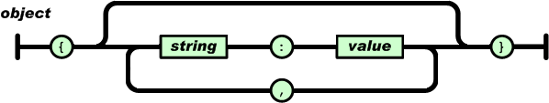
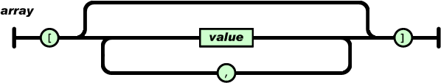
An object is an unordered set of name/value pairs.
An array is an ordered collection of values.

Slide 418
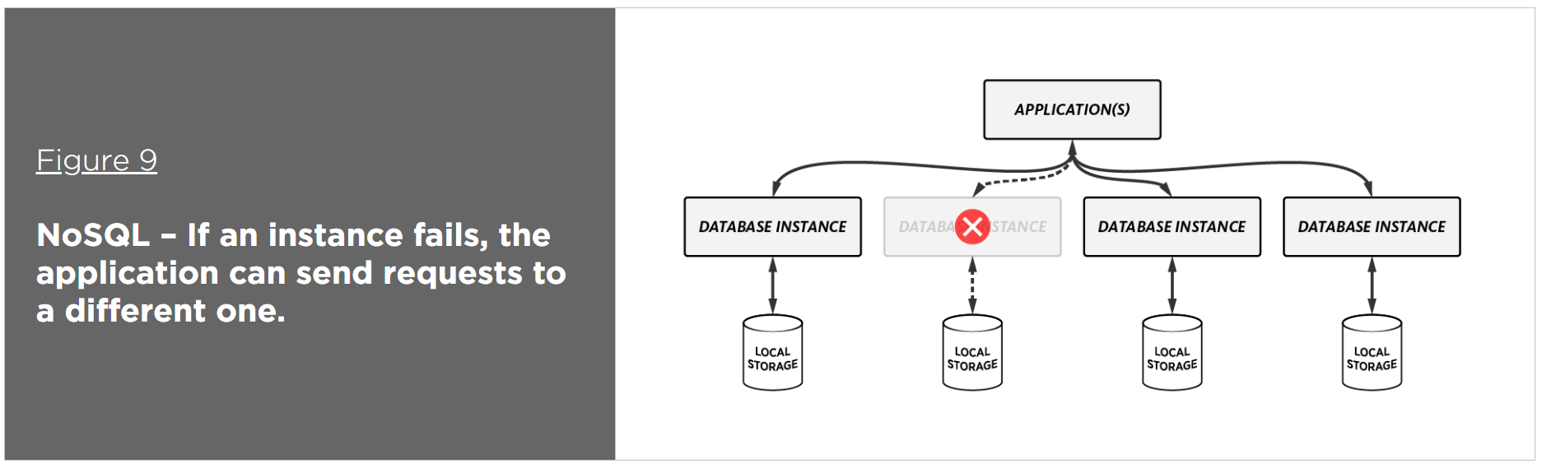
NoSQL
NoSQL database are primarily called as non-relational database. MongoDB is Scalable (A system that is scalable can successfully grow larger using the same methods.), open-source, high-perform, document-oriented database.

Slide 419
SQL vs NoSQL Database
Relational databases are commonly referred to as SQL databases because they use SQL (structured query language) as a way of storing and querying the data.
NoSQL databases are document based, key-value pairs, or wide-column stores. This means that SQL databases represent data in form of tables which consists of n number of rows of data whereas NoSQL databases are the collection of key-value pair, documents, or wide-column stores which do not have standard schema definitions.
SQL databases have predefined schema whereas NoSQL databases have dynamic schema for unstructured data.
SQL databases are vertically scalable whereas the NoSQL databases are horizontally scalable.
SQL databases uses SQL ( structured query language ) for defining and manipulating the data. In NoSQL database, queries are focused on collection of documents.

Slide 420
MongoDB
A record in MongoDB is a document, which is a data structure composed of field and value pairs. MongoDB documents are similar to JSON objects. The values of fields may include other documents, arrays, and arrays of documents.
Core MongoDB Operations (CRUD)
CRUD stands for create, read, update, and delete, which are the four core database operations used in database driven application development.
RDBMS | MongoDB
database | database
tables | collections
rows | Documents or BSON document
column | Field

Slide 421
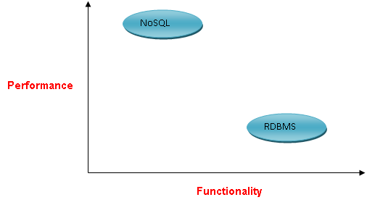
MongoDB
MongoDB stores data as BSON documents. BSON is a binary representation of JSON documents.
JSON (JavaScript Object Notation) is a lightweight data-interchange format. It is easy for humans to read and write.

Slide 422
Class Room
Session 19

Slide 423
Topics to be covered in session 19
How to Configure and access the store using the Admin Console
NoSQL database: MongoDB
  MongoDB is a document-based database system
  The abstract idea of a document - data encapsulation into some file format. In the case of MongoDB, JSON is used.
  If you are familiar with relational databases and SQL, then analogies: tables => collections; records (or rows) => documents
  Each document can have different fields from other documents
  All documents must have an _id field
Similarities Between SQL and MongoDB Query Features
Accessing Data from Column-Oriented Databases Like HBase
Performing CRUD Operations
Accessing Data Updating and Deleting Data
Querying NoSQL Stores
Essential Concepts behind a Database Index
Indexing and Ordering in MongoDB
Creating and Using Indexes in MongoDB
MongoDB Operations

Slide 424
document
MongoDB stores data as BSON documents. BSON is a binary representation of JSON documents.

Slide 425
document
MongoDB documents are composed of field-and-value pairs. The value of a field can be any of the BSON data types, including other documents, arrays, and arrays of documents.
The field name _id is reserved for use as a primary key; its value must be unique in the collection, is immutable, and may be of any type other than an array.
The primary key _id is automatically added if _id field is not specified.
{
field1: value1,
field2: value2,
field3: value3,
...
fieldN: valueN
}

Slide 426
db
In the mongo shell, db is the variable that references the current database. The variable is automatically set to the default database test or is set when you use the use <db_name> to switch current database.

Slide 427
 | MongoDB | Redis | MySQL | Oracle
Database Server | mongod | redis-server | mysqld | oracle
Database Client | mongo | redis-cli | mysql | sqlplus
start db server

Slide 428
start server and client
To start MongoDB server, execute mongod.exe.
The --dbpath option points to your database directory.
The --bind_ip_all option : bind to all ip addresses.
The --bind_ip arg option : comma separated list of ip addresses to listen on, localhost by default.
--bind_ip <hostnames | ipaddresses>
mongod --dbpath "c:\database" --bind_ip_all --journal
mongod --dbpath "c:\database" --bind_ip stp10 --journal
mongod --dbpath "c:\database" --bind_ip 192.168.100.20 --journal
To start MongoDB client, execute mongo.exe.
mongo "192.168.100.20:27017/db1"
mongo --host "192.168.100.20" --port "27017"

Slide 429
db.version() // version number
db.getMongo(); // connection to 192.168.100.20:27017
getHostName() // stp5
comparison operator

Slide 430
comparison operator
$eq | Matches values that are equal to a specified value.
$gt | Matches values that are greater than a specified value.
$gte | Matches values that are greater than or equal to a specified value.
$lt | Matches values that are less than a specified value.
$lte | Matches values that are less than or equal to a specified value.
$ne | Matches all values that are not equal to a specified value.
$in | Matches any of the values specified in an array.
$nin | Matches none of the values specified in an array.

Slide 431
comparison operator
$eq
$ne
{ field: {$eq: value} }
{ field: {$ne: value} }
$gt
$gte
{ field: {$gt: value} }
{ field: {$gte: value} }
$lt
$lte
{ field: {$lt: value} }
{ field: {$lte: value} }
$ne
{ field: {$in: [<value1>, <value2>, ..., <valueN>]} }

Slide 432
logical operator

Slide 433
logical operator
$or | Joins query clauses with a logical OR returns all documents that match the conditions of either clause.
$and | Joins query clauses with a logical AND returns all documents that match the conditions of both clauses.
$not | Inverts the effect of a query expression and returns documents that do not match the query expression.
{ $or: [ { <expr1> }, { <expr2> }, ... , { <exprN> } ] }
{ $and: [ { <expr1> }, { <expr2> }, ... , { <exprN> } ] }
{ field: { $not: { <operator-expression> } } }

Slide 434
logical operator
$or
{ $or: [ { <expr1> }, { <expr2> }, ... , { <exprN> } ] }
db.emp.find({$or: [{job: 'manager'}, {job: 'salesman'}]})
$and
{ $and: [ { <expr1> }, { <expr2> }, ... , { <exprN> } ] }
db.emp.find({$and: [{job:'manager'}, {sal:3400}]})
$not
{ field: { $not: { <operator-expression> } } }
db.emp.find({ job: {$not: {$eq: 'MANAGER'}}})

Slide 435
ObjectId()
The ObjectId class is the default primary key for a MongoDB document and is usually found in the _id field in an inserted document.
The _id field must have a unique value. You can think of the _id field as the document’s primary key.

Slide 436
ObjectId()
MongoDB uses ObjectIds as the default value of _id field of each document, which is auto generated while the creation of any document.
ObjectId()
x = ObjectId()

Slide 437
list databases

Slide 438
list database
Print a list of all databases on the server.
show { dbs | databases }
show dbs
show databases // Returns: all database name.
db.getName()
db
db.getName() // Returns: the current database name.

Slide 439
To access an element of an array by the zero-based index position, concatenate the array name with the dot (.) and zero-based index position, and enclose in quotes
use database

Slide 440
use database
Switch current database to <db>. The mongo shell variable db is set to the current database.
use <db>
use db1

Slide 441
new Date()

Slide 442
new Date()
MongoDB uses ObjectIds as the default value of _id field of each document, which is auto generated while the creation of any document.
var variable_name = new Date()
x = Date()

Slide 443
db.getCollectionNames()

Slide 444
db.getCollectionNames()
Returns an array containing the names of all collections in the current database.
show collection
db.getCollectionNames()
show collection
db.getCollectionNames();

Slide 445
db.createCollection()

Slide 446
db.createCollection()
Capped collections have maximum size or document counts that prevent them from growing beyond maximum thresholds. All capped collections must specify a maximum size and may also specify a maximum document count. MongoDB removes older documents if a collection reaches the maximum size limit before it reaches the maximum document count.
db.createCollection(name, { options1, options2, ... })
The options document contains the following fields:
capped : boolean
size : number
max : number
db.createCollection("log");
db.createCollection("log", { capped:true, size:1, max:2}); // This command creates a collection named log with a maximum size of 1 byte and a maximum of 2 documents.

Slide 447
db.collection.isCapped()

Slide 448
db.collection.isCapped()
Returns true if the collection is a capped collection, otherwise returns false.
db.collection.isCapped()
db.log.isCapped();

Slide 449
db.getCollection()

Slide 450
db.getCollection()
db.getCollection('name')
db.getCollection('emp').find();

Slide 451
db.getSiblingDB()
To access another database without switching databases.

Slide 452
db.getSiblingDB()
Used to return another database without modifying the db variable in the shell environment.
db.getSiblingDB(<database>)
db.getSiblingDB('db1').getCollectionNames();

Slide 453
db.collection.renameCollection()
Renames a collection.

Slide 454
db.collection.renameCollection()
db.collection.renameCollection(target, dropTarget)
db.emp.renameCollection('e', false);
dropTarget : If true, mongod drops the target of renameCollection prior to renaming the collection. The default value is false.

Slide 455
db.collection.drop()
Removes a collection or view from the database. The method also removes any indexes associated with the dropped collection.

Slide 456
db.collection.drop()
Removes a collection or view from the database. The method also removes any indexes associated with the dropped collection.
db.collection.drop(<options>)
db.emp.drop();

Slide 457
Method
.pretty()
db.collection.find()
The find() method always returns the _id field unless you specify _id: 0 to suppress the field.
By default, mongo prints the first 20 documents. The mongo shell will prompt the user to “Type it” to continue iterating the next 20 results.

Slide 458
db.collection.find()
A projection cannot contain both include and exclude specifications, except for the exclusion of the _id field.
db ['collection'].find (query, projection)
db.collection.find(query, projection)
db.getCollection('name').find (query, projection)
query: Specifies selection filter using query operators. To return all documents in a collection, omit this parameter or pass an empty document ({}).
projection: Specifies the fields to return in the documents that match the query filter. To return all fields in the matching documents, omit this parameter.
Projection
{ field1: <value>, field2: <value> ... }
1 or true to include the field in the return documents.
0 or false to exclude the field.

Slide 459
db.collection.find()
db ['collection'].find (query, projection)
db.collection.find(query, projection)
db.getCollection('name').find (query, projection)
db.emp.find();
db ['emp'].find ()
db.getCollection('emp').find();
db.getSiblingDB('db1').getCollection('emp').find();
db.emp.find({job: 'manager'})
db.emp.find({}, {ename:1, job: true});
db.emp.find({sal:{ $gt:4}})
db.emp.find({job:'manager'}, {ename:true, job:true})
db.emp.find({job:'manager'}, {_id:false, ename:true, job:true})

Slide 460
db.collection.find()[<index_number>]
db ['collection'].find (query, projection) [<index> [.field] ]
db.collection.find(query, projection) [<index> [.field] ]
db.getCollection('name').find (query, projection) [<index> [.field] ]
db.emp.find()[0];
db.emp.find()[0].ename;
db.getCollection('emp').find() [0];
db.emp.find()[db.emp.find().count()-1]

Slide 461
cursor with db.collection.find()
In the mongo shell, if the returned cursor is not assigned to a variable using the var keyword, the cursor is automatically iterated to access up to the first 20 documents that match the query.
var variable_name = db.collection.find(query, projection)
The find() method returns a cursor.
var x = db ['emp'].find ()
x.forEach(printjson)

Slide 462
sort

Slide 463
db.collection.find().sort({ })
Specifies the order in which the query returns matching documents. You must apply sort() to the cursor before retrieving any documents from the database.
cursor.sort({ field: value })
db ['collection'].find (query, projection).sort({ field: value })
db.collection.find(query, projection).sort({ field: value })
Specify in the sort parameter 1 or -1 to specify an ascending or descending sort respectively.
db['emp'].find({}, {ename:true}).sort({ename: 1});
db['emp'].find({}, {ename:true}).sort({ename: -1});

Slide 464
limit

Slide 465
db.collection.find().limit()
A limit() value of 0 (i.e. .limit(0)) is equivalent to setting no limit.
Use the limit() method to specify the maximum number of documents the cursor will return.
cursor.limit(<number>)
db ['collection'].find (query, projection).limit(<number>)
db.collection.find(query, projection).limit(<number>)
db['emp'].find({},{ename:true}).limit(0); // all documents
db['emp'].find({},{ename:true}).limit(2);

Slide 466
skip

Slide 467
db.collection.find().skip()
The skip() method is used for skipping the given number of documents in the Query result.
cursor.skip(<offset_number>)
db ['emp'].find (query, projection).skip(<offset_number>)
db.collection.find(query, projection).skip(<offset_number>)
db.emp.find().skip(4);
db.emp.find().skip(db.emp.countDocuments({}) - 1);

Slide 468
count

Slide 469
db.collection.find().count()
Counts the number of documents referenced by a cursor. Append the count() method to a find() query to return the number of matching documents. The operation does not perform the query but instead counts the results that would be returned by the query.
cursor.count()
db.collection.find(<query>).count()
db ['collection_name'].find(<query>).count()
db.emp.find().count();
db.emp.find({job: 'manager'}).count();

Slide 470
db.collection.distinct()

Slide 471
db.collection.distinct()
Finds the distinct values for a specified field across a single collection or view and returns the results in an array.
db.collection.distinct(field, query, options)
db.emp.distinct("job")
db.emp.distinct("job", { sal: { $gt: 5000 } } )
var x = db.emp.find()[10]
for (i in x) {
print(i)
}

Slide 472
db.collection.count[Documents]()

Slide 473
db.collection.count[Documents]()
db.collection.count[Documents]( <query>, <options> )
Field | Description
limit | Optional. The maximum number of documents to count.
skip | Optional. The number of documents to skip before counting.
db.emp.count({});
db.emp.countDocuments({});
db.emp.countDocuments({job: 'manager'});
db.emp.countDocuments({job: 'salesman'}, {skip: 1, limit: 3});

Slide 474
findOne
The find() method always returns the _id field unless you specify _id: 0 to suppress the field.

Slide 475
db.collection.findOne()
findOne() returns one document that satisfies the specified query criteria on the collection. If multiple documents satisfy the query, this method returns the first document according to the order in which order the documents are stored in the disk. If no document satisfies the query, the method returns null.
db ['emp'].findOne(query, projection)
db.collection.findOne(query, projection)
db.emp.findOne();
db.emp.findOne({ job: 'manager' });

Slide 476
If the document does not contain an _id field, then the save() method calls the insert() method. During the operation, the mongo shell will create an ObjectId and assign it to the _id field.
If the document contains an _id field, then the save() method is equivalent to an update with the upsert option set to true and the query predicate on the _id field.
db.collection.save()
Updates an existing document or inserts a new document, depending on its document parameter.

Slide 477
db.collection.save()()
Updates an existing document or inserts a new document, depending on its document parameter.
db.collection.save( <document> )
db.e.save({_id: 10, firstName: 'neel', sal: 5000, color: ['blue', 'black', 'brown' ], size: ['small', 'medium', 'large', 'xx-large' ] })

Slide 478
db.collection.insert()
Inserts a document or documents into a collection.

Slide 479
db.collection.insert()
Inserts a document or documents into a collection.
db.collection.insert({<document>})
db.collection.insert([{<document 1>} , {<document 2>}, ... ])
db.e.insert({})
db.e.insert({ ename: 'a', job: 'abc', salary: 2000 })
db.e.insert([ { ename: 'x'} , { ename: 'y' } ]) // for multiple documents.

Slide 480
db.collection.insertOne()
Inserts a document into a collection.

Slide 481
db.collection.insertOne()
Inserts a document or documents into a collection.
db.collection.insertOne({<document>})
db.emp.insertOne({ ename: 'x', job: 'pqr', salary: 2000 })

Slide 482
db.collection.insertMany()
Inserts multiple documents into a collection.

Slide 483
db.collection.insertMany()
Inserts a document or documents into a collection.
db.collection.insertMany([{<document 1>} , {<document 2>}, ... ])
db.e.insertMany([ { ename: 'x', salary: 2000}, { ename : 'y', job: 'hr' } ])

Slide 484
javascript object

Slide 485
javascript object
Inserts a document or documents into a collection using javascript object.
var obj = {}
> var doc = {}; // JavaScript object
> doc.title = "MongoDB Tutorial"
> doc.url = "http://mongodb.org"
> doc.comment = "Good tutorial video"
> doc.tags = ['tutorial', 'noSQL']
> doc.saveondate = new Date ()
> doc.meta = {} // object within doc object {}
> doc.meta.browser = 'Google Chrome’
> doc.meta.os = 'Microsoft Windows7'
> doc.meta.mongodbversion = '2.4.0.0'
> doc
> db.book.insert (doc);

Slide 486
After executing a file with load(), you may reference any functions or variables defined the file from the mongo shell environment.
load ("app.js")
Loads and runs a JavaScript file into the current shell environment.

Slide 487
load(file.js)
Specifies the path of a JavaScript file to execute.
load(file)
cat(file)
function app(x, y) {
return (x + y);
}
function app1(x, y, z) {
return (x + y + z);
}
load("scripts/app.js")
cat ("scripts/app.js")

Slide 488
javascript function
TODO
db.emp.find().forEach(function(doc) {
if (doc.ename == 'saleel')
{
print (doc.ename, doc.job);
}
else
{
quit;
};
}
)

Slide 489
db.collection.update()
Modifies an existing document or documents in a collection. The method can modify specific fields of an existing document or documents or replace an existing document entirely, depending on the update parameter. By default, the update() method updates a single document. Set the Multi Parameter to update all documents that match the query criteria.

Slide 490
db.collection.update()
By default, the update() method updates a single document. Set the Multi Parameter to update all documents that match the query criteria.
db.collection.update({query}, {update}, {options})
db.collection.update({query}, {$set:{update}}, {options})
Options : { $set: { field: value } }, { multi: true, upsert: true }
db.emp.update({ job: 'abc1‘ }, { job: 'sales' }, { upsert: true } );
db.emp.update({ job: 'bbc' }, { $set: { job:'abc' } }, { upsert : true, multi: true });
db.emp.update({ ename: 'saleel' }, { $set : { size: 'small', color: ['red', 'blue'] } }, { multi: true } );

Slide 491
db.collection.updateOne()
updateOne() operations can add fields to existing documents using the $set operator.

Slide 492
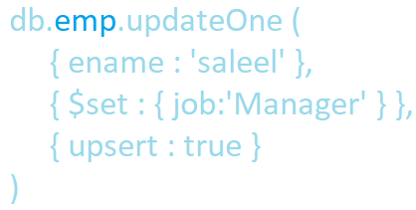




db.collection.updateOne()
Updates a single document within the collection based on the filter.
db.collection.updateOne({filter}, {$set:{update} }, {options})
Options : { $set: { field: value } }, { upsert: true }
db.emp.updateOne({ ename : 'saleel1' }, { $set : { job : 'A' } })
db.emp.updateOne({ename : 'saleel2' }, { $set : { job : 'A' } }, { upsert: true })

Slide 493
db.collection.updateMany()
updateMany() operations can add fields to existing documents using the $set operator.

Slide 494
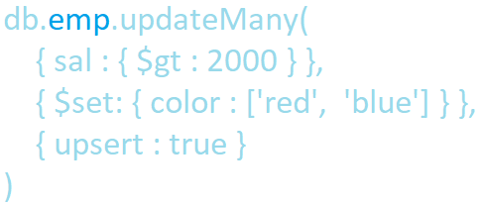
db.collection.updateMany()
Updates multiple documents within the collection based on the filter.
db.collection.updateMany({filter}, {$set:{update} }, {options})
Options : { $set: { field: value } }, { upsert: true }
db.emp.updateMany({ sal: { $gt : 2000 } }, { $set: { color : ['red', 'yellow', 'green', 'blue'] } }, { upsert: true } );

Slide 495
$inc
The $inc operator increments a field by a specified value.

Slide 496
$inc
The $inc operator increments a field by a specified value.
{ $inc: { <field1>: <amount1>, <field2>: <amount2>, ... } }
db.emp.updateMany({ sal: { $gt: 300 } }, { $inc: { sal: 1 } })

Slide 497
$unset
The $unset operator deletes a particular field.

Slide 498
$unset
The $unset operator deletes a particular field.
{ $unset: { <field1>: "", ... } }
db.emp.update({ename: 'saleel'}, {$unset: {comm: 0, ename: '', sal: 0}})
db.emp.updateOne({ename: 'saleel'}, {$unset: {comm: 0, ename: '', sal: 0}})
db.emp.updateMany({ename: 'saleel'}, {$unset: {comm: 0, ename: '', sal: 0}})

Slide 499
db.collection.replaceOne()
Replaces a single document within the collection based on the filter.

Slide 500
db.collection.replaceOne()
Replaces a single document within the collection based on the filter.
db.collection.replaceOne(filter, replacement, options)
db.emp.replaceOne({ename: 'saleel'}, {x: 500, y: 500 })

Slide 501
db.collection.deleteOne()
Removes a single document from a collection.

Slide 502
db.collection.deleteOne()
Removes a single document from a collection. Specify an empty document { } to delete the first document returned in the collection.
db.collection.deleteOne({<filter>})
db.emp.deleteOne({})
db.emp.deleteOne({job: 'manager'})

Slide 503
db.collection.deleteMany()
Removes all documents that match the filter from a collection.

Slide 504
db.collection.deleteMany()
Removes all documents that match the filter from a collection.
db.collection.deleteMany({<filter>})
db.emp.deleteMany({});
db.emp.deleteMany({job: 'manager'})

Slide 505
All stages are independent.
stages
$match WHERE clause | $project SELECT clause | $unwind PIVOT an array | $group GROUP BY clause | $match HAVING clause | $sort ORDER BY clause | $limit TOP clause | $skip
aggregate()
In aggregation, the result of one stage is simply passed to another stage.

Slide 506
db.collection.aggregate()
stages
$match WHERE clause | $project SELECT clause | $unwind PIVOT an array | $group GROUP BY clause | $match HAVING clause | $sort ORDER BY clause | $limit TOP clause | $skip
db.collection.aggregate( [ { <stage1> }, { <stage2> }, { <stage3> } ... , { <stageN> } ] )
db.emp.aggregate([])

Slide 507
aggregation <stageOperators> and aggregation <expression>
Each sage starts with stage operator.
{ $<stageOperator> : { } }
{ $match : { job: 'manager' } }
{ $group : { _id : '$job' } }
Stage Operators
$match | $sort
$project | $limit
$unwind | $skip
$group | $count
$match
Each aggregation expression starts with $ sign.
'$<fieldName>'

Slide 508
$match
Filters the documents to pass only the documents that match the specified condition(s) to the next pipeline stage.

Slide 509
$match
Filters the documents to pass only the documents that match the specified condition(s) to the next pipeline stage.
{ $match: { <query> } }
db.emp.aggregate ([ {$match: {job: 'manager'} } ])
db.emp.aggregate ([ {$match: {comm: {$eq: null} } } ])
db.emp.aggregate ([ {$match: {sal: {$gt: 4000} }}, {$group: {_id: '$job', count: {$sum: '$sal'} } } ])
db.emp.aggregate([ {$match: {favouriteFruit: {$size: 1} } } ])
db.emp.aggregate([ {$match: {'favouriteFruit.0': 'Orange'} }, {$project: {favouriteFruit: true} } ])

Slide 510
$project
Passes along the documents with the requested fields to the next stage in the pipeline. The specified fields can be existing fields from the input documents or newly computed fields.

Slide 511
$project
Passes along the documents with the requested fields to the next stage in the pipeline. The specified fields can be existing fields from the input documents or newly computed fields.
{ $project: { <specification(s)> } }
db.emp.aggregate ([ {$project: { ename: true } } ])
db.emp.aggregate ([ {$project: {_id: false, sal: true, comm: true } } ])
db.emp.aggregate ([ {$project: {sal: true, sm: {$sum: '$sal'} } } ])
db.emp.aggregate ([ {$project: {_id: false, sal: true, comm: true, xx: {$max: ['$sal', '$comm'] } } } ])
db.emp.aggregate([ {$project :{_id: false, indexID: true, favouriteFruit: {$size: '$favouriteFruit'} } } ])

Slide 512
arithmetic expression operators

Slide 513
arithmetic expression operators
Arithmetic expressions perform mathematic operations on numbers. Some arithmetic expressions can also support date arithmetic.
Arithmetic expressions
$abs | x: { $abs: '$<number>' }
$add | x: { $add: ['$<expression1>', '$<expression2>', ... ] }
$subtract | x: { $subtract: ['$<expression1>', '$<expression2>' ] }
$multiply | x: { $multiply: ['$<expression1>', '$<expression2>', ...] }
$divide | x: { $divide: ['$<expression1>', '$<expression2>' ] }
$mod | x: { $mod: ['$<expression1>', '$<expression2>' ] }
$trunc | x: { $trunc: '$<number>' }
db.emp.aggregate ([ {$project : { op: { $trunc: "$sal" } } } ])
db.emp.aggregate([ {$project: { sal: true, op : { $add: ['$sal', 1000] } } } ])

Slide 514
$ifNull(), $toUpper, $toLower, $concat, …

Slide 515
$ifNull(), $toUpper(), $toLower(), $concat
Evaluates an expression and returns the value of the expression if the expression evaluates to a non-null value. If the expression evaluates to a null value, including instances of undefined values or missing fields, returns the value of the replacement expression.
x: { $ifNull:[ '$<expression>', <replacement-expression-if-null> ] }
x: { $toUpper: '$<expression>' }
x: { $toLower: '$<expression>' }
x: { $concat:[ '$<expression1>', '$<expression2>', ... ] }
x: { $substr: [ <string>, <start>, <length> ] }
x: { $size: '$<expression>' }
x: { $arrayElemAt: ['$<array>', <idx> ] }

Slide 516
$ifNull(), $toUpper(), $toLower(), $concat
db.emp.aggregate([ { $project: {comm : { $ifNull: ['$comm', 'NA'] } } } ])
db.emp.aggregate([ { $project: {sal: true, comm: true, "Gross Salary": { $add: ['$sal', { $ifNull: [ '$comm', 0] } ] } } } ])
db.emp.aggregate([ { $project: { ename : { $toUpper : '$ename'} } } ])
db.emp.aggregate([ { $project: { ename : { $toLower : '$ename'} } } ])
db.emp.aggregate([ { $project: { ename : { $concat : ['$ename', '$job'] } } ])
db.emp.aggregate([ { $project: { favouriteFruit: { $size: '$favouriteFruit'} } }])
db.emp.aggregate([ {$project: { op: { $arrayElemAt: ['$favouriteFruit', 1]}}}])
db.emp.aggregate([ {$project: { x :{ $arrayElemAt: [ '$favouriteFruit', 1] } } }, {$match: { x: 'Orange' } } ])

Slide 517
date operators

Slide 518
date operators
Date expressions
$dayOfMonth | x: { $dayOfMonth: '$<dateExpression>' }
$dayOfWeek | x: { $dayOfWeek: '$<dateExpression>' }
$dayOfYear | x: { $dayOfYear: '$<dateExpression>' }
$month | x: { $month: '$<dateExpression>' }
$week | x: { $week: '$<dateExpression>' }
$year | x: { $year: '$<dateExpression>' }
db.emp.aggregate([ {$project: { Day: {$dayOfMonth: '$hiredate'} } } ])
db.emp.aggregate([ {$project: { Month: {$month: '$hiredate'} } } ])

Slide 519
$unwind

Slide 520
$unwind
Deconstructs an array field from the input documents to output a document for each element.
{ $unwind: '$<field path>' }
db.emp.aggregate([ {$project: {favouriteColor: true}}, {$unwind: '$favouriteColor'} ])

Slide 521
$group
Groups documents by some specified expression and outputs to the next stage a document for each distinct grouping. The output documents contain an _id field which contains the distinct group by key. The output documents can also contain computed fields that hold the values of some accumulator expression grouped by the $group’s _id field.

Slide 522
$group
The _id field is mandatory; however, you can specify an _id value of null to calculate accumulated values for all the input documents as a whole.
{ $group: { _id: '$<expression>', <field1>: { <accumulator1> : <expression1> }, ... } }
Accumulator Operator - [ $group and $project stage ]
$avg | x: { $avg: '$<expression>' }
$sum | x: { $sum: '$<expression>' }
$min | x: { $min: '$<expression>' }
$max | x: { $max: '$<expression>' }
db.emp.aggregate([ {$group: {_id: null, count: {$sum: 1} } } ])
db.emp.aggregate([ {$group: {_id: null, total: {$sum: "$sal"} } } ])
db.emp.aggregate([ {$group: {_id: "$job", count: {$sum: 1} } } ])

Slide 523
$group on multiple fields

Slide 524
$ group
The _id field is mandatory; however, you can specify an _id value of null to calculate accumulated values for all the input documents as a whole.
{ $group: { _id: { <field1>: '$<expression>', ... }, <field1>: { <accumulator1> : '$<expression1'> }, ... } }
db.emp.aggregate([ { $group: {_id: { job: "$job", deptno: "$deptno“ }, count : { $sum: 1 } } } ])

Slide 525
$sort
Sorts all input documents and returns them to the pipeline in sorted order.

Slide 526
$sort
{ $sort: { <field1>: <sort order>, <field2>: <sort order> ... } }
db.emp.aggregate([ {$sort: {ename: 1} } ])

Slide 527
$limit
Limits the number of documents passed to the next stage in the pipeline.

Slide 528
$limit
{ $limit: <positive integer> }
db.emp.aggregate([ {$limit: 2} ])
db.emp.aggregate([ {$project: {ename: true, sal: true, comm: true, total: {$add: ['$sal', '$comm']}}}, {$limit: 2} ])

Slide 529
$skip

Slide 530
$skip
{ $skip: <positive integer> }
db.emp.aggregate([ {$skip:2} ])

Slide 531
$count
<string> is the name of the output field which has the count as its value. <string> must be a non-empty string, must not start with $ and must not contain the . character.

Slide 532
$count
{ $count: <string> }
db.collection.aggregate( [
{ $group: { _id: null, myCount: { $sum: 1 } } },
{ $project: { _id: 0 } }
] )

Slide 533
JSON Datatype

Slide 534
Datatype – JSON
JSON (JavaScript Object Notation) documents.
Data is in name/value pairs
Data is separated by comm
Curly braces hold objects
Square brackets hold arrays

Slide 535
An object is an unordered set of name/value pairs.
An array is an ordered collection of values.

Slide 536
JSON
Returns data from a JSON document, selected from the parts of the document matched by the path arguments. Returns NULL if any argument is NULL or no paths locate a value in the document. An error occurs if the json_doc argument is not a valid JSON document or any path argument is not a valid path expression.
JSON_EXTRACT(json_doc, path[, path] ...)
SELECT ('[10, 20, [30, 40], [50, 60, 70]]');
SELECT JSON_EXTRACT('[10, 20, [30, 40], [50, 60, 70]]', '$[0]');
SELECT JSON_EXTRACT('[10, 20, [30, 40], [50, 60, 70]]', '$[3][0]');
SELECT JSON_EXTRACT('[10, 20, [30, 40]]', '$[0]', '$[1]');
SELECT ('{"id" : "1001", "ename" : "saleel"}');
SELECT ('[ {"id" : "1001“ ,"ename" : "saleel"}, {"id" : "1002", "ename" : "sharmin", "mob" : "12345"} ]');
SELECT JSON_EXTRACT ('[ {"id" : "1001" ,"ename" : "saleel"}, {"id" : "1002", "ename" : "sharmin", "mob" : "12345"} ]', '$[0].id');
SELECT JSON_EXTRACT('{"id" : "1001", "ename" : "saleel"}', '$.ename');

Slide 537
Datatype – JSON … (Insert)
MySQL supports a native JSON data type that enables efficient access to data in JSON (JavaScript Object Notation) documents.
CREATE table E (data json);
INSERT into E VALUES ('{}');
INSERT into E VALUES ('{"empno" : "1001", "ename" : "saleel", "phone" : [123, 456]}');
INSERT into E VALUES ('{"empno" : "1002", "ename" : "sharmin" ,"phone" : [9922, 8811], "address" : "Paud Road"}');
INSERT into E VALUES ('{"empno" : "1003", "ename" : "vrushali", "phone" : [7788, 9977], "address" : {"city" : "Pune", "state" : "MH"}}');
INSERT into E VALUES (' [{"empno" : "1004", "ename" : "ram" ,"phone" : [6672, 8811], "address" : "Paud Road"}, {"empno" : "1005", "ename" : "sham" ,"phone" : [6672, 8843], "address" : "Paud Road"} ]');

Slide 538

Datatype – JSON … (Select)
MySQL supports a native JSON data type that enables efficient access to data in JSON (JavaScript Object Notation) documents.
CREATE table E (data json);
SELECT * from E;
SELECT json_extract (data, '$.*') FROM E;
SELECT json_extract (data, '$.empno') FROM E;
SELECT json_extract (data, '$.phone[1]') FROM E;
SELECT json_extract (data, "$.address.city") FROM E;
SELECT json_extract (data, "$.empno", "$.ename" ) FROM E;

Slide 539
mongoimport
The mongoimport tool imports content from an Extended JSON, CSV export created by mongoexport, or another third-party export tool.

Slide 540
mongoimport
The mongoimport tool imports content from an Extended JSON, CSV, or TSV export created by mongoexport.
mongoimport < --host > < --port > < --db > < --collection > < --file>
mongoimport --host 192.168.0.3 --port 27017 --db db1 --collection emp --file "d:\emp.json"

Slide 541
mongoimport
The mongoimport tool imports content from an Extended JSON, CSV, or TSV export created by mongoexport.
mongoimport < --host > < --port > < --db > < --type csv > < --collection > < --file> < --fields "Field-List">
mongoimport --host 192.168.100.20 --port 27017 --db db1 --collection o --type csv --file d:\o.csv --fields "EMPNO, ENAME, JOB, MGR,HIREDATE, SAL, COMM, DEPTNO,BONUSID, USERNAME, PWD"
mongoimport --db db1 --collection o --type csv --file d:\o.csv --fields "EMPNO.int(32), ENAME.string(), JOB.string(), MGR.int32(), HIREDATE.date(2006-01-02), SAL.int32(), COMM.int32(), DEPTNO.int32(), BONUSID.int32(), USERNAME.string(), PWD.string()"

Slide 542
mongoexport
mongoexport is a utility that produces a JSON or CSV export of data stored in a MongoDB instance.

Slide 543
mongoexport
mongoexport is a utility that produces a JSON or CSV export of data stored in a MongoDB instance..
mongoexport < --host > < --port > < --db > < --collection > < --out >
mongoexport --host "192.168.0.3" --port 27017 --db "db1" --collection emp –out "d:\e.json"

Slide 544
SELECT ... INTO

Slide 545
Select … INTO
The SELECT ... INTO form of SELECT enables a query result to be stored in variables or written to a file.
An INTO clause should not be used in a nested SELECT because such a SELECT must return its result to the outer context.
SELECT ... INTO var_list
SELECT ... INTO OUTFILE
SELECT ... INTO DUMPFILE
Selects column values and stores them into variables.
Writes the selected rows to a file. Column and line terminators can be specified to produce a specific output format.
Writes a single row to a file without any formatting.

Slide 546
SELECT ... INTO var_list

Slide 547
Select … INTO var_list
The SELECT ... INTO form of SELECT enables a query result to be stored in variables or written to a file.
SELECT ... INTO var_list
The selected values are assigned to the variables.
The number of variables must match the number of columns.
The query should return a single row.
If the query returns no rows, a warning with error code 1329 occurs (No data), and the variable values remain unchanged.
If the query returns multiple rows, error 1172 occurs (Result consisted of more than one row).
The statement may retrieve multiple rows, you can use LIMIT 1 to limit the result set to a single row.

Slide 548
Select … INTO var_list
The SELECT ... INTO form of SELECT enables a query result to be stored in variables or written to a file.
SELECT ... INTO var_list
SET @x = 0;
SET @y = null;
SELECT empno, ename into @x, @y from EMP where empno=7788;
SET @x = 0;
SET @y = null;
SELECT max(sal), min(sal) into @x, @y from EMP where empno=7788;

Slide 549
If not working then do changes in my.ini file.
secure_file_priv = ""
SELECT ... INTO OUTFILE

Slide 550
Select … INTO OUTFILE
Writes the selected rows to a file. Column and line terminators can be specified to produce a specific output format.
SELECT ... INTO OUTFILE
SELECT * from EMP INTO OUTFILE "d:/Test/o.txt";
SELECT * from EMP INTO OUTFILE "d:/Test/o.txt" fields terminated by ',';
SELECT * from EMP INTO OUTFILE "d:/Test/o.txt" fields terminated by ',' lines terminated by '\n';
SELECT * from EMP INTO OUTFILE "d:/Test/o.txt" fields terminated by ',' optionally enclosed by '"' lines terminated by '\n';
SELECT * from EMP INTO OUTFILE "d:/o.csv" fields terminated by ',';

Slide 551
SELECT ... INTO DUMPFILE

Slide 552
Select … INTO DUMPFILE
If you use INTO DUMPFILE instead of INTO OUTFILE, MySQL writes only one row into the file, without any column or line termination and without performing any escape processing. This is useful if you want to store a BLOB value in a file.
SELECT ... INTO DUMPFILE
SELECT * from EMP where empno = 7788 INTO DUMPFILE "d:/Test/o.txt";

Slide 553
Class Room
Session 20

Slide 554
Topics to be covered in session 20
What is Big Data
MySQL as a NoSQL Solution
Migrating from RDBMS to NoSQL

Slide 555
Big Data?
Big data is a term that describes the large volume of data – both structured and unstructured
Big data is often characterized by the 3Vs: the extreme volume of data, the wide variety of data types and the velocity at which the data must be processed.

Slide 556
3Vs
3Vs (volume, variety and velocity) are three defining properties or dimensions of big data.
Volume refers to the amount of data.
Variety refers to the number of types of data.
Velocity refers to the speed of data processing.

Slide 557

"Live as if you were to die tomorrow.
Learn as if you were to live forever"

